Slide 1
NVL-HX RVP TOPS Training
NVL-HX RVP Team
WW37Y2025

Slide 2
Introduction
Ap, Santhosh

Slide 3
Contents
Introduction
SKU Offerings
High level RVP overview
Board Layout
SOC & PCH Retention Solution
Memory
Display
Camera
Modular TCSS
Type C TBT eUSB2 USB3
MODPHY mapping & Storage
UFS
Connectivity
Audio
Sensors
LPSS and LSIO
Embedded Controllers
16. Debug and Validation
17. Power Delivery
18. Quick Start
20. Jumper, Switch & LED details
21. NVL-UH SOC straps
22. RVP DAC
23. UCP-SQUID
24. RVP NEST
25. Back-up
Notes:
RVP NEST
UCP - backup

Slide 4
NVL-HX RVP Key Contacts
Program Management Team
U, Vinay
Design/Engineering Manager
M, Manjunatha B
RVP Architect
Fernandez, Jaison
PD Architect
Srighakollapu, N V S Kumar
DE Lead
Ap, Santhosh
PD Lead
Vankunavath, Ramesh
DE Team
C M, Aparna
George, Priyan
Harshali, Bapat
Patil, Guruprasad
K, Vishnu
M K, Muhammed Naseef
Prabha, Abhijith
Vidaya, Divya
Mechanical Team
Kadadevaramath, Akarsha
MTEG Team
Raupp, James C
Chong, Jet Khit
Layout Team
J, Diana Kumari
Selvaraj, Balaji
Elayaraj, David
V, Singaravelan
Validation Team
V, Manjunatha (CSF)
M, Ramesh S
MPM/ME/Factory Team
Binti Jalaluddin, Adnin Falina (MPM)
Nagaraju, Elawarasi (ME)
Mohd Tarmizi, Mior Muhammad Baihaq (ME)
Raman, Letchumanan (OPM)
Chua, Alex Chong Beng (Factory test lead)
Prakash, M (Factory test lead)

Slide 5
Important Links [goto/rvp]
NVL-HX RVP SharePoint link : NVL HX, UPH, UL RVP Engineering Documents
NVL-HX Architecture document link : 03_NVL_HX_UPH_UL_RVP_HAS
NVL Board ID doc : CCG NVL Client System PDT - 01_NVL_Board_ID_document - All Documents
NVL-HX RVP SOC and EC GPIO mapping link : 05_NVL_HX_UPH_UL_RVP_PCH_EC_GPIO
NVL-HX RVP Schematics link : 02_NVL_HX_UPH_UL_RVP_Schematics
NVL-HX RVP Layout link : NVL-HX_UPH_UL_RVP_Layout_File
NVL-HX TOPS File link : 02_NVL-HX_RVP_TOPS_Document
Platform MRD link : NVL Platform MRD (Marketing Requirements) All
NVL-Hx Delta PRD link : DeltaPRD NVL Hx RVP (1st Collection)
NVL-UPH Delta PRD link : Delta PRD NVL UPH RVP (2nd round)

Slide 6
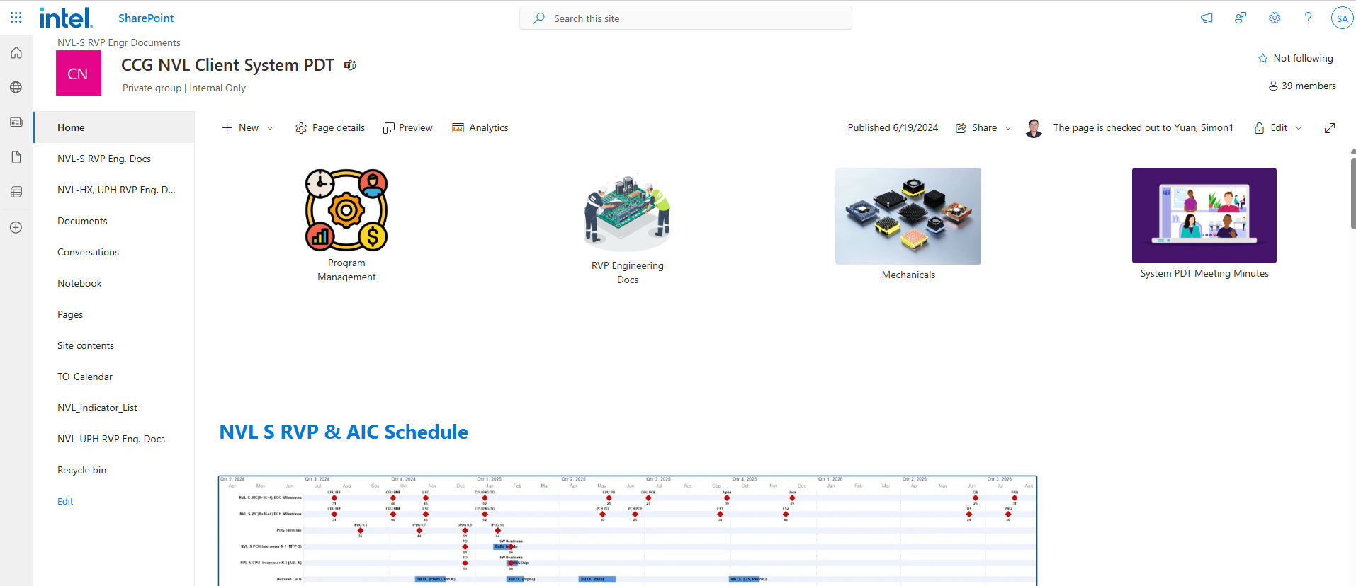
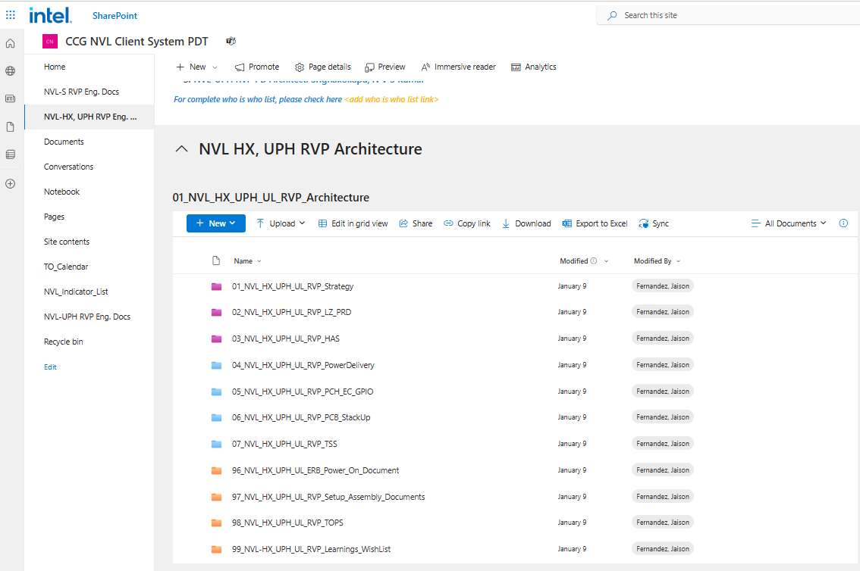
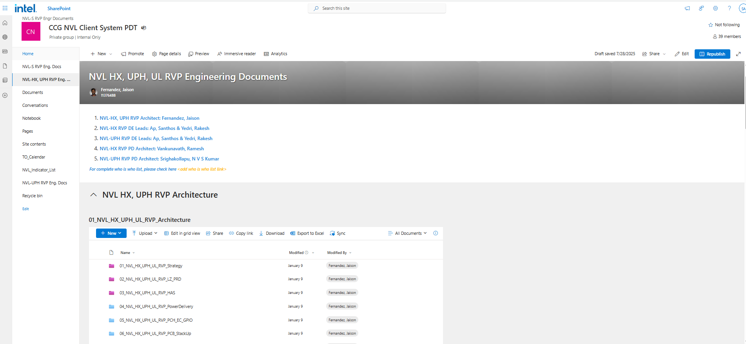
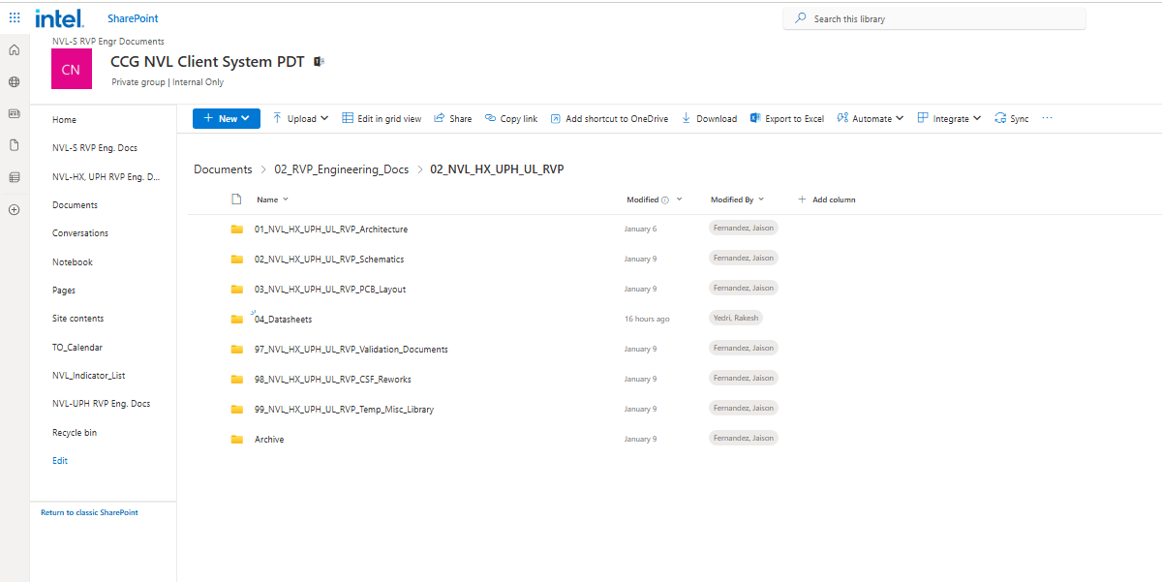
NVL-HX RVP SharePoint
NVL_HX_UPH_UL_RVP
NVL Share point
RVP Strategy
RVP LZ
RVP HAS
Platform Mapping Doc
RVP TOPS
HX/UPH Share point
RVP Schematic
RVP Board Layout

Slide 7
RVP strategy & SKU Offerings
Fernandez, Jaison; Ap, Santhosh

Slide 8
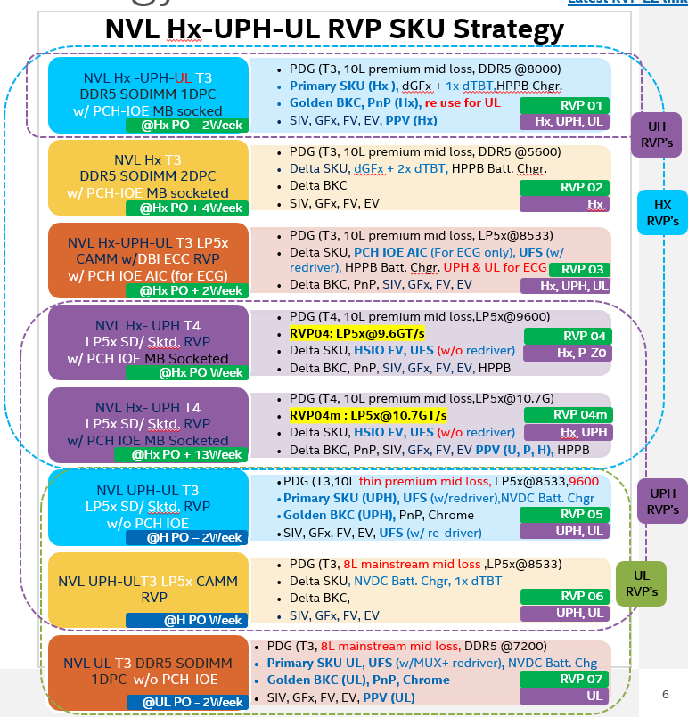
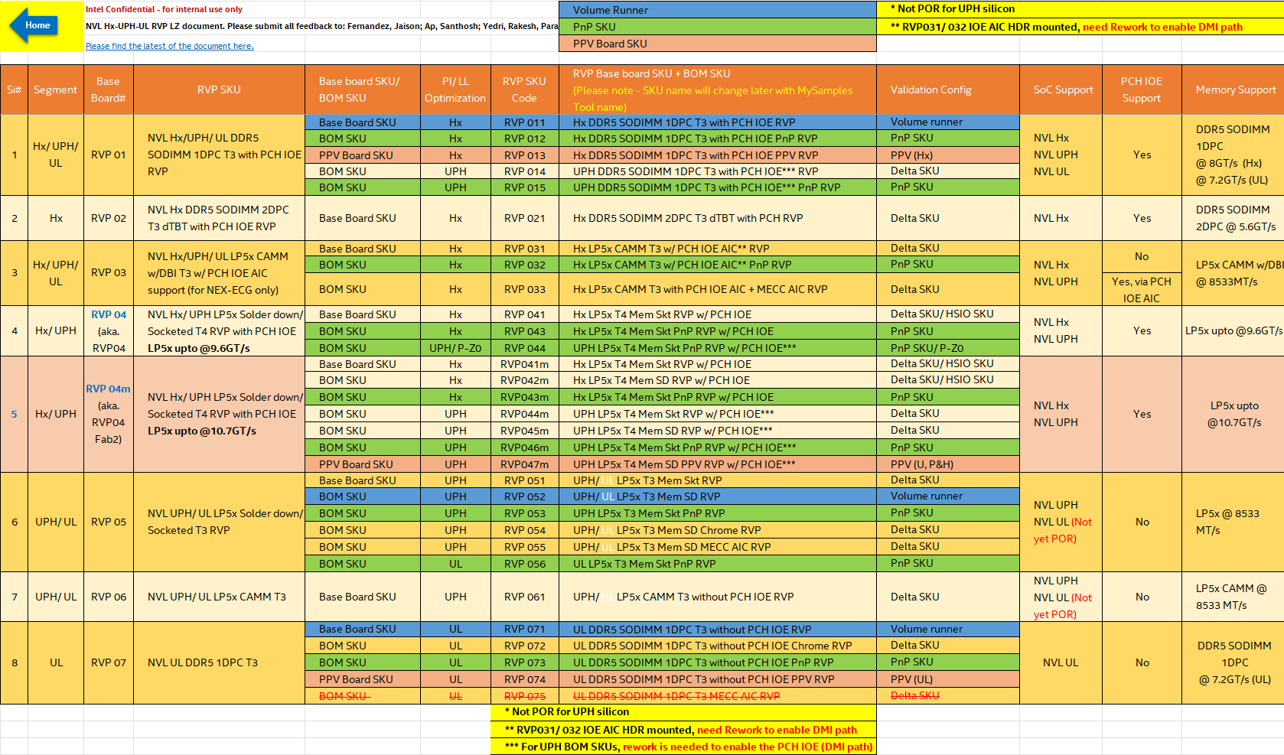
NVL-HX RVP Strategy and SKU Offering
Sku Strategy
RVP SKU Strategy:01_NVL_HX_UPH_UL_RVP_Strategy
RVP Landing Zone:02_NVL_HX_UPH_UL_RVP_LZ_PRD
Notes:
Add IPNs for the PB/PBA/AA/TA

Slide 9
Boot KIT:NVL-HX RVP-01
Base SKU | BOM SKU | SL NO | Item Code/IPN | Description | Qty | Comments
RVP-01 | RVP-011 (Base) N72227-001 | 1 | N34281-001 | SOCKET, 2540BGA, NSP ELASTOMER,BENCHTOP, RVP/MDV, NVL-H/U | 1 | NVL–HX SOC socket
 |  | 2 | N69163-001 | SKT,ISC,ELASTOMER,NVP-S, | 1 | NVL-PCH-IOE socket
 |  | 3 | N72043-001 | SKT, RETENTION, ISC, 05V, NVPS, | 1 | NVL-PCH-IOE Retention HW (15W)
 |  | 4 | N72618-001 | ASSY, RT HW 2540BGA,,ELASTOMER, HAND SOCKET, NVL | 1 | NVL–HX SOC Retention HW
 |  | 5 | N76346-001 | DDR5SODIMM,MOD,1RX16NE,1.10V,7200Mbps, | 2 | DDR5 Memory
 | RVP-012 (PNP) N71412-001 | 1 | N34281-001 | SOCKET, 2540BGA, NSP ELASTOMER,BENCHTOP, RVP/MDV, NVL-H/U | 1 | NVL–HX SOC socket
 |  | 2 | N69163-001 | SKT,ISC,ELASTOMER,NVP-S, | 1 | NVL-PCH-IOE socket
 |  | 3 | N72043-001 | SKT, RETENTION, ISC, 05V, NVPS, | 1 | NVL-PCH-IOE Retention HW (15W)
 |  | 4 | N72618-001 | ASSY, RT HW 2540BGA,,ELASTOMER, HAND SOCKET, NVL | 1 | NVL–HX SOC Retention HW
 |  | 5 | N76346-001 | DDR5SODIMM,MOD,1RX16NE,1.10V,7200Mbps, | 2 | DDR5 Memory
 | RVP-013 (PPV ) N71483-001 | 2 | N69163-001 | SKT,ISC,ELASTOMER,NVP-S, | 1 | NVL-PCH-IOE socket
 |  | 3 | N72043-001 | SKT, RETENTION, ISC, 05V, NVPS, | 1 | NVL-PCH-IOE Retention HW (15W)
 |  | 5 | N76346-001 | DDR5SODIMM,MOD,1RX16NE,1.10V,7200Mbps, | 2 | DDR5 Memory

Slide 10
Boot KIT: NVL-HX RVP-02
Base SKU | BOM SKU | SL NO | Item Code/IPN | Description | Qty | Comments
RVP-02 | RVP-021 (Base) N75380-001 | 1 | N34281-001 | SOCKET, 2540BGA, NSP ELASTOMER,BENCHTOP, RVP/MDV, NVL-H/U | 1 | SOC socket
 |  | 2 | N69163-001 | SKT,ISC,ELASTOMER,NVP-S, | 1 | PCH socket
 |  | 3 | N72043-001 | SKT, RETENTION, ISC, 05V, NVPS, | 1 | 15W PCH R. HW
 |  | 4 | N72618-001 | ASSY, RT HW 2540BGA,,ELASTOMER, HAND SOCKET, NVL | 1 | SOC R. HW
 |  | 5 | N76346-001 | DDR5SODIMM,MOD,1RX16NE,1.10V,7200Mbps, | 2 | Memory

Slide 11
Boot KIT:NVL-HX RVP-03
Base SKU | BOM SKU | SL NO | Item Code/IPN | Description | QTY | Comments
RVP-03 | RVP-031 (base) N76449-001 | 1 | N72618-001 | ASSY, RT HW 2540BGA,,ELASTOMER, HAND SOCKET, NVL | 1 | SOC R. HW
 |  | 2 | N34281-001 | SOCKET, 2540BGA, NSP ELASTOMER,BENCHTOP, RVP/MDV, NVL-H/U | 1 | SOC socket
 |  | 3 | N50207-001 | RETENTION HW, LP5 CAMM 1.0,POGOPIN CONNECTOR, RVP | 1 | LPCAMM2 R. HW
 |  | 4 | N23835-001 | CONN,MISC,644P,CAMM, | 1 | LPCAMM2 Conn
 |  | 5 | N54752-001 | TOP SHIELD, LP5 CAMM,POGOPIN CONNECTOR | 1 | Top shield
 |  | 6 | N78521-001 | LPDDR5X CAMM2,MOD,1RX16,5.00V,8533MHZ, | 1 | Memory
 | RVP-032 (PnP) N71417-001 | 1 | N72618-001 | ASSY, RT HW 2540BGA,,ELASTOMER, HAND SOCKET, NVL | 1 | SOC R. HW
 |  | 2 | N34281-001 | SOCKET, 2540BGA, NSP ELASTOMER,BENCHTOP, RVP/MDV, NVL-H/U | 1 | SOC socket
 |  | 3 | N50207-001 | RETENTION HW, LP5 CAMM 1.0,POGOPIN CONNECTOR, RVP | 1 | LPCAMM2 R. HW
 |  | 4 | N23835-001 | CONN,MISC,644P,CAMM, | 1 | LPCAMM2 Conn
 |  | 5 | N54752-001 | TOP SHIELD, LP5 CAMM,POGOPIN CONNECTOR | 1 | Top shield
 |  | 6 | N78521-001 | LPDDR5X CAMM2,MOD,1RX16,5.00V,8533MHZ, | 1 | Memory
 | RVP-033 (MECC) N71450-001 | 1 | N72618-001 | ASSY, RT HW 2540BGA,,ELASTOMER, HAND SOCKET, NVL | 1 | SOC R. HW
 |  | 2 | N34281-001 | SOCKET, 2540BGA, NSP ELASTOMER,BENCHTOP, RVP/MDV, NVL-H/U | 1 | SOC socket
 |  | 3 | N50207-001 | RETENTION HW, LP5 CAMM 1.0,POGOPIN CONNECTOR, RVP | 1 | LPCAMM2 R. HW
 |  | 4 | N23835-001 | CONN,MISC,644P,CAMM, | 1 | LPCAMM2 Conn
 |  | 5 | N54752-001 | TOP SHIELD, LP5 CAMM,POGOPIN CONNECTOR | 1 | Top shield
 |  | 6 | N78521-001 | LPDDR5X CAMM2,MOD,1RX16,5.00V,8533MHZ, | 1 | Memory

Slide 12
Boot KIT:NVL-HX RVP-04
Base SKU | BOM SKU | SL NO | Item Code/IPN | Description | QTY | Comments
RVP-04 | RVP-041 | 1 | N34281-001 | SOCKET, 2540BGA, NSP ELASTOMER,BENCHTOP, RVP/MDV, NVL-H/U | 1 | SOC socket
 |  | 2 | N70393-001 | MEMORY IC,N/A,MEM,BL,LPDDR5X,N/A,N/A,FBGA,315, | 4 | LP5x memory
 |  | 3 | M16851-002 | RETENTION,LPDDR5,4X ARRAY,20MM,SPACE,HORIZONTAL,M3,ALTERNAT | 1 | Mem. R.HW
 |  | 4 | M15275-001 | SOCKET,315BGA, LPDDR5,,ELASTOMER | 4 | Mem, Socket
 |  | 5 | N72618-001 | ASSY, RT HW 2540BGA,,ELASTOMER, HAND SOCKET, NVL | 1 | SOC R. HW
 |  | 6 | N69163-001 | SKT,ISC,ELASTOMER,NVP-S, | 1 | PCH socket
 |  | 7 | N72043-001 | SKT, RETENTION, ISC, 05V, NVPS, | 1 | PCH R. HW
 | RVP-042 | 1 | N34281-001 | SOCKET, 2540BGA, NSP ELASTOMER,BENCHTOP, RVP/MDV, NVL-H/U | 1 | SOC socket
 |  | 2 | N72618-001 | ASSY, RT HW 2540BGA,,ELASTOMER, HAND SOCKET, NVL | 1 | SOC R. HW
 |  | 3 | N69163-001 | SKT,ISC,ELASTOMER,NVP-S, | 1 | PCH socket
 |  | 4 | N72043-001 | SKT, RETENTION, ISC, 05V, NVPS, | 1 | PCH R. HW
 | RVP-043 | 1 | N34281-001 | SOCKET, 2540BGA, NSP ELASTOMER,BENCHTOP, RVP/MDV, NVL-H/U | 1 | SOC socket
 |  | 2 | N70393-001 | MEMORY IC,N/A,MEM,BL,LPDDR5X,N/A,N/A,FBGA,315, | 4 | LP5x memory
 |  | 3 | M16851-002 | RETENTION,LPDDR5,4X ARRAY,20MM,SPACE,HORIZONTAL,M3,ALTERNAT | 1 | Mem. R.HW
 |  | 4 | M15275-001 | SOCKET,315BGA, LPDDR5,,ELASTOMER | 4 | Mem, Socket
 |  | 5 | N72618-001 | ASSY, RT HW 2540BGA,,ELASTOMER, HAND SOCKET, NVL | 1 | SOC R. HW
 |  | 6 | N69163-001 | SKT,ISC,ELASTOMER,NVP-S, | 1 | PCH socket
 |  | 7 | N72043-001 | SKT, RETENTION, ISC, 05V, NVPS, | 1 | PCH R. HW

Slide 13
AIC’s/ KIT supported along with NVL-HX RVP
SL NO | Item/ type | Main / Respin/reuse | Ownership | RVP SKU name / board # | Description | TA Brd + BK | Comments
1 | AIC | New | RVP | RVP-03 | TCSS-901 JBR 80G FFC CABLE MODULE 48V | N56135-100 | New : AIC: TCSS 706 Rood bridge 80G TCSS Single module WW18 CP for GBR or RBR will be used
2 | AIC | New | RVP | RVP-01,02,03 & 04 | TCSS 107 JBR 80G TCSS Single module (TI) 48V | N70770-102 | New
3 | AIC | New | RVP | RVP-01 & 04 | TCSS 108 JBR 80G TCSS Dual module (TI) 48V | N70783-101 | New
4 | AIC | New | RVP | RVP-01,02,03 & 04 | TCSS 602 USB3/2 Type-A redriver with eUSB2 repeater | N74653-100 | New
5 | AIC | New | RVP | RVP-01,02,03 & 04 | TCSS 603 USB3/2 Type-A with eUSB2 repeater | N74657-100 | New
6 | AIC | New | RVP | RVP-01 & 02 | TCSS 401 DP2.1 Retimer with Mux Module | N70819-100 | New
7 | AIC | New | RVP | RVP-01,02,03 & 04 | TCSS 500 eDP module | N70373-200
8 | AIC | New | RVP | RVP-03 & 04 | UFS GEAR 5 M.2 MODULE | N56203-300 | New
9 | AIC | New | RVP | RVP-03 | NVL-S PCH-IOE AIC | N76051-100
10 | AIC | New | RVP | RVP-02,03 & 04 | edp Display Mux AIC |  | New -NOT A por ,CCB pending for approval TO will be udpated post that. Not part of 1st DC
11 | AIC | New | 3PE | RVP-01 & 04 | CRD-G3_CPHY_DPHY_AOB (PB:N57184-001) | N57181-100 | New
12 | AIC | New | 3PE | RVP-01 & 04 | NVL_CPHY_DPHY_eUSB2_G1_AOB_ AIC (PB:N56238-001) | N56212-100 | New
13 | AIC | New | 3PE | RVP-01,02,03 & 04 | TPM AIC |  | New
14 | AIC | New | 3PE | RVP-03 | MECC AIC |  | New - Vendor design and build , 3 PE deploys
15 | AIC | Rebuild | RVP | RVP-01 & 02 | BOBCAT AIC (dTBT BR suppot) +PD AIC with SCVR | N70860-100 | Rebuild
16 | AIC | Rebuild | RVP | RVP-01 & 02 | NVL CFP 1.0 PD AIC w/ SCVR (Rq'd for Bobcat) | N70629-100 | NVL - rebuild
17 | AIC | reuse | 3PE | RVP-02 &03 | Camera AIC's - (DPHY : G3, AON AIC;) | N44171-301 | Reuse_WCL
18 | AIC | reuse | 3PE | RVP-02 &03 | Camera AIC's - (DPHY : G1/ D1, AON AIC;) | N44169-301 | Reuse_NVL
19 | AIC | reuse | 3PE | RVP-01,02,03 & 04 | Audio AIC's (Gen6,Gen4) |  | Reuse_NVL
20 | AIC | reuse | 3PE | RVP-01,02,03 & 04 | MOSAIC Gen2 AIC |  | Reuse_NVL
21 | AIC | reuse | 3PE | RVP-01,02,03 & 04 | Foxville AIC |  | Reuse_NVL

Slide 14
High Level RVP Overview
Ap, Santhosh

Slide 15
NVL-HX RVP-01 & RVP-02 Architecture

Slide 16
NVL-HX RVP-03 & RVP-04 Architecture

Slide 17
Board Layout
Gunnam, Mahesh

Slide 18
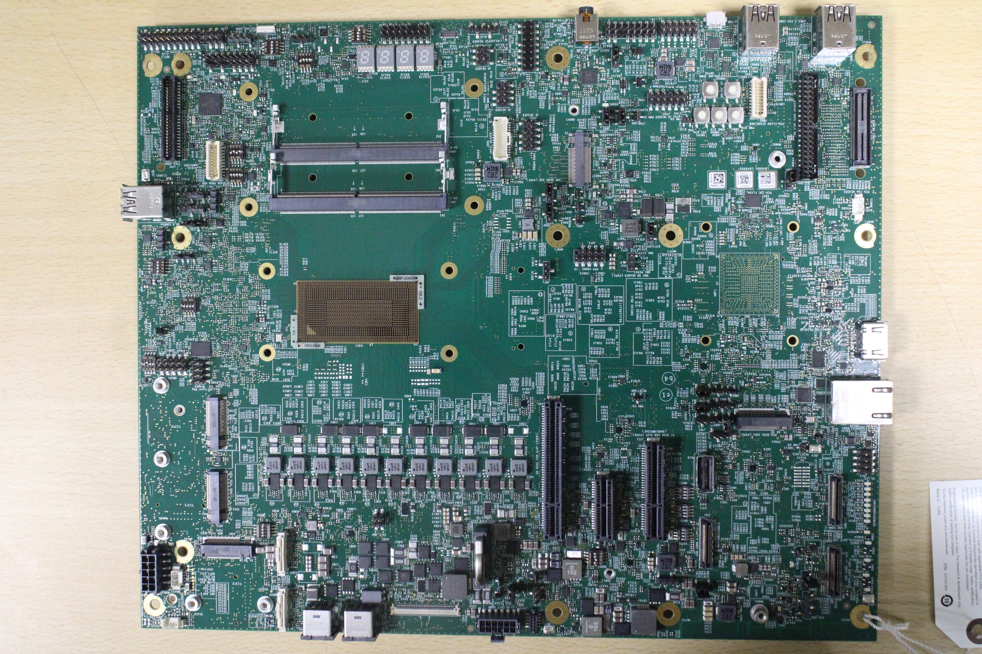
NVL-Hx DDR5 1DPC T3 RVP01 - Board Layout – TOP
Auxiliary Adapter
TCP2 TCSS
CRD Conn3
CMOS Battery
eDP Conn
Main Adapter
Touch Panel
Fan HDR
CRD Conn1
MCIO Conn
Fan W/ PWM
BR-AIC PWR HDR
Debug LED indicators
PCH SSD
Gen5 (Port-D)
X1 Gen4
CPU PCIe x4 lane
TCP1 TCSS
CPU Gen5 PCIe x8 lane
CRD Conn2
TCP0 TCSS
GbE LAN
HDMI2.1
NVL-Hx CPU
NVL PCH
PCH 5V FAN
Stacked Type-A connector
CPU SSD
DDR5 SODIMM connectors
SF600/TPM HDR
SINAI header
TTK3 Connector
PM Sideband header
PCH Type-A USB3.2
Debug uUSB
3.5mm Jack
Audio HDRs
FPS HDR
Intec HDR
Touch Pad
eSPI HDR

Slide 19
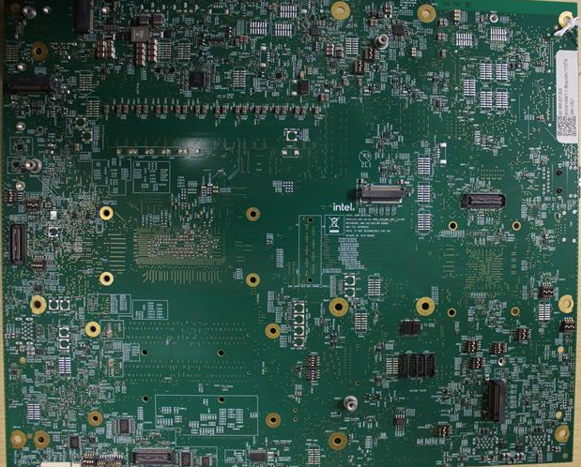
NVL-Hx DDR5 1DPC T3 RVP01 - Board Layout – BOTTOM (Flipped)
WLAN
CPU PCIe
Gen4 x2 SSD
PCH SSD
(Port-F)
Merged MIPI60 JTAG Connector
DMI MID BUS Probe
CPU VISA
MIP60 Connector
PCH SSD
(Port-E)
ISH Sensor HDR
Scan Matrix keyboard

Slide 20
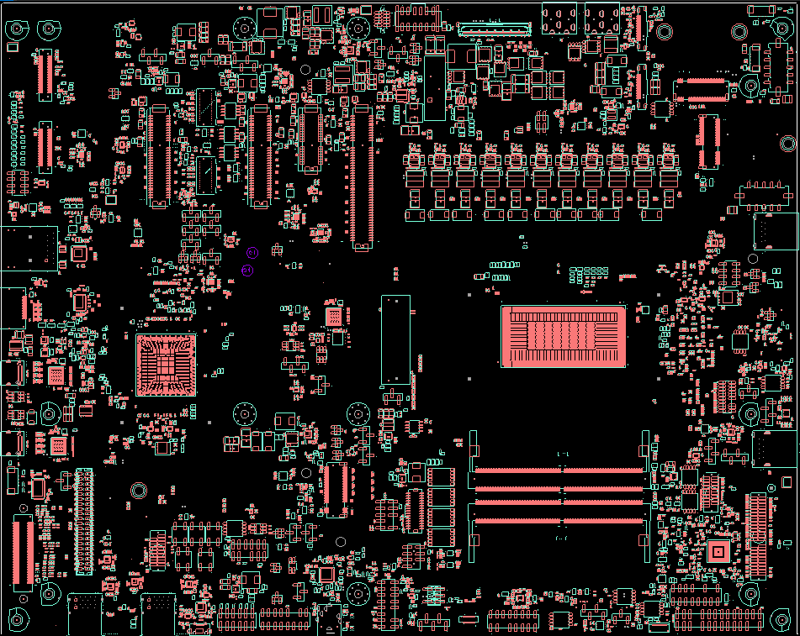
NVL-Hx DDR5 2DPC T3 RVP02 - Board Layout – TOP
TCP0 TCSS
CRD Conn1
PCH CLKS
MCIO Conn
CMOS Battery
Auxiliary Adapter
Main Adapter
Touch Panel
Fan HDR
BR-AIC2
Fan W/ PWM
CRD Conn2
eDP Conn
BR-AIC1 PWR HDR
Debug LED indicators
PCH PCIe x4 lane
X1 Gen4
WLAN
CPU PCIe x4 lane
CPU Gen5 PCIe x8 lane
BR-AIC2 PWR HDR
CPU Type-A USB3.2 P1
GbE LAN
HDMI2.1
NVL-Hx CPU
NVL PCH
TCP1
TCP2
DDR5 SODIMM connectors
CPU Type-A USB3.2 P2
PCH 5V FAN
CPU SSD
SF600/TPM HDR
Push buttons
TTK3 Connector
SINAI header
PM Sideband header
PCH Type-A USB3.2
Debug uUSB
3.5mm Jack
Audio HDRs
FPS HDR
Intec HDR
Touch Pad
eSPI HDR

Slide 21
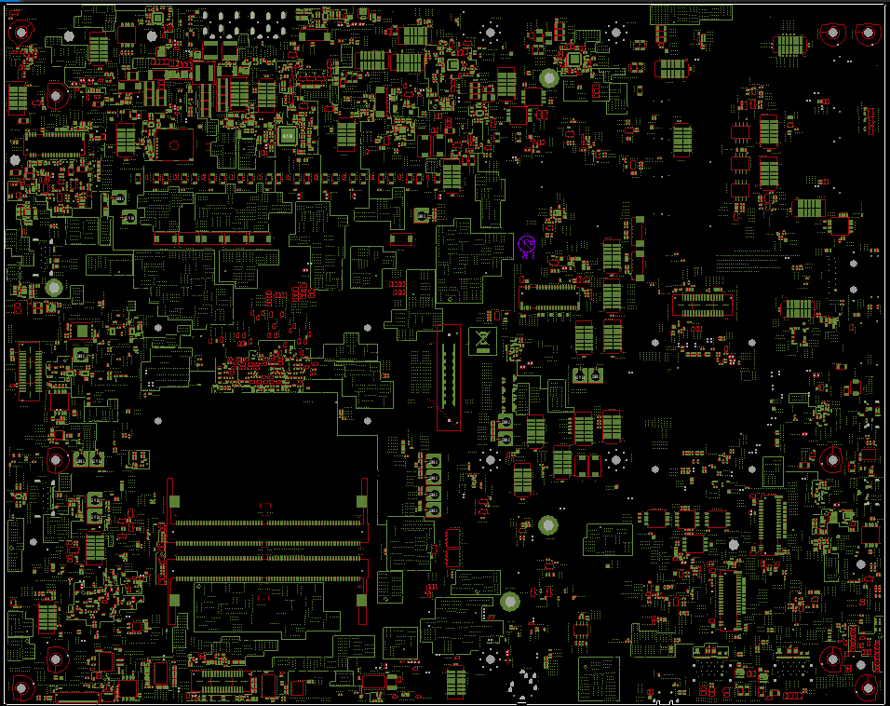
NVL-Hx DDR5 2DPC T3 RVP02 - Board Layout – BOTTOM (Flipped)
SIM Slot
PCH SSD
(Port-F)
WWAN
Merged MIPI60 JTAG Connector
DMI MID BUS Probe
CPU VISA
MIP60 Connector
DDR5 SODIMM connectors
PCH SSD
(Port-B)
PCH SSD
(Port-C)
ISH Sensor HDR
Scan Matrix keyboard

Slide 22
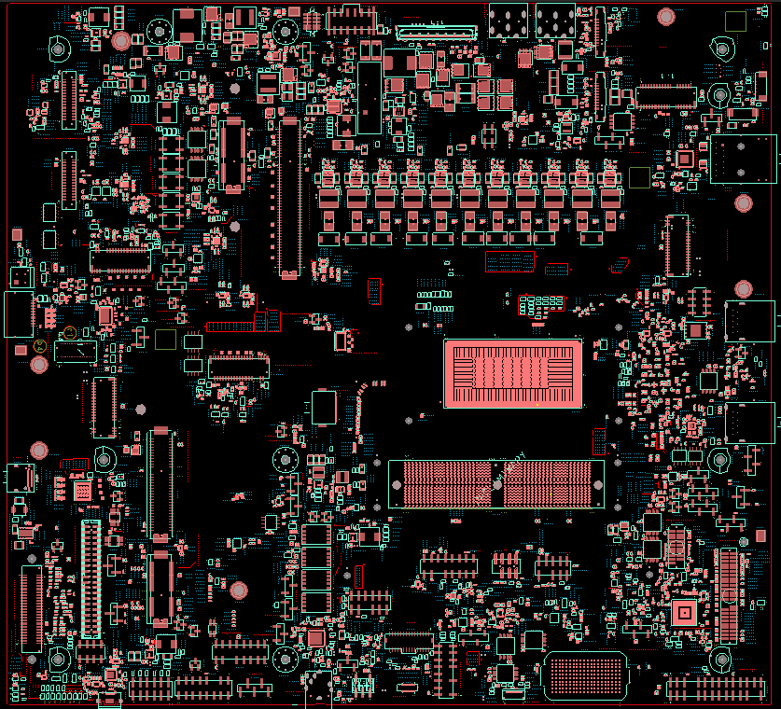
NVL-Hx LP5CAMM2 T3 RVP03 - Board Layout – TOP
CPU GEN4 SSD
Touch Panel
CMOS Battery
Auxiliary Adapter
Main Adapter
WLAN
CRD Conn1
eDP Conn
Fan HDR
CRD Conn2
Fan W/ PWM
Push buttons
X1 Gen4
GbE LAN
CPU Gen5 PCIe x8 lane
MCIO Connector
TCP0 TCSS
HDMI2.1 Redriver port
CPU Type-A USB3.2 P1
NVL-Hx CPU
TCP2 TCSS Module with FFC cable
CPU Type-A USB3.2 P2
LP5CAMM2 Connector
TCP1
CPU GEN5 SSD
Audio Header
SF600/TPM HDR
TTK3 Connector
SINAI header
Debug LED indicators
PM Sideband header
Debug uUSB
3.5mm Jack
FPS HDR
eSPI HDR
Intec HDR
Touch Pad
MECC AIC
NEX PCH-IOE AIC

Slide 23
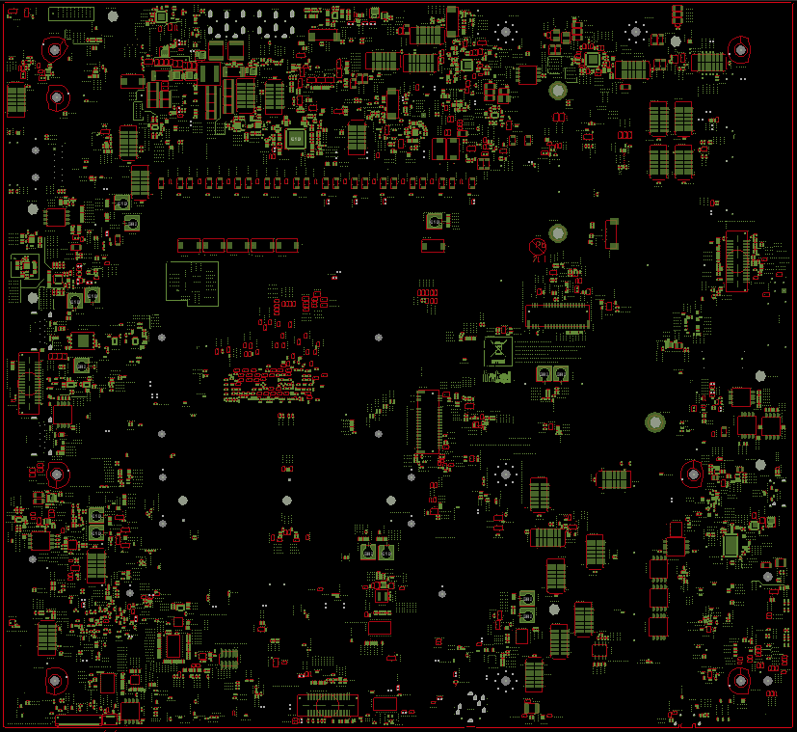
NVL-Hx LP5CAMM2 T3 RVP03 - Board Layout – BOTTOM (Flipped)
M.2 UFS module
Merged MIPI60 JTAG Connector
CPU VISA
MIP60 Connector
CPU Gen5 DMI SSD (Rework)
ISH Sensor HDR
Scan Matrix keyboard

Slide 24
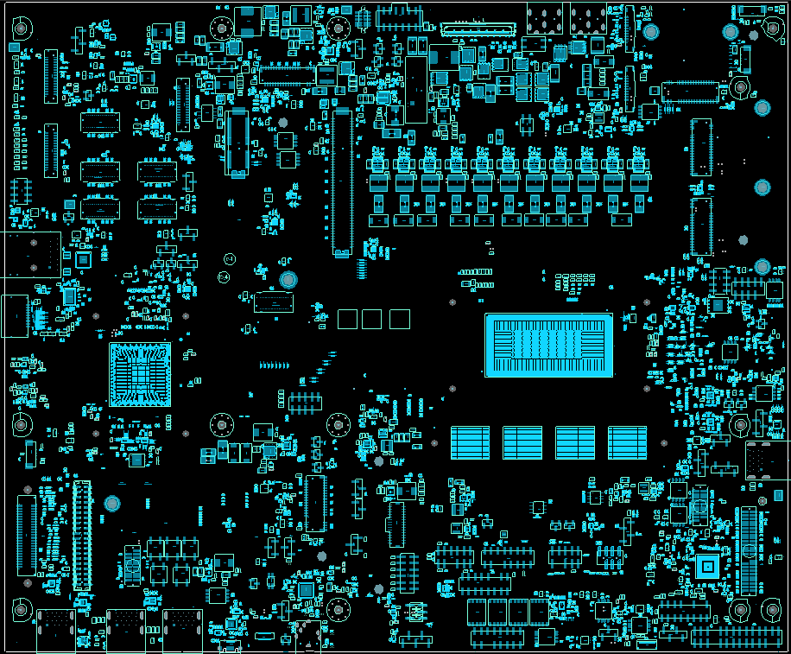
NVL-Hx LP5x T4 RVP04 - Board Layout – TOP
TCP2 TCSS
CRD Conn1
MCIO Conn
CRD Conn3
CMOS Battery
Auxiliary Adapter
Main Adapter
Touch Panel
Fan HDR
Fan W/ PWM
eDP Conn
Debug LED indicators
X1 Gen4
TCP1 TCSS
CPU Gen5 PCIe x8 lane
CRD Conn2
TCP0 TCSS
GbE LAN
CPU Gen4 SSD
(Port-B)
HDMI2.1
NVL-Hx CPU
NVL PCH
LP5x Memory Socket
Stacked Type-A connector
PCH 5V FAN
SF600/TPM HDR
SINAI header
Audio Header
Push buttons
TTK3 Connector
PM Sideband header
PCH Type-A USB3.2 ports
3.5mm Jack
Intec HDR
Touch Pad
eSPI HDR
FPS HDR
Debug uUSB

Slide 25
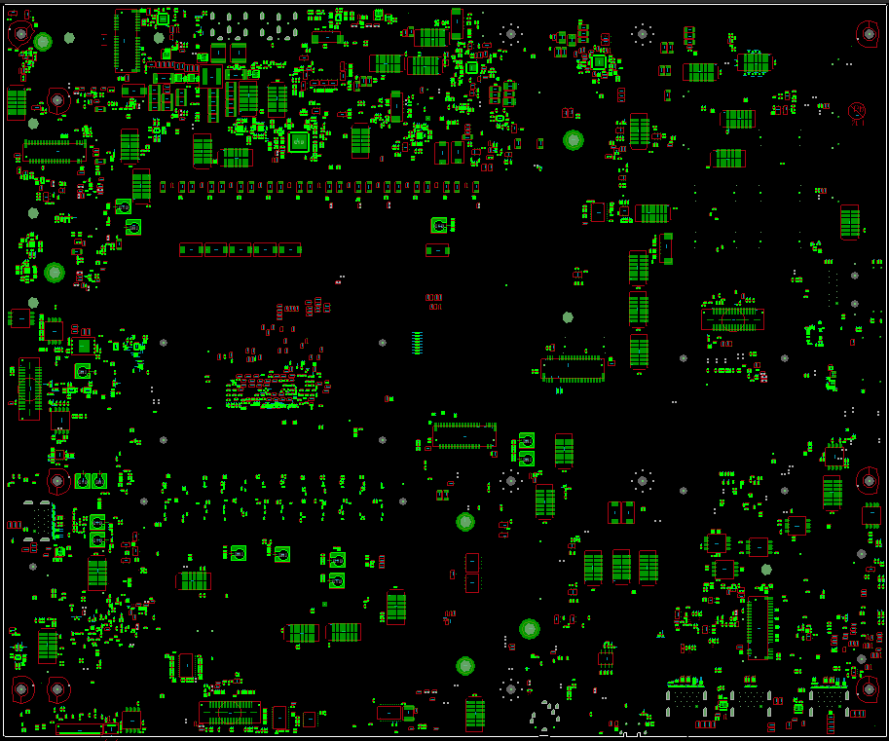
NVL-Hx LP5x T4 RVP04 - Board Layout – BOTTOM (Flipped)
WLAN
CPU PCIe
Gen4 x2 SSD
PCH SSD
(Port-C)
Merged MIPI60 JTAG Connector
CPU VISA
MIP60 Connector
PCH SSD
(Port-E)
ISH Sensor HDR
Scan Matrix keyboard

Slide 26
NVL-Hx/u/p/h/ul VALIDATION HEATSINK assembly instructions
Jamie Raupp
Aug 05, 2025

Slide 27
Sections
Part ordering guide
Tools required
Assemblies
Socket handling precautions
SoC package handling precautions
Troubleshooting
Contact information

Slide 28
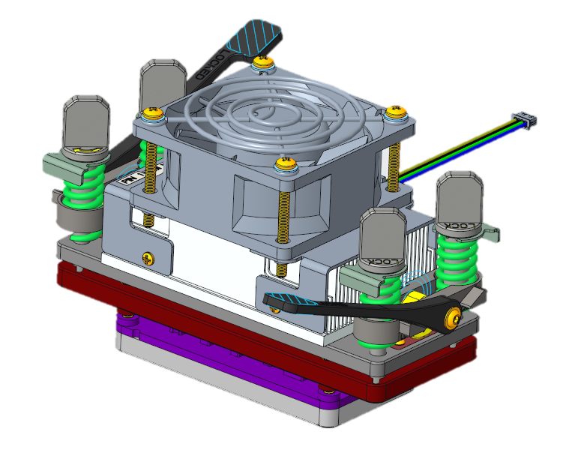
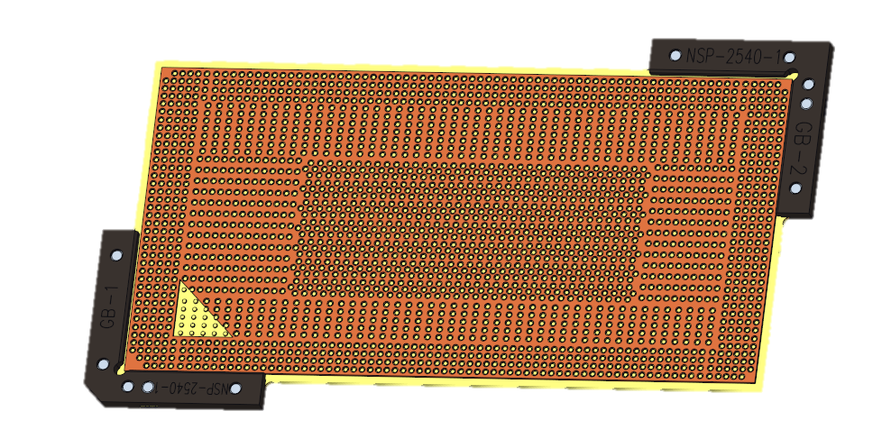
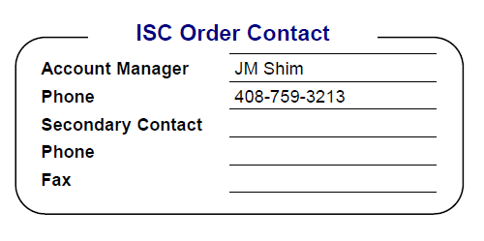

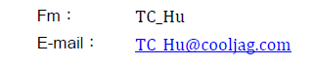
1. Ordering guide you must order socket and retention hardware separately – these parts included in the boot kit
Socket Retention Hardware
N72618-001
NVL Elastomer Socket
N34281-001

Slide 29

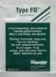
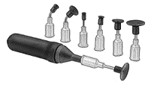
2. Tools Required
Tweezers
1. 2.5mm hex screwdriver
Ordering info:
McMaster Carr
Part no: 7289A13
Web: http://www.mcmaster.com/
2. Tweezers
Ordering info:
Excelta Corporation
Part no: 00D-SA
Web: http://www.excelta.com/
3. Isopropyl Alcohol Wipe – type FO
Ordering info:
Polywater
Part no: FO-1
Web: www.polywater.com
4. Vacuum Pick
Ordering info:
McMaster Carr
Part no: 54195A49
Web: http://www.mcmaster.com
Alcohol Wipe
Vacuum Pick

Slide 30
3a. Hardware Assembly Instructions
N72618-001
NVL-Hx/U/P/H/UL
Retention Hardware
Notes:
Picture swapped and PN

Slide 31
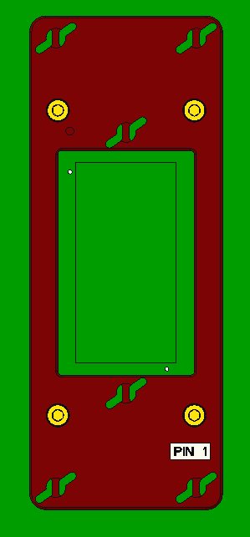
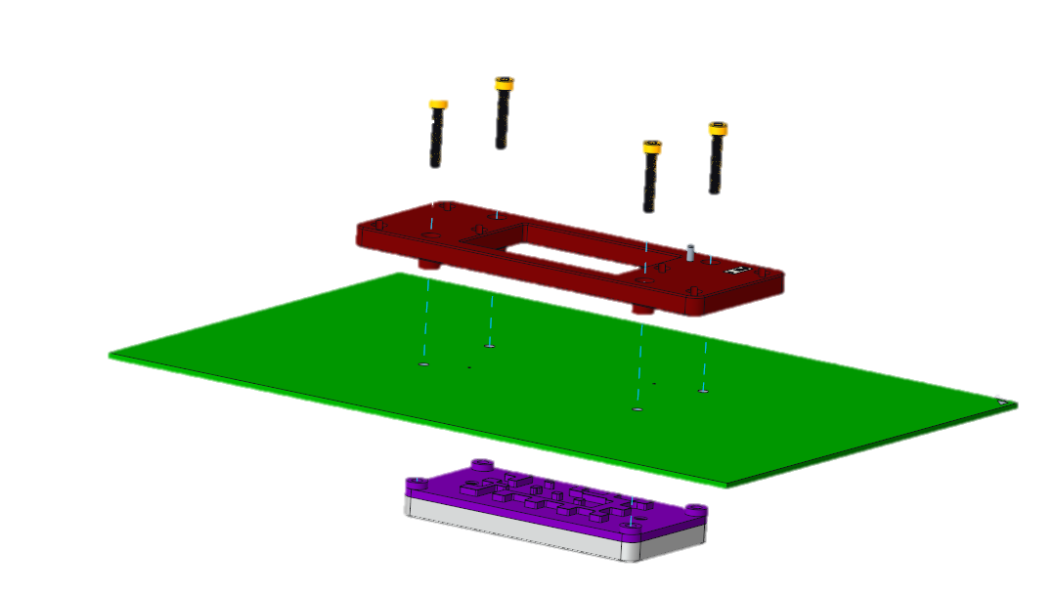
3b. Hardware Assembly Instructions NVL-Hx/U/P/H/UL Retention HW
Tightening Pattern
Assemble Stiffener Plates
Ensure Pin 1 marks and notches are properly aligned
Parts List
M3 Socket Head Screw (x4)
Stiffener Plate (x1)
Backplate (x1)
Use hex screwdriver to assemble stiffener plate to backplate through the board, till reaching top plate’s hard stop.
Tighten fasteners 1-2 turns at a time, alternating diagonally (see tightening pattern in image to right) until contact is made, then 1/8 turn more
1
3
4
2
Notes:
Pin 1 marked on opposite corner?
Picture Swapped.
Colors of Arrows changed, I have seen many end users in the lab not follow procedure when installing this part of the hardware. It is important to draw attention to the process and highlight during training.

Slide 32
3c. Hardware Assembly Instructions NVL-Hx/U/P/H/UL Retention HW
2. Locate the elastomer socket’s Pin 1 on board’s Pin 1
NVL Elastomer socket PN: N34281-001
Pin 1 is indicated by a chamfer on the corner block and an arrow cut out of the dark brown ball guide on the top surface of the socket.
Notes:
Do all sockets expire? (Lightly highlight this as well as storage information, I’ve seen too many of these laying on benches without the package, and they do fail.)

Slide 33
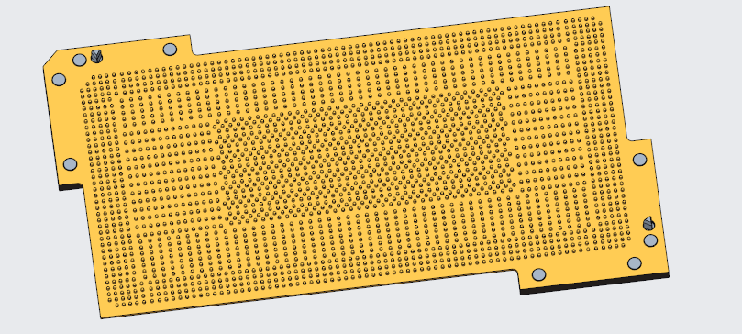
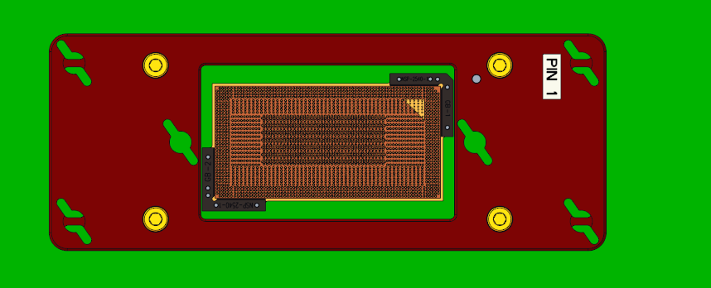
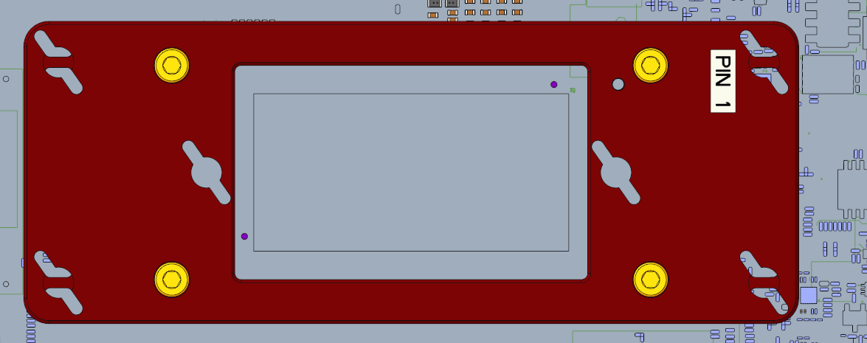
3d. Hardware Assembly Instructions NVL-Hx/U/P/H/UL Retention HW
3. Clean board contacts
Clean board contacts with alcohol wipe (dab don’t scrub)
DO NOT use alcohol on socket (deionized water or air ok)
4. Place the Elastomer Socket
Ensure Pin 1 marks are properly aligned
Handle socket only by the edges (do not touch contacts)
Gently press (on black corner block) the two alignment pins into alignment holes on board
Alignment pins
Pin 1 markers
Notes:
Yuriko needs to swap out this picture, how does she get right color of socket in creo?

Slide 34
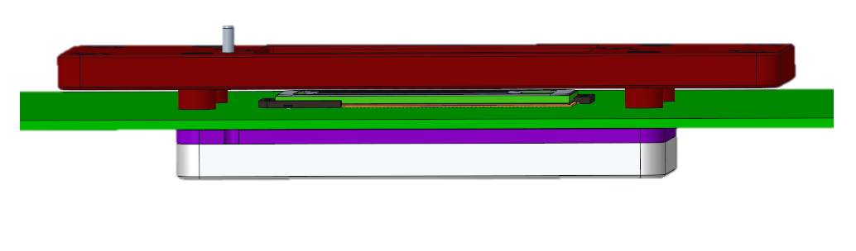
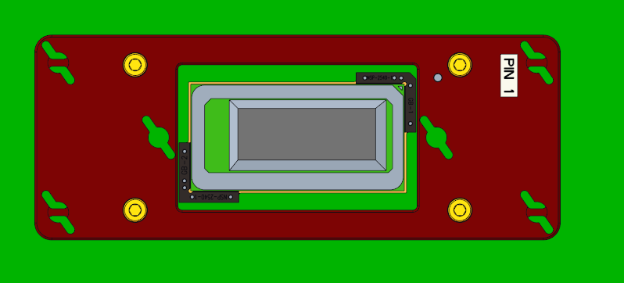
3e. Hardware Assembly Instructions NVL-Hx/U/P/H/UL Retention HW
5. Place NVL Package
Clean BGA with alcohol wipe. Dab don’t scrub. Scrubbing can cause fibers to dislodge from the wipe, which can cause connection problems.
Ensure Pin 1 marks are properly aligned
Use vacuum pick to place NVL package into the elastomer socket.
Gently ‘wiggle’ the package to ensure that the balls are settled all the way into the ball guide on the socket
Notes:
Maybe talk to the reason why we “dab” with we don’t scrub, I have scrubbed and don’t know why scrubbing is bad. This is good learning we could take to our global group, I think we all scrub wen we do use the wippes

Slide 35
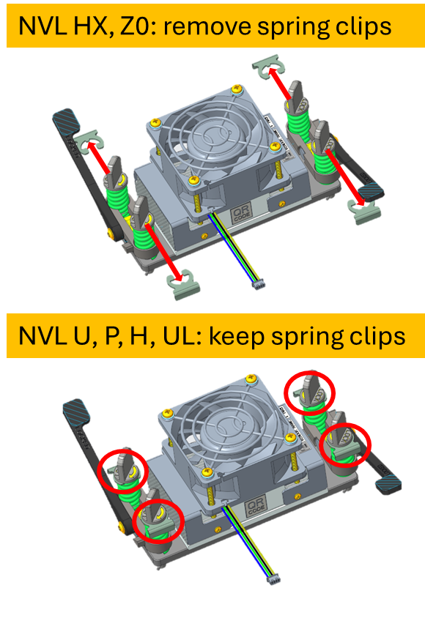
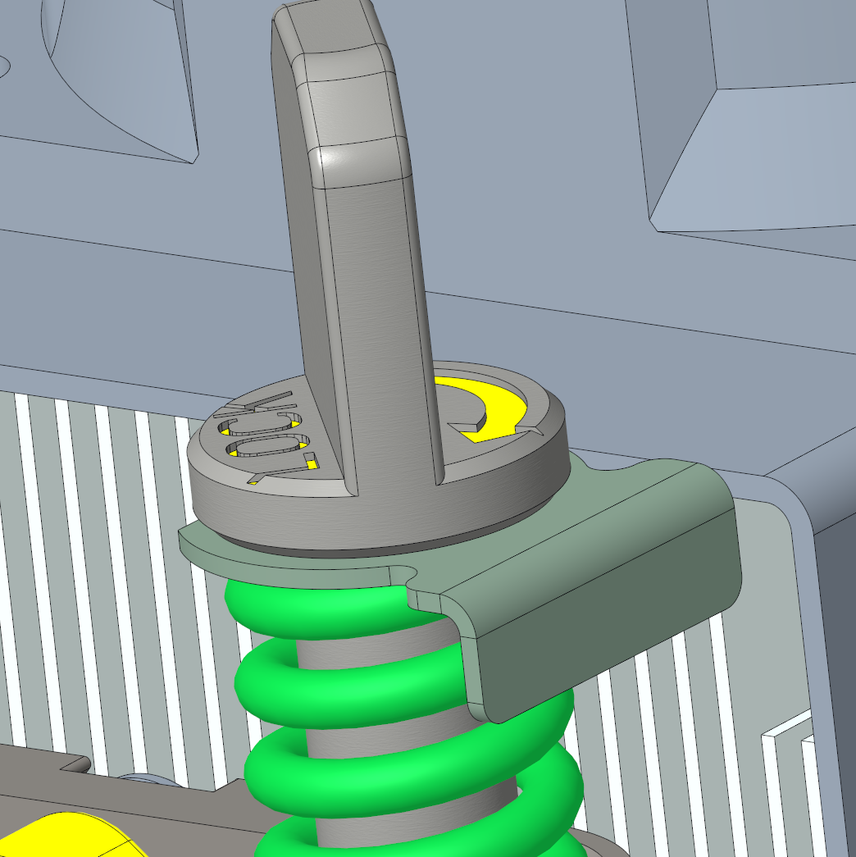
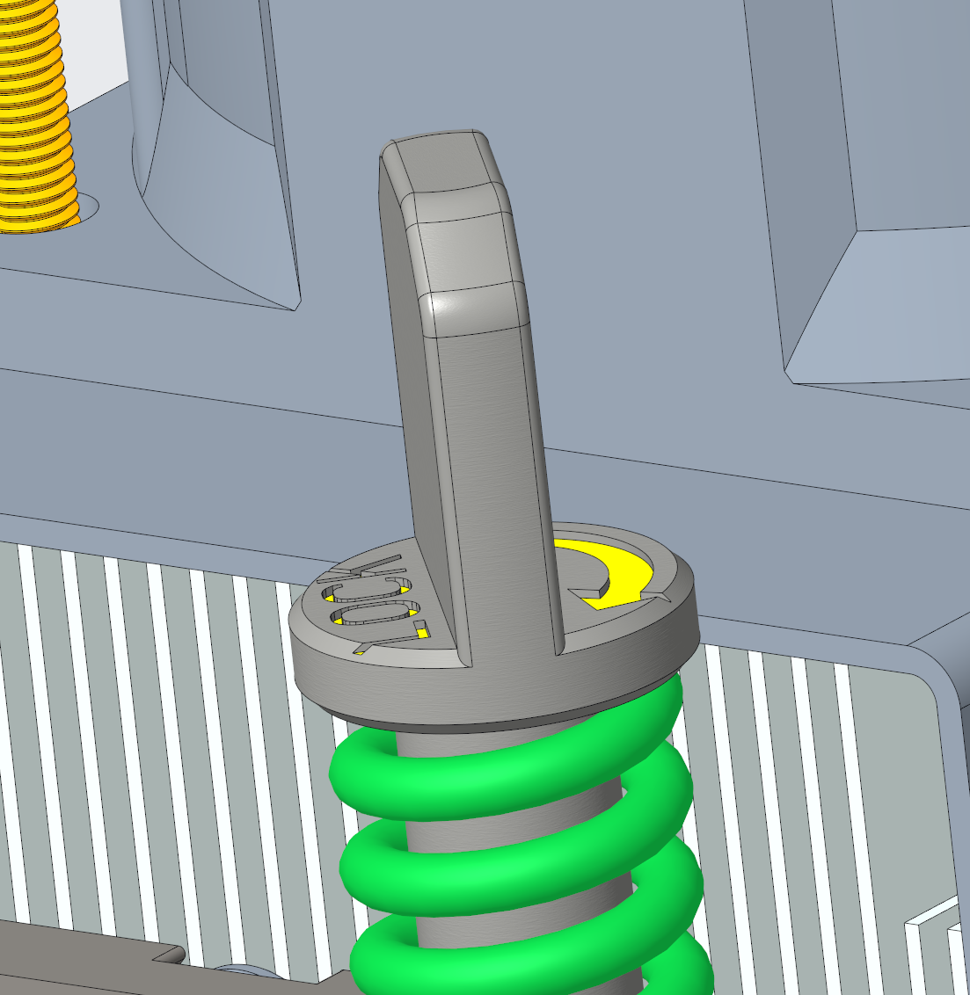
3f. Hardware Assembly Instructions NVL-Hx/U/P/H/UL Retention HW
 | SPRING CLIP
NVL HX | NEED TO REMOVE
NVL ZO | NEED TO REMOVE
NVL U | INSTALLED
NVL P | INSTALLED
NVL H | INSTALLED
NVL UL | INSTALLED
6. Ensure correct package configuration
Remove spring clips (4 pcs) for NVL-HX, Z0
Only remove or replace spring clips in while the heatsink is removed from the test board
Use small screwdriver (or similar tool) to pop off clips if necessary
Store spring clips is a location where they can be found again
Leave in or replace spring clips (4 pcs) for NVL U,P,H,UL
Only remove or replace spring clips in while the heatsink is removed from the test board
Push on flat surface of spring clip to install
Insert sprig clips between top of spring and the underside of the top section of the thumb screw

Slide 36
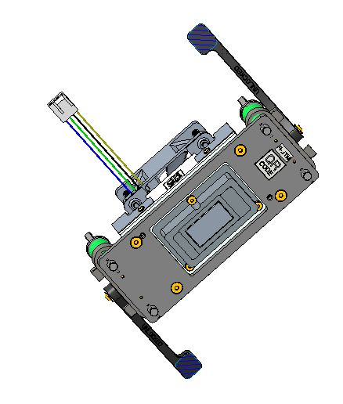
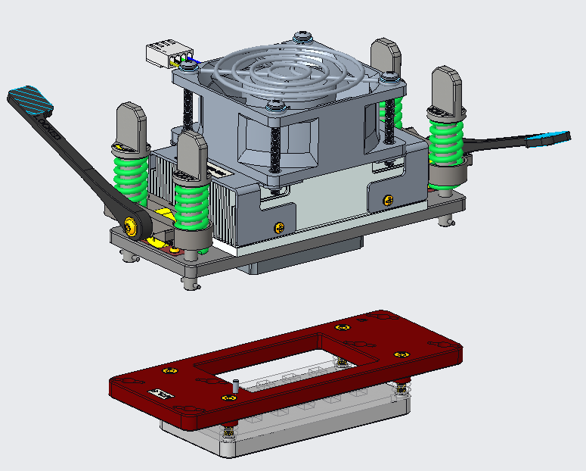
3g. Hardware Assembly Instructions NVL-Hx/U/P/H/UL Retention HW
7. Place Load Plate Assembly
Inspect Thermal interface material (TIM) for damage or debris
If Replacement is needed, order the following
P/N = N81253-001 Mfg = Chia Cherne
No thermal grease is needed at die interface, vcTIM will provide thermal conduction
Align pin 1 marks
Ensure latches are in the unloaded position.
Place load cell pins in keyholes

Slide 37
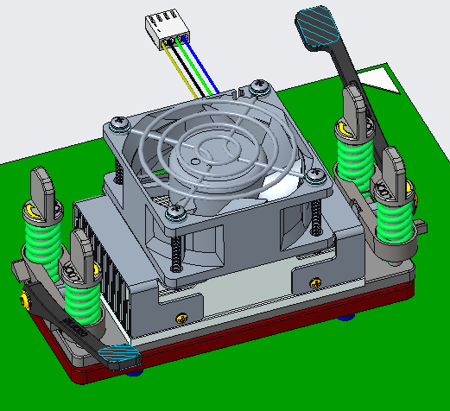
3h. Hardware Assembly Instructions NVL-Hx/U/P/H/UL Retention HW
8. Lock Load Plate Assembly
Ensure levers are in the unlocked position
Twist load cell pins 90 Deg to the clockwise to engage lock features
NO DOWNWARD PRESSURE IS REQUIRED. If pins will not turn freely, check the following:
Pin 1 location – Poke yoke pins prevent load cells from dropping into receptacles if load plate assembly is not properly oriented
Ensure levers are in the unlocked position
Notes:
No changes to slide

Slide 38
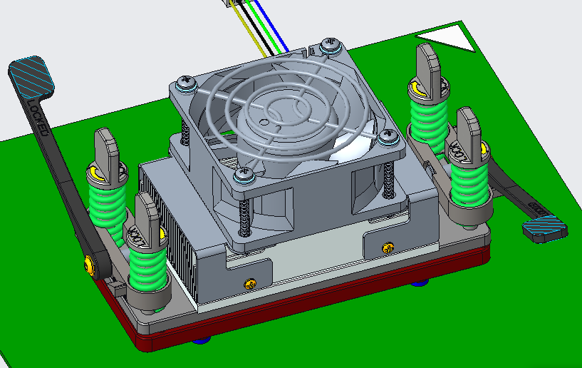
3i. Hardware Assembly Instructions NVL-Hx/U/P/H/UL Retention HW
9. Apply Load
Move both levers from the unlocked to locked position simultaneously.
Connect the Fan cable to Fan header on the board
Notes:
No changes to slide

Slide 39
4. Socket Handling Precautions
Frequently inspect sockets for contamination or damage
Clean socket with air or deionized water ONLY
NEVER use any sort of solvent on sockets (this includes isopropyl alcohol)
If socket is dropped on the floor or table, clean with air or deionized water before use
Always handle socket by edges or corner frames
Never touch the middle (oils from your skin will degrade socket performance)
Always store socket and SoC Package in protective bags or boxes when not in use.
Leaving the socket out uncovered can result in contamination of the contacts and reduced performance
Remove the socket from the board by corner frames with tweezers
Notes:
This is good information to know about, I’ve never seen his before and think it’s added value.

Slide 40
5. SoC Package Handling Precautions
Make sure not to use SoC Packages with damaged or missing solder balls
Handle SoC Packages using vacuum pick or by the corners similar to sockets.
Do not set SoC Packages down on solder ball side when not in use
Store SoC Package in protective boxes when not in use.
Notes:
Last point needs to highlighted as this is not a followed rule.

Slide 41
6. Troubleshooting Steps
Reverse assembly steps.
Verify correct Pin 1 orientation for all components.
Verify socket is fully seated on the board
Inspect SoC Packages for damage to top caps and solder balls.
If solder ball damage is present, replace SoC Package
Damaged solder balls will appear shiny compared to neighboring undamaged balls when the SoC Package is visually inspected under a light or microscope.
Inspect socket for physical damage.
Clean BGA on SoC Packages and FGA (ball pattern) on the board with Alcohol Wipes
Clean Sockets with clean, dry air (Deionized air)
Contact MTEG Mechanical Team for assistance: (see contact info next slide)
Notes:
Good debug practice, this fits the L1 Checklist for triage used by labs. Is this a standard process for all retention hardware?

Slide 42
7. Contact Information
NVL Socket and H/W :
Jamie Raupp james.c.raupp@intel.com
Supplier Contacts:
Retention Hardware (Chia Cherne): Maximo Wang (Maximo_Wang@cooljag.com)
Elastomer socket (ISC): JM Shim jmshim@isc21.kr
Notes:
Are the supplier contacts the same?

Slide 43
Nova Lake PCH-S (NVP-S) ISC Socket Retention Hardware
User Manual
Muzammil (20th March 2025)

Slide 44
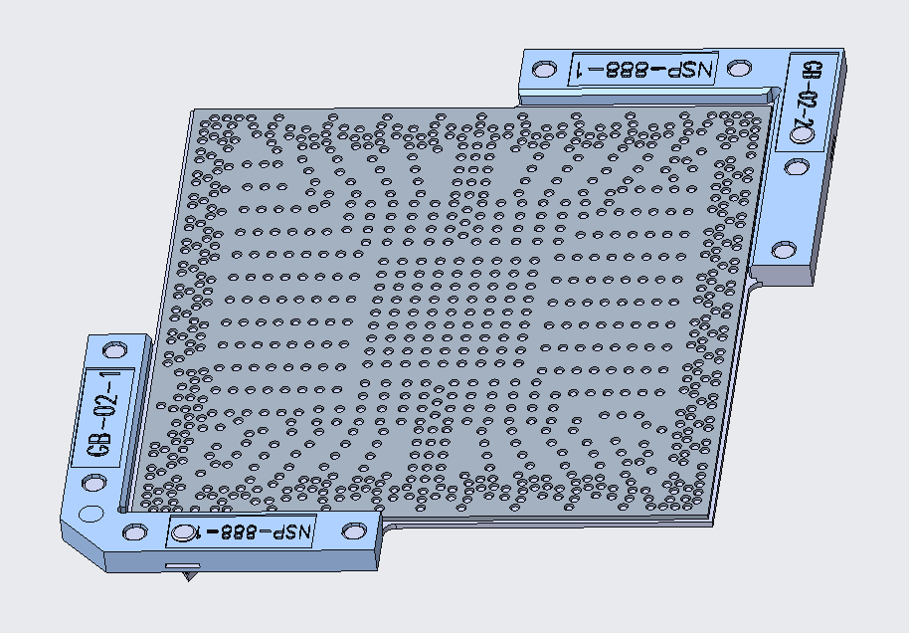
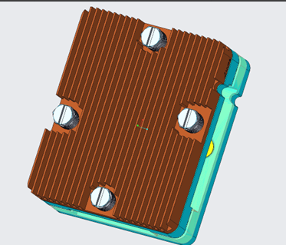
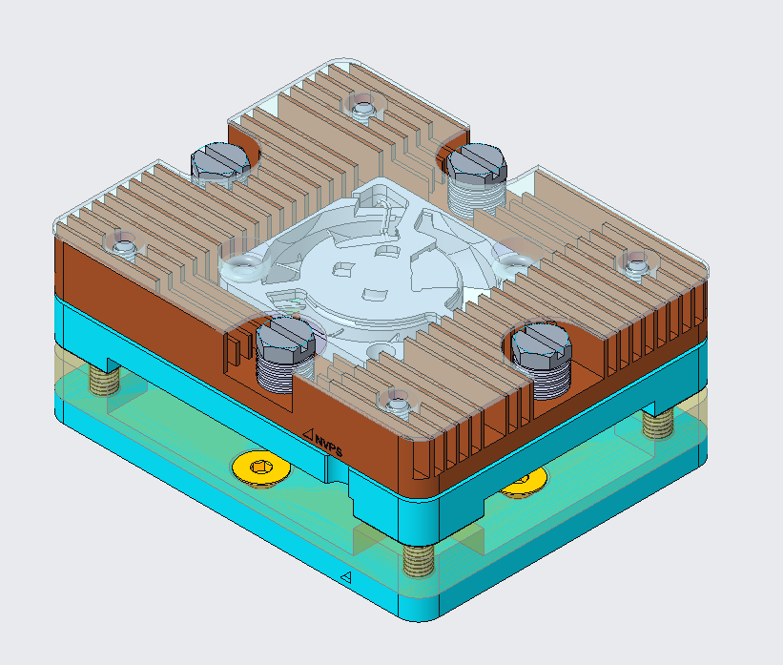
NVP-S ISC Socket & Retention Hardware
ISC Elastomer Socket
N69163-001
Retention Hardware
N72043-001 (5V/ 15W)
For Pre PO boards (Active)
Retention Hardware
N77767-001(6.5W)
For Post- PO boards (Passive)

Slide 45
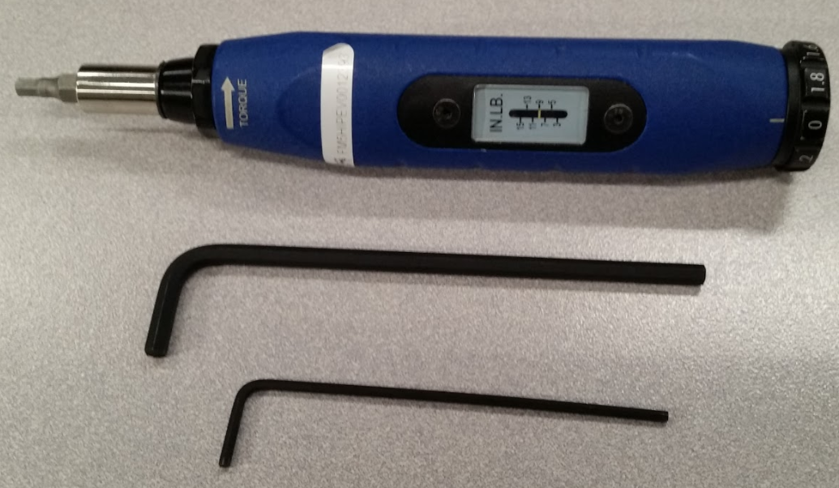
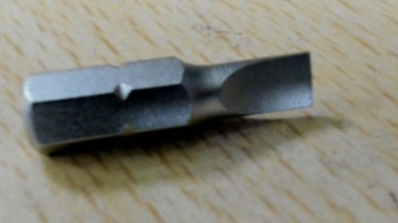
Tools Required
Torque wrench with 4mm bit(Flat or minus bit)
4mm Allen wrench
(if torque wrench is not available)
2mm Allen wrench
Slotted screwdriver

Slide 46
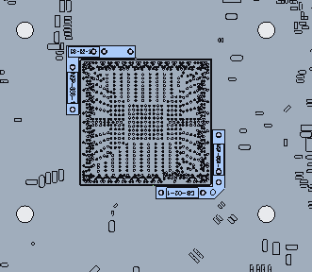
Retention HW Assembly
Place socket onto board.
Ensure Pin 1 orientation is followed.
2x guide pins align socket to PCB.
Press pins into board
Fit should be tight.
Pin 1 Indicator
1

Slide 47
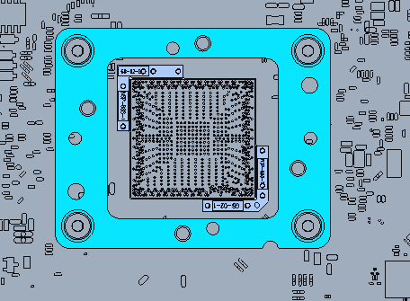
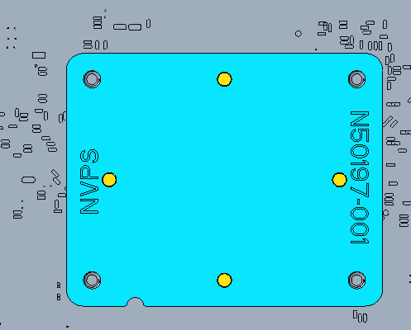
Retention HW Assembly Cont.
2. Attach Top Plate and Bottom Plate to PCB
Align Top Plate with mounting holes on top side of PCB
Align Bottom Plate with mounting holes on back side of PCB.
Secure with 4x screws using 2mm Allen wrench.
Only needs to be snug. Do not torque.
2a
2b
2c
Pin 1
Top Side of PCB
Back Side of PCB

Slide 48
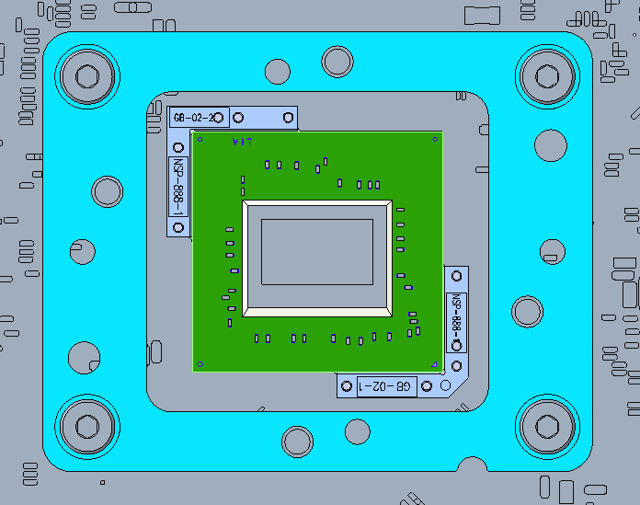
Retention HW Assembly Cont.
3
3.Place package into socket.
Verify Pin 1 orientation matches socket.
Wiggle package gently so solder balls align to the ball guide on the socket.

Slide 49
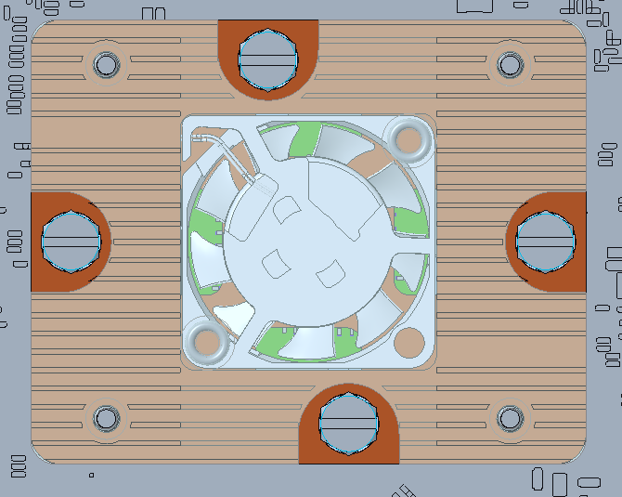
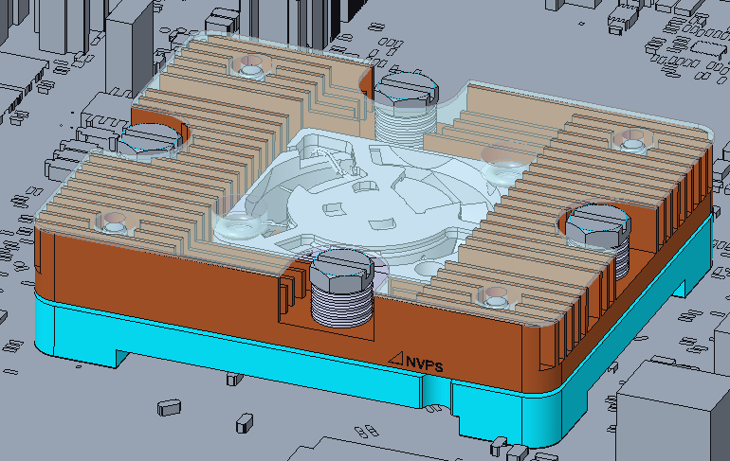
Retention HW Assembly Cont.
4. Place heatsink assembly into top plate.
Verify Pin 1 orientation matches socket.
Heatsink assembly has Pin 1 marking on the side of it.
5. Align the 4 screws to the top plate screws hole.
Tighten the screws using torque wrench (3 inch lbs). Use cross tightening method while tightening the 4 screws.
Rev.1
5
4
4a
4b
Pin 1

Slide 50
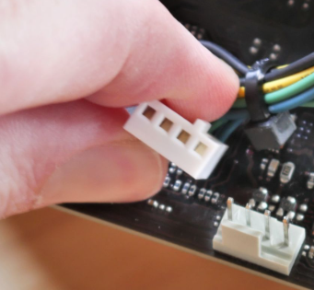
Retention HW Assembly Cont.
4. Connect the fan connector accordingly.

Slide 51
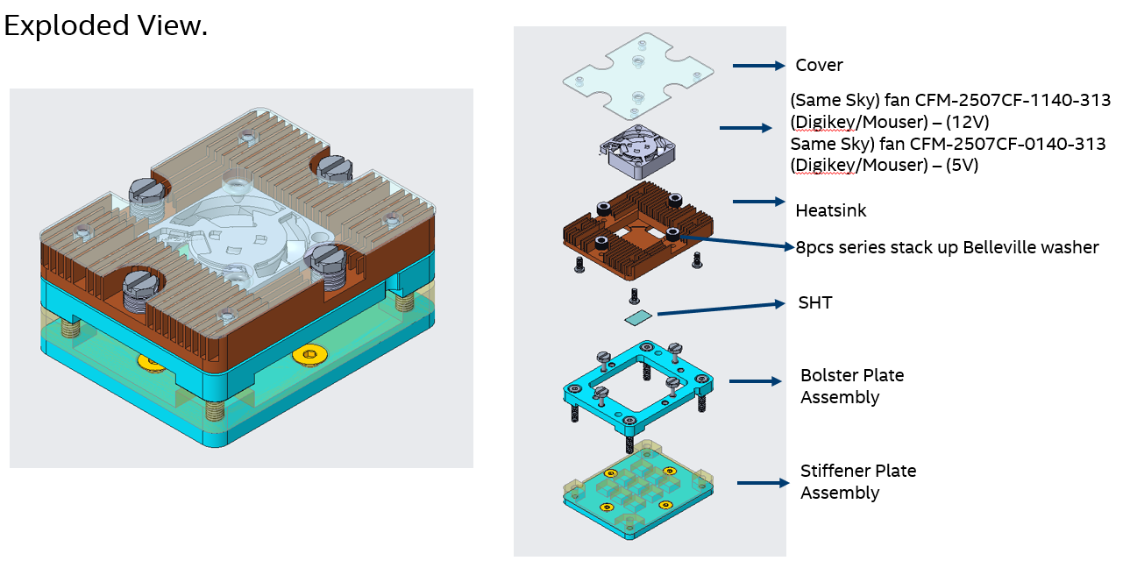
NVP-S ISC Retention Hardware Configuration

Slide 52
Memory
Vidaya, Divya

Slide 53
POR Memory Configurations
RVP SKU # | Config | i-POR Speed (MT/s) | e-POR Speed (MT/s) | Memory Devices Supported | Package Width | Routing Topology | Channel Config | Supported Memory density |  | PCB Stack-Up | Memory Routing Layers
 |  |  |  |  |  |  |  | Default BK | System Max
RVP 01 | DDR5 SODIMM 1DPC | 2R 8800 | 2R 8000 | CSODIMM /SODIMM | x8, x16 | P2P | 4x32 | 16GB | 32GB (8Gb, 1R x16) 96GB (24Gb, 1R x8) 128GB (32Gb, 2R x8) | T3/10L PML | 3
RVP 02 | DDR5 SODIMM 2DPC | 0R2R 5600 2R2R 5200 | 2R 5600 | CSODIMM /SODIMM | x8, x16 | Tee ClamShell | 4x32 | 16GB | 32GB (8Gb, 1R x16) 96GB (24Gb, 1R x8) 128GB (32Gb, 2R x8) | T3/10L PML | 3
RVP 03 | LPDDR5x CAMM w/DBI ECC | 2R 8533 | 2R 8533 | LPCAMM2 | x32 315BGA | P2P | 8x16 (4x16 per MC) | 16GB | 64GB (16Gb, 1R x16) | T3/10L PML | 4
RVP 04 | LPDDR5x Device Down / Socketed | 2R 9600 | 2R 9600 | DDP /QDP /ODP | x32 315BGA | P2P | 8x16 (4x16 per MC) | 16GB | 32GB (8Gb, 2R x16) 64GB (16Gb, 2R x8) | T4/10L PML 2x2+ | 4
RVP 04m (Post Alpha deployment) | LPDDR5x Device Down / Socketed | 2R 10700 (Hx/P) 2R 9600 (UH) | 2R 9600 | DDP /QDP /ODP | x32 315BGA | P2P | 8x16 (4x16 per MC) | 16GB | 32GB (8Gb, 2R x16) 64GB (16Gb, 2R x8) | T4/10L PML 2x2+ | 4
CSODIMMs must be used for modules with target frequency more than 6400MT/s
RVP BK will have only 1 specific mem config as listed in each following RVP pages - Part may vary depending upon availability sometimes.
Any other config must be ordered directly from supplier (MIO to guide on price & vendor details)
Notes:
P2P – Point to Point
PML – Premium Mid Loss
CSODIMM – Clocked SODIMM

Slide 54
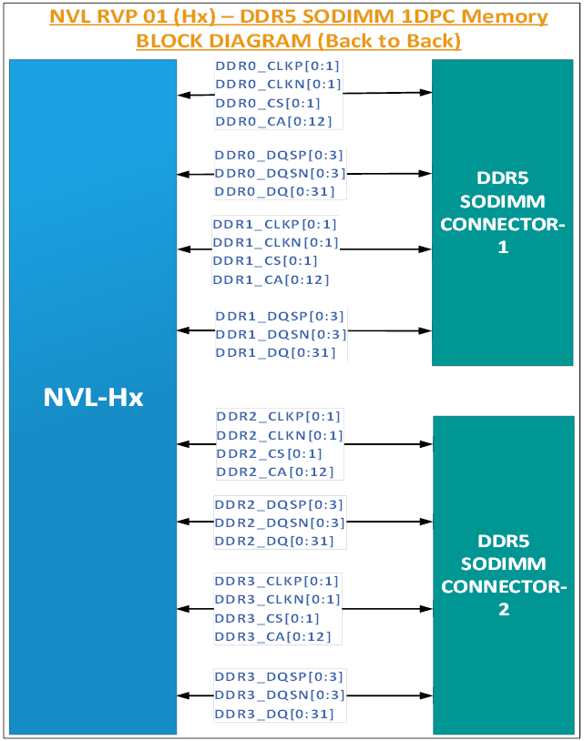
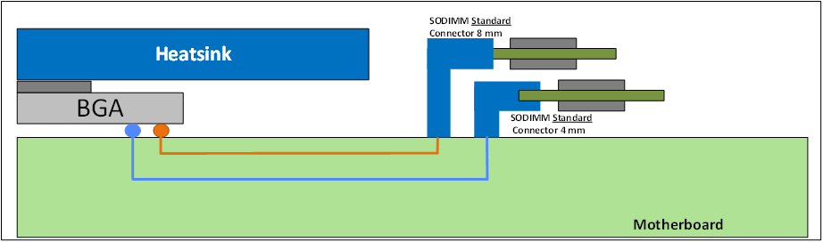
RVP01 : DDR5 SODIMM 1DPC Memory B2B Topology
DDR5 routing will be P2P for all the DDR5 signals w/ 1 DIMM per channel.
DIMM connectors will be placed B2B using double stacked connector as shown in the below figure.
Notes:
B2B – Back-to-Back

Slide 55
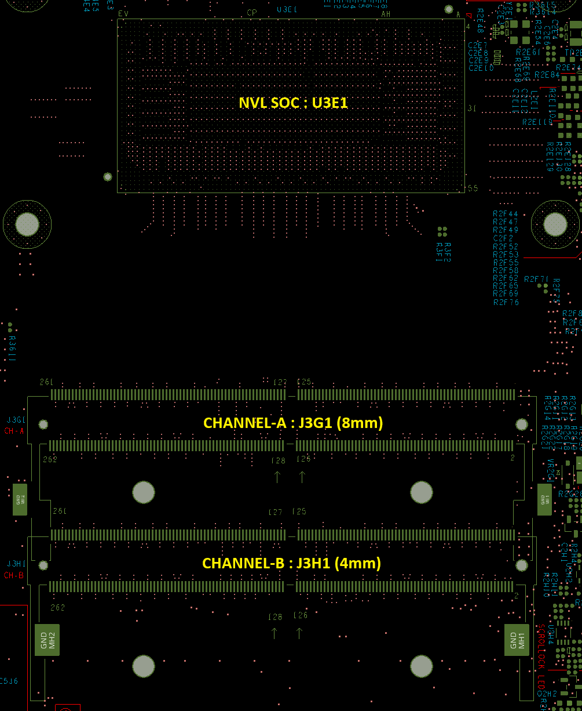
RVP01 : DDR5 SODIMM 1DPC Memory Specification
Default BK supported DDR5 SODIMM Details
Type | x32 DDR5 CSODIMM 1DPC
Topology | P2P
Connector | Double Stacked
Placement | B2B
Routing | Non-Interleaved
Memory IPN | N76346-001
Memory MPN | HMCG78CKBVA (SK HYNIX AMERICA INC)
Quantity | 2
Total Size | 16GB (8GB per DIMM) (1R x8)
Speed | 7200 MT/s
SPD | EEPROM on the Module BIOS Hard Coded by default for BK part 7-bit I2C Address - 0x50 / 0x52 8-bit I2C Address - 0xA0 / 0xA4
ALERT | Enabled
Datasheet : DDR5_Suppliers_Secure - Datasheets - 16Gb - All Documents
Notes:
BK – Boot Kit

Slide 56


RVP02 : DDR5 SODIMM 2DPC Memory Tee Topology
Both the DDR5 routing & the SODIMMs will be placed in Tee ClamShell topology w/ 2 DIMMs per channel.
Only CLK & CS is routed P2P.
DIMMs of each channels will be placed top & bottom as shown in the below figure.

Slide 57


RVP02 : DDR5 SODIMM 2DPC Memory Specification
Default BK supported DDR5 SODIMM Details
Type | x32 DDR5 CSODIMM 2DPC
Topology | Tee ClamShell
Connector | 4 Individual connectors
Placement | 2 Top & 2 Bottom
Routing | Non-Interleaved
Memory IPN | N76346-001
Memory MPN | HMCG78CKBVA (SK HYNIX AMERICA INC)
Quantity | 2
Total Size | 16GB (8GB per DIMM) (1R x8)
Speed | 7200 MT/s
SPD | EEPROM on the Module BIOS Hard Coded by default for BK part 7-bit I2C Address - 0x50 / 0x52 8-bit I2C Address - 0xA0 / 0xA4
ALERT | Enabled
NVL SOC
NVL SOC
TOP
BOTTOM
Datasheet : DDR5_Suppliers_Secure - Datasheets - 16Gb - All Documents

Slide 58


RVP03 : LPCAMM2 w/DBI ECC Memory P2P Topology
LPCAMM2 routing will be P2P for all memory signals.
LPCAMM2 Assembly Instructions Wiki :
LPDDR5X CAMM2 16-64GB - VMH WIKI Pages - Intel Enterprise Wiki

Slide 59

RVP03 : LPCAMM2 w/DBI ECC Memory Specification
Default BK supported LPCAMM2 Details
Type | x32 LPCAMM2 w/DBI ECC
Topology | P2P
Routing | Non-Interleaved , Mixed CAC
Placement | Socketed
Memory IPN | N78521-001
Memory MPN | HM8G76DK8FB (SK HYNIX AMERICA INC)
Quantity | 1
Total Size | 16GB (1R x16 DDP)
JEDEC Version | 1.08
Speed | 8533 MT/s
SPD | EEPROM on the Module BIOS Hard Coded by default for BK part 7-bit I2C Address - 0x50 8-bit I2C Address - 0xA0
DVFSQ | Enabled
DBI ECC | Enabled
NVL SOC
LPCAMM2
Datasheet : LP5-LP5x_secure - LP5_supplier_secure_docs - 8500 - All Documents

Slide 60


RVP04 : LPDDR5x MD x32 T4 Memory P2P Topology
CAC signals are routed with P2P topology along with Data and Strobe signals.
Topology for x32 devices is illustrated in the figure.
LPDDR5x Assembly Instructions Wiki :
LPDDR5 Multi Package Sockets - 315BGA - VMH WIKI Pages - Intel Enterprise Wiki
Notes:
CAC – Command & Control

Slide 61

RVP04 : LPDDR5x MD x32 T4 Memory Specification
Default BK supported LPDDR5x Details
Type | LPDDR5x 4x32, 2 devices per channel
Topology | P2P
Routing | Non-Interleaved , Descending CAC
Placement | Landscape mode, Inline
Device | Soldered / Socketed
Memory IPN | N70393-001
Memory MPN | H58G56DK9BX068 (SK HYNIX AMERICA INC)
Quantity | 4
Total Size | 16GB (4GB per channel) (1R x16 ODP)
Speed | 9600 MT/s
SPD | EEPROM on the RVP board BIOS Hard Coded by default for BK part For any other part validation, SW/HDRs are provided on RVP for SPD EEPROM programming 7-bit I2C Address - 0x54 8-bit I2C Address - 0xA8
DVFSQ | Enabled
NVL SOC
Channel-B
MC1
Channel-A
MC1
Channel-B
MC0
Channel-A
MC0
Datasheet : LP5-LP5x_secure - LP5_supplier_secure_docs - 1b nm - All Documents

Slide 62



RVP04 : Switch / Headers for SPD programming
SPD is supported over LPSS I2C2 interface.
There are multiple way to program SPD onboard chip.
Aardvark tool user manual : Aardvark I2C/SPI Host Adapter User Manual - Total Phase
Steps to program through python SV : SPD_Files - Client Memory Development - Intel Enterprise Wiki
SW / HDRs | Ref Des
JA | J4H2
JB | J3H2
JC | J3H1
SPD PRSNT | SW3J1

Slide 63
Memory Reference Links
Platform Specific
Generic
Memory PAS | NVL-Mobile/Desktop Platform Memory Architecture
Memory Domain Platform PRD | NVL Plat. req. HX & UPH – Memory
Memory Domain RVP LZ PRD | NVL HX & UPH RVP LZ-PRDs – Memory
MIO | MIO Memory – Home
PMO | Home - LPDDR5/x
MPE | Memory Pathfinding & Enabling (MPE) – Home
SPD | SPD_Files - Client Memory Development - Intel Enterprise Wiki
SPD FV | LP5 SPD Decoder Table - FVCommon - Intel Enterprise Wiki
MRC | MRC - Client Memory Development - Intel Enterprise Wiki

Slide 64







Memory Assembly Instructions - LPCAMM2
https://wiki.ith.intel.com/spaces/PEVH/pages/3480142200/LPDDR5X+CAMM2+16-64GB

Slide 65






Memory Assembly Instructions - LPDDR5x
LPDDR5 Multi Package Sockets - 315BGA - VMH WIKI Pages - Intel Enterprise Wiki

Slide 66
DISPLAY
K, Vishnu

Slide 67
NVL-Hx RVP - Display Mapping
NVL-Hx RVP Display mapping for different SKUs is as follow:
Silicon Interface | RVP 01: NVL Hx-UPH-UL DDR5 SODIMM 1DPC T3 with PCH IOE RVP | RVP 02: NVL Hx DDR5 SODIMM 2DPC T3 dTBT with PCH IOE RVP | RVP 03: NVL Hx-UPH-UL LP5x CAMM w/DBI T3 without PCH IOE MB down RVP | RVP 04: NVL Hx-UPH LP5x Solder down/ Socketed T4 RVP with PCH IOE
DDI3 | eDP 1.5 Connector | eDP 1.5 Connector | eDP 1.5 Connector | eDP 1.5 Connector
DDI2 | HDMI 2.1 @12Gbps w/ retimer | HDMI 2.1 @12Gbps w/ retimer | HDMI 2.1 @12Gbps w/ redriver | HDMI 2.1 @12Gbps w/ retimer
Second eDP will be supported on TCP0 port with eDP module.
Retimer used PS8419QFN46GTR-A1-GN0A02
Redriver Used : PS8219QFN46ITR-B0
SoC Display port mapping; Display HAS link: https://docs.intel.com/documents/pch_doc/NVL/PCD-S/HAS/Display_NVL/display_nvl.html#pcd-h

Slide 68
CAMERA
K, Vishnu

Slide 69
NVL-Hx RVP – Camera support & configurations
NVL-Hx RVP camera configuration supported in each SKU is shown below,
RVP-01 and RVP-04 supports new camera CRD 60 pinout
RVP-02 and RVP-03 supports legacy Camera CRD 60 pinout
Therefore, AIC supported in RVP-01,04 is different from RVP-02,03 (although it may look similar).
CVS Synaptics AIC is supported only in RVP-02, RVP03.
Do not plug RVP-01,04 supported AICs to RVP-02,03 RVPs and Vice versa as it may damage Si.
RVP 01: NVL Hx-UPH-UL DDR5 SODIMM 1DPC T3 with PCH IOE | RVP 02: NVL Hx DDR5 SODIMM 2DPC T3 dTBT with PCH IOE | RVP 03: NVL Hx-UPH-UL LP5x CAMM w/DBI T3 without PCH IOE MB down | RVP 04: NVL Hx-UPH LP5x Solder down/ Socketed T4 RVP with PCH IOE
D-PHY C-PHY eUSB2 | DPHY Only | D-PHY Only | D-PHY C-PHY eUSB2

Slide 70
NVL-Hx RVP – Camera support & configurations
Below are the supported Camera AICs for RVP02,RVP03 SKUs
Camera AICs supported by RVP01, RVP04,
Note : CRD G3 CPHY DPHY AIC does not support CPHY on IR xfer connector (Middle conn)
Note : Kindly do not swap the CRD AICs between RVP-01,04 and RVP-02,03. This may ground the HSIO signals from SoC and may damage the Si. This is because new CRD-60 pinout followed in RVP-01,04.
RVP connector | Synaptics AIC | CRD-D1 | CRD-G3
CRD Conn 1 | 1 x2 lane | 1 x4 lane | 2 x2 lane
CRD Conn 2 | NA | 1 x2 lane | 1 x2 lane
RVP connector | CRD D1 C-PHY D-PHY AIC | CRD G3 C-PHY DPHY AIC
CRD Conn 1 | CPHY : 3 Trio lane | CPHY :1 x2 Trio on UF
 | DPHY : 1 x4 lane
 |  | DPHY : 2 x2 lane (UF and IR)
 | Eusb2 : eUSB2 P8
 |  | Eusb2 : eUSB2 P8
CRD Conn 2 | CPHY : 2 Trio lane | CPHY : 1 x2 Trio WF
 | DPHY : 1 x2 lane | DPHY : 1x2 lane
Notes:
SKU strategy similar like LNL –One SKU C-PHY rest all are D-PHY

Slide 71

NVL-Hx RVP – Camera support & configurations
CRD CONN1
CRD Connector Positions on NVL RVPs
Figure Shows NVL RVP-01
CRD CONN1 and CRD CONN2 are the two POR connectors provided for all NVL RVPs
RVP-01 and RVP-04 RVPs will have 3rd connector (CRD CONN3) which is provided for future RZL program support.
CRD CONN3 is not enabled for NVL program (Eusb2 v2 is not available in NVL Si).
CRD CONN3
Cannot be used for NVL.
CRD CONN2
Notes:
SKU strategy similar like LNL –One SKU C-PHY rest all are D-PHY

Slide 72


NVL-Hx RVP – Camera support & configurations
How to identify new CPHY DPHY AICs (AICs only supported in RVP-01 and RVP-04) ?
Notes:
SKU strategy similar like LNL –One SKU C-PHY rest all are D-PHY

Slide 73



NVL-Hx RVP – Camera support & configurations
How to identify legacy DPHY AICs (AICs only supported in RVP-02 and RVP-03) ?
Notes:
SKU strategy similar like LNL –One SKU C-PHY rest all are D-PHY

Slide 74
NVL-Hx RVP – Camera support & configurations
CRD CON2
CRD CON1
2x Data
1xCLK
4x Data
2xCLK
GPIOs in RVP1, RVP2 & RVP4 | Discrete G1 or PMIC G3 | Discrete G1 or PMIC G3/ or Synaptics
1X PWREN | ✓ | ✓
1X RST | ✓ | ✓
1X Flash Trigger | ✓ | (optional path from con2)
1X Privacy LED | ✓ | ✓
1X CLK Enable | (optional path from con1) | ✓
VSYNC | Option from VSync1 | VSync1
I2C | I2C0 | I2C1

Slide 75
NVL-Hx RVP – Camera support & configurations C-PHY
CRD CON2
CRD CON1
2Trios
3Trios
GPIOs in RVP3 SKU | Discrete CRD D1 C-PHY | Discrete CRD D1 C-PHY
1X PWREN | ✓ | ✓
1X RST | ✓ | ✓
1X Flash Trigger | ✓ | (optional path from con2)
1X Privacy LED | ✓ | ✓
1X CLK Enable | (optional path from con1) | ✓
VSYNC | Option from VSync1 | VSync1
I2C | I2C0 | I2C1

Slide 76
NVL-HX POR Camera Sensors
Below are the current set of POR camera sensor/Modules defined for NVL-Hx.
Note that RVP team does not work on the module list and the adapters (Transfer cards) for these modules on the CRD card.
Vendor | Sensor | Module P/N
Omni Vision | BC-A22(OG0VA1B_KPFA068) | KPFA068
Omni Vision | BC-A20(OV08X40_KAFE799) | KAFE799
Omni Vision | BC-A18(OV01A1S_KAFB025) | KAFB025
SONY | BC-A21(IMX688_KBFG809) | KBFG809
Omni Vision | BC-A19(OV13B_AF_KBAG152) | KBAG152 V2

Slide 77
Synaptic Sabre AIC Support on NVL-Hx RVP
RVP-02 and RVP-03 supports Synaptics Sabre AIC.
Synaptic Sabre AIC is only supported in CRD-1 connector
No rework required to enable the same.
Below Table lists the GPIOs for the sabre-AIC for BIOS settings if required
Sabre SOC | Direction w.r.t Sabre AIC | Signal Activity | NVL-Hx GPIO
HOST_WAKE | Input | 0: No Wake 1: Wake | GPP_H0
HOST_RST_N | Input | 1: Out of Reset 0: In Reset | GPP_E10
ISH Slave Interrupt | Output– Open drain | Active Low | ISH_GP_11
Sabre_I2C0 | I2C bus | For sensor Metadata communication | ISH_I2C1
Sabre_I2C1 | I2C bus | For camera communication | LPSS_I2C1
USB2_DP/DN | USB Bus | For Host-MCF communication | USB Port 8

Slide 78
NVL-HX Modular TCSS OVERVIEW
Usha
Naseef
Harshali

Slide 79

Modular TCSS on NVL-HX RVP
Modular TCSS enable multiple Type-C configuration on Modular TCSS connector.
No rework or IFWI re-flashing on RVP needed for enabling the different modules.
NVL-Hx RVP supports Modular TCSS connector on which multiple IO modules can be plugged.
Modules designed based on the defined pinout to support all IO modules without rework.
Module routing is taken care to meet the PDG limit.
TCSS Modules are not hot pluggable. Module can be plugged/swapped in G3 only.
Note : Do not plug TCSS module on legacy M.2 SSD slot and vice versa.
Without Stand offs (M.2 screws) do not use TCSS modules

Slide 80
POR Module List for NVL-HX RVP
Each module can be identified using the TCSS Card# label provided on the module.
Individual module schematics and layout files are available in goto/tcssmodule wiki link.
 | NVL Module List
Sl No | Module Name | eUSB2 Repeater on Module | Reuse | Solder Mask Color
1 | TCSS-901 JBR 80G FFC CABLE MODULE 48V | Integrated in PD controller | New TO | Blue
2 | TCSS-107 JBR 80G TCSS Single module (TI) 48V | Integrated in PD controller | New TO / TO done | Blue
3 | TCSS-108 JBR 80G TCSS Dual module (TI) 48V | Integrated in PD controller | New | Blue
4 | TCSS-401 DP2.1 Retimer with Mux Module | NA | New TO | Blue
5 | TCSS-602 USB3/2 Type-A TCSS Module with redriver - eUSB2 repeater | Discrete IC | New (re-tapeout) | Blue
6 | TCSS-603 USB3/2 Type-A Redriverless TCSS Module - eUSB2 repeater | Discrete IC | New (re-tapeout) | Blue
7 | TCSS-500 eDP (short channel) module | NA | Reuse(PTL) | Green
Note:
TCSS 600 and 601 Modules should not be used on NVL-Hx
TCSS 500 module can be plugged only on TCP0 Port
Type-A redriverless TCSS 603 module can be validated only on short channel length.
For more details on specific routing lengths for each of the TCPx ports (EV validation), please refer to link NVL-Hx-UPH_Type-C_lengths_TCSS_support.xlsx
For detailed module list including UPH and S goto/tcssmodule

Slide 81




Modules Assembly on RVP
Modules are connected on TCSS Key-M connector (IPN# N23242-001) and recommended to screw the modules to avoid removal of module due to cables being plugged.
Module gets mounted to the M.2 stud and M3 screw. Card has a half-moon mounting hole which is shared over the modules. Middle Mounting hole is shared with both the cards.
TCSS 107
JBR 80G Single Module
TCSS 108
JBR 80G Dual Module
TCSS 602
Type-A with redriver and eUSB2 repeater Module
TCSS 500
eDP (short channel) Module

Slide 82
TCSS Modules – Programmable Devices
EEPROM , JBR retimer SPI Flash and PD controller pre-programmed from factory.
In case if user requires re-flashing, the procedure is provided in back up foils.[EEPROM] , [Retimer Flash]
PD controller EC-PD I2C1 address need to be set from RVP. Switches provided on RVP to select the specific vendor I2C1 address. By default, switch setting is set for TI PD controller.
PD controller detailed programming procedure document is available in sharepoint link
PD controller can be flashed by using Aadvark I2C/SPI Host adapter or PD FW capsule update.
If TBT modules with blank PD controller part (without PD FW being flashed) is plugged, it will block RVP boot sequence. Once PD controller is programmed, RVP can be booted to windows.

Slide 83
TBT Modules - Compatibility
For TBT modules, BKC PD FW release is considering the SiV config. Incase, any new vendor support which is different from SiV config, need to get the PD FW from PSE team separately.
Once the dynamic module detection is enabled with EC/BIOS/CSME changes, any PoR module can be plugged on Modular TCSS slot.
dTBT BOBCAT is supported only in RVP01 and RVP02.
dTBT validation config has to be set by a switch on RVP.
When dTBT config is selected on RVP01 or RVP02, suggested to not plug any TCSS TBT module. This is due to TI PD Controller address limitation.

Slide 84
TBT Type-C Interface
Harshali
Naseef

Slide 85
NVL-HX-TCSS Subsystem
Supports 3 integrated Type-C ports, supporting DP2.1, USB3.2, TBT3, TBT4, TBT5 and USB4 protocols.
eDP over Type C is supported on NVL Hx RVPs on TCP Port0 TCSS module.
NVL-Hx introduces Integrated 80G (CIO-80) enabling support for USB4v2. Compared to USB4 v1.0, USB4 v2.0 uses the same number of lanes with double the bandwidth per lane.
For NVL Hx-UPH, USB4SS is integrated in PCD die.

Slide 86
NVL-HX TYPE-C SUPPORT
Silicon Port | RVP 01 | RVP 02 | RVP 03 | RVP 04
TCP0 (TBT 80G/ eDP2) | M.2 Modular TCSS Single module (107) 2. Dual module (108) USB PD: 48V EPR w/JBR + Skywarrior TI dual port PD Controller | 1. M.2 Modular TCSS (single module 107 ) w/ M.2 PDG max length USB PD: 48V EPR w/JBR + Skywarrior TI dual port PD Controller | 1. M.2 Modular TCSS (single module 107) w/ M.2 short length USB PD: 48V EPR w/JBR + Skywarrior TI dual port PD Controller | M.2 Modular TCSS Single module (107) 2. Dual module (108) USB PD: 48V EPR w/JBR + Skywarrior TI dual port PD Controller
TCP1 (TBT 80G) | M.2 Modular TCSS Single module (107) 2. Dual module (108) USB PD: 48V EPR w/JBR + Skywarrior TI dual port PD Controller | Type C Con - TBT 80G Single retimer JBR + TI TOMCAT dual port PD Controller Solder down (PDG Max length support) USB PD: 48V EPR | Type C Con - TBT 80G Single retimer JBR + TI TOMCAT dual port PD Controller Solder down (IL Max length Support) USB PD: 48V EPR EC I3C debug via MECC AIC | M.2 Modular TCSS Single module (107) 2. Dual module (108) USB PD: 48V EPR w/JBR + Skywarrior TI dual port PD Controller
TCP2 (TBT 80G) | M.2 Modular TCSS 1. Single module (107) USB PD: 48V EPR w/JBR + Skywarrior TI dual port PD Controller | Type C Con - TBT 80G w/ cascaded June bridge solder down (Any length SoC to 1st June bridge Retimer + b/w Retimers w/PD PDG max)+ Tomcat TI dual port PD Controller USB PD: 48V EPR | Type C Con - TBT 80G Single retimer (June Bridge) FFC cable solution w/new FFC TCSS 901 module + Skywarrior TI dual port PD Controller USB PD: 48V EPR | M.2 Modular TCSS 1. Single module (107) USB PD: 48V EPR w/JBR + Skywarrior TI dual port PD Controller
Note: June Bridge (JBR) is 80G Retimer in NVL Hx-UPH. RBR is Zbbed in NVL-HX-UPH.

Slide 88
Note:
In RVP03, on TCP2 only TCSS 901 module can be plugged.
As 901 is FFC cable module having one FFC connector on RVP and other FFC connector on module.
Other modules will not work on TCP2 port of RVP03.

Slide 89

NVL-HX BOBCAT SUPPORT
Interface/Feature | RVP 01 | RVP 02 | RVP 03 | RVP 04
PCIe Gen4 # | 1. dGFx support via x8 PCIe Gen5 CEM Slot 2. 1x No's - Barlow Ridge dTBT Support w/ dGFx via BOBCAT AIC | 1. 1x No's - dGFx support via x8 PCIe Gen5 CEM Slot 2. 2x No's - Barlow Ridge dTBT Support w/ dGFx via BOBCAT AIC | No dTBT support | No dTBT support
Barlow Type C PD Support | 48V/20V No 28V and 36V support | 48V/20V No 28V and 36V support | No support | No support
Note: NVL BOBCAT AIC uses NVL CFP 1.0 w/ SCVR PD AIC hence, 28V and 36V power profiles cannot be validated on NVL-Hx RVP as Jamestown buck converter needs minimum 19V as input.
BOBCAT/TCSS Configuration Switch
Notes:
Switch setting

Slide 90

Power and Data Path Block Diagram
Note:
Use only NVL deployed BOBCAT AIC, do not use any BOBCAT AIC from ARL/ PTL program.
PD AIC - NVL CFP 1.0 w/ SCVR PD AIC
RVP02 BOBCAT AIC High level connection block diagram is provided in backup slides
Notes:
NVL BOBCAT AIC has BOM changes compared to previous programs.
High level BOBCAT AIC BOM changes
LSx level shifter unstuff
EC PD address setting change
Unstuffing bottom side header due to height restriction
Vpro level shifter bypass

Slide 91
NVL-HX Retimer Flash Topology
TCP Port | RVP01 | RVP02 | RVP03 | RVP04
TCP0 | 1. TCSS 108 - JBR Shared Flash or 2. TCSS 107 – Single flash per module | TCSS 107 – Single flash per module | TCSS 107 – Single flash per module | 1. TCSS 108 - JBR Shared Flash 2. TCSS 107 – Single flash per module
TCP1
TCP1 |  | 1. Shared flash between TCP1 JBR and TCP2 JBR2 2. Separate flash for TCP2 JBR1 | RVP solder down single flash
TCP2 | TCSS 107 – Single flash per module
TCP2 | TCSS 107 – Single flash per module |  | TCSS 901 – Single flash | TCSS 107 – Single flash per module
June Bridge Retimer (JBR) has an option to share the Flash between 2 Retimers for BOM cost saving.
At a time only one Retimer have the access for flash. This is controlled by the FLASH Busy signal connected between the Retimers. Flash share setting is done in Hardware.
Barlow Ridge (BR) has dedicated flash on NVL-HX-UPH RVP01, RVP02.
Note: Flash IPN- N25827-001
Notes:
Flash IPN

Slide 92
Retimer Flash Programing - Contd
Below is the list of Flash and FW programming header details across NVL-HX-UPH SKUs.
Note: Retimer Flash will be factory programmed by default. Only FW upgrade is required through Dediprog.
TCP Port | NVL-HX-UPH RVP 01 and RVP04 |  | MTL-P DDR5 SBS | NVL-HX-UPH RVP 02 |  | MTL-P LP5x T3 RVP | NVL-HX-UPH RVP 03
 | Flash option | Programming Header Ref.Des | SPI Flash device Ref.Des | Flash option | Programming Header Ref.Des | SPI Flash device Ref.Des | Flash option | Programming Header Ref.Des | SPI Flash device Ref.Des
TCP0 | Flash on TCSS module | TCSS 107 - J9F1 TCSS 108 – J1G1 | TCSS 107 – U9T1 TCSS 108 –U1U1 | Flash on TCSS module | TCSS 107 - J9F1 | TCSS 107 – U9T1 | Flash on TCSS module | TCSS 107 - J9F1 | TCSS 107 – U9T1
TCP1 | Flash on TCSS module | TCSS 107 - J9F1 TCSS 108 – J1G1 | TCSS 107 – U9T1 TCSS 108 –U1U1 | Shared flash JBR | U9T1 | J9F3 | Individual flash JBR | J8G4 | U8U1
TCP2 | Flash on TCSS module | TCSS 107 - J9F1 | TCSS 107 – U9T1 | Individual flash JBR1 Shared flash JBR2 | JBR1 - U6E4 JBR2 - U9T1 | JBR1 - J6F1 JBR2 - J9F3 | Flash on TCSS module | TCSS 901 - J9F1 | TCSS 901 - U9T1

Slide 93
PD controller Details
TI CFP2.0 (Skywarrier) PD Controller will be supported over TCSS modules by default. (Note: To use/validate different PD Controller, appropriate switch setting must be selected on NVL RVP).
RVP-02, RVP-03 RVP SKUs, we have TI CFP1.0 (TOMCAT) PD Controller motherboard down solution.
NVL Hx-UPH supports - BR AIC V2.1+NVL CFP 1.0 w/ SCVR PD AIC.
Below table provides details for CFP based PD Controllers from multiple PD vendors
Sr No | Description | MPN | IPN | Used in
1 | Dual port CFP2.0 SPR 20V PD Controller (Skywarrior) | PTPS669982CAZBJTR | N79123-001 | TCSS107, 108, 901
2 | Dual port CFP1.0 SPR 20V PD Controller (TOMCAT) | PTPS66994CAREPR | N78079-001 | RVP02, RVP03 Motherboard down
3 | Dual port CFP1.0 SPR 20V PD Controller (TOMCAT) | PTPS66994AAREPR | N13673-001 | BOBCAT PD AIC

Slide 94



PD Controller Programming
PD controller can be programmed in two ways,
Through 2x4 header on RVP using Aardvark programmer
Capsule update via BIOS
Please refer below link for PD controller programming guide PD FW flashing guide
TOP (NVL-HX-UPH RVP)
Below table provides details for PD FW programming headers
TCP Port | NVL-HX-UPH RVP01 |  | NVL-HX-UPH RVP02 |  | NVL-HX-UPH RVP03 |  | NVL-HX-UPH RVP04
 | TCSS Module/ Solderdown | PD FW programming header | TCSS Module/ Solderdown | PD FW programming header | TCSS Module/ Solderdown | PD FW programming header | TCSS Module/ Solderdown | PD FW programming header
TCP0 | J1D1 | J1D2 | J2B2 | J1D2 | J2B2 | J1D2 | J1D1 | J1D2
TCP1 | J1C1 |  | EU9G1 |  | EU9G1 |  | J1C1
TCP2 | J2B2 |  |  |  |  |  | J2B2
Notes:
CC line programming (applicable only for Realtek PD AIC on Chrome SKUs)

Slide 95



PD controller – Vendor Select Switch
TCP0 Vendor Switch
TCP1 Vendor Switch
TCP2 Vendor Switch

Slide 96
eUSB2 & USB3
Harshali
Naseef
Shubham Kumar

Slide 97
eUSB2
NVL Hx-UPH-UL PCD die supports 8 eUSB2 ports and NVL PCH IOE supports 14 USB2.0 Ports.
eUSB2 is introduced newly in NVL.
The embedded USB2 (eUSB2) specification is a supplement to the USB 2.0 specification that addresses issues related to interface controller integration with advanced system-on-chip (SoC) process nodes by enabling USB 2.0 interfaces to operate at I/O voltages of 1 V or 1.2 V instead of 3.3 V.
The eUSB2 technology is developed to offload the USB 2.0 PHY and serves as a repeater to bridge between and eUSB2 PHY that is 1.2V based and the 3.3V USB 2.0 PHY off the SoC.
Si# | HW BOM Description | Part#/ IPN | Vendor
1 | eUSB2 repeater - single port | PTN3222HMJ (N78817-001) | NXP
2 | eUSB2 repeater - dual port | TUSB2E2211005VBWR (N80025-001) | TI
Notes:
File Download URL: https://cdrdv2.intel.com/v1/dl/getContent/791949
File Download URL: https://cdrdv2.intel.com/v1/dl/getContent/793958

Slide 98
NVL-Hx-UPH RVP – eUSB2.0 Modphy mapping
eUSB2 Port # | RVP 01 |  | RVP 02 |  | RVP 03 |  | RVP 04
 | Default | Rework # | Default | Rework # | Default | Default | Default | Rework #
eUSB2 #1 | Type-C Port #0 | 2x5 USB PPV HDR #1 | Type-C Port #0 |  | Type-C Port #0 |  | Type-C Port #0 | 2x5 USB PPV HDR #1
eUSB2 #2 | Type-C Port #1 |  | Type-C Port #1 |  | Type-C Port #1 |  | Type-C Port #1
eUSB2 #3 | Type-C Port #2 |  | Type-C Port #2 |  | Type-C Port #2 |  | Type-C Port #2
eUSB2 #4 | M.2 WLAN | Type-C Port #0 | M.2 WLAN | M.2 WWAN | M.2 WLAN |  | M.2 WLAN | M.2 WWAN
eUSB2 #5 | USB3.2 Gen2 w/ redriver Type-A WP #1 |  | USB3.2 Gen2 w/ redriver Type-A WP #1 |  | USB3.2 Gen2 redriverless Type-A WP #1 |  | USB3.2 Gen2 w/ redriver Type-A WP #1
eUSB2 #6 | USB3.2 Gen2 w/ redriver Type-A WP #1 |  | USB3.2 Gen2 w/ redriver Type-A WP #2 |  | USB3.2 Gen2 w/ redriver Type-A WP #2 |  | USB3.2 Gen2 w/ redriver Type-A WP #1
eUSB2 #7 | USB2 FPS | 1. eUSB2 FPS | USB2 FPS | eUSB2 FPS | USB2 FPS | eUSB2 FPS | USB2 FPS | 1. eUSB2 FPS
 |  | 2. 2x5 USB PPV HDR #1 |  |  |  |  |  | 2. 2x5 USB PPV HDR #1
eUSB2 #8 | CRD CPHY-DHY Connector 1 | 1. CRD CPHY-DHY Connector | CRD DPHY Connector 1 |  | CRD DPHY Connector 1 |  | CRD CPHY-DHY Connector 1 | 1. CRD CPHY-DHY Connector
 |  | 2. 2x5 USB PPV HDR #2 |  |  |  |  |  | 2. 2x5 USB PPV HDR #2

Slide 101
USB3.2 – Modphy Mapping
NVL Hx-UPH PCD die supports 2 USB3.2 Gen2 ports and NVL PCH IOE supports 10 USB3.2 Ports.
NVL-Hx-UPH RVP supports Redriver and Redriverless USB3.2 Topologies.
Domain Feature | Type A Port # | RVP 01 | RVP 02 | RVP 03 | RVP 04
USB3.1/2 Type-A Ports (not from TCSS ports) from SoC | Port 1 | Default Option: 1x No's - USB3.2 Gen2 with redriver Type-A Port | Default Option: 1x No's - USB3.2 Gen2 with redriver Type-A Port | Default Option: 1x No's - USB3.2 Gen2 redriver less Type-A Port | Default Option: 1x No's - USB3.2 Gen2 with redriver Type-A Port
 | Port 2 | Default Option: 1x No's - USB3.2 Gen2 with redriver Type-A Port | Default Option: 1x No's - USB3.2 Gen2 with redriver Type-A Port Rework Option: M.2 WWAN Key B for USB3.2 Port. | Default Option: 1x No's - USB3.2 Gen2 with redriver Type-A Port | Default Option: 1x No's - USB3.2 Gen2 with redriver Type-A Port
USB3.1/2 Type-A Ports from PCH IOE | Please find mapping in Block Diagram | 4x No's - USB3.2 Gen2 w/ redriver Type-A Ports | 4x No's - USB3.2 Gen2 w/ redriver Type-A Ports | NA | 1x No's - USB3.2 Gen2 redriver less Type-A Port 3x No's - USB3.2 Gen2 w/ redriver Type-A Ports
Note: USB3.2 Redriver Part: MPN: PI3EQX1002E2ZREX , IPN: J41453-002 (Vendor – Diodes)

Slide 103
PCIe MODPHY mapping
George, Priyan

Slide 104
NVL-HX RVP – SOC PCIe port mapping
SOC has total of 24 PCIe lanes. (14 root ports).
First 8 lanes are Gen4 capable, and rest 16 lanes are Gen5 capable.
Support x4 DMI3 (Gen5 x4 PCIe) on PXPC port. Works in IOE mode.
TOP PLACEMENT
BOTTOM PLACEMENT

Slide 105
NVL-HX RVP – PCH PCIe port mapping
PCH has total of 24 PCIe lanes (22 root ports).
First 12 lanes are Gen4 capable, and rest 12 lanes are Gen5 capable.
Support x4 DMI3 (Gen5 x4 PCIe).
TOP PLACEMENT
BOTTOM PLACEMENT

Slide 106
NVL-HX RVP – SOC SRC CLKOUT & CLKREQ port mapping
All 9 SRC CLK are Gen5 PCIe capable.
CLKREQ 8 of SOC is muxed with REFCLK of PCH.
TOP PLACEMENT
BOTTOM PLACEMENT

Slide 107
NVL UH RVP – SRC CLKOUT & CLKREQ port mapping
Total of 12 SRC CLK & CLKREQs.
4 SRC CLK are Gen4 capable & rest 8 CLK are Gen5 capable.
TOP PLACEMENT
BOTTOM PLACEMENT

Slide 108
STORAGE
George, Priyan

Slide 109
NVL-HX CPU + PCH RVP Storage
: Indicates the RVP SKUs which the marked storage device is implemented.
Note: PCIe DMI(PCIe Gen5) (0-3) will be connected to M.2 NVMe SSD in RVP 03 and 04 (Rework option) from CPU PXPC controller.
*UFS not POR for HX segment. Support only in A0 silicon.
*RVP 03 supports DMI over PCH IOE AIC for NEX.

Slide 110
NIST-193 Firmware Recovery
NIST193 firmware resiliency support on platform mainly focuses on recovery part.
Recovery architecture aims at providing,
Single Platform Root Of Trust for Recovery
Unified Recovery flows across all Platform and SOC devices
Alternate storage media (non-SPINOR) for storing the Recovery image
Platform recovery architecture has following key components,
A Primary firmware that resides on the SPINOR flash.
A Recovery firmware image that resides on alternate storage media (M.2 SSD). In this architecture, storage media acts as the storage for Recovery image.
Root Of Trust for Recovery (EC) that recovers the system using the recovery image.
I2C: RVP01, 02, 03 and 04 | I3C: RVP03
Gen5 SSD (PXPE) | Gen5 SSD (PXPE)
TOP PLACEMENT
BOTTOM PLACEMENT

Slide 111
NIST-193 Recovery Feature block diagram
I2C based NIST recovery is enabled through onboard EC.
I3C based NIST recovery is enabled through MECC on RVP03.

Slide 112
UFS
Patil, Guruprasad

Slide 113
NVL-Hx RVP – UFS Support
NVL-Hx RVP supports UFS4.0 interface on RVP3 and RVP4 SKUs.
NVL-Hx RVP1 and RVP2 SKUs does not support UFS interface.
The RVP supports Key-M M.2 Connector only. Other AICs (Eg: Little Mount UFS AIC) are not supported
The M.2 UFS AIC uses 512GB SK-Hynix UFS4.0 device.
RVP3 will have redriver topology but RVP4 will be redriver-less topology
Note: Only NVL M.2 UFS AIC and WCL Fab3 M.2 UFS AIC will support in NVL-Hx RVPs.
RVP1: DDR5 SODIMM T3 1DPC | RVP2: DDR5 SODIMM T3 2DPC | RVP3: LP5CAMM T3 | RVP4: LP5x T4
NA | NA | M.2 UFS AIC | M.2 UFS AIC
Notes:
SKU strategy similar like LNL –One SKU C-PHY rest all are D-PHY

Slide 114
Connectivity
Prabha, Abhijith

Slide 115
Overview- Connectivity
The NVL Hx chipset supports Integrated Connectivity CNVio/STEP and discrete WLAN+BT solutions.
The other connectivity options are Gbe LAN and WWAN.
WWAN is not POR for NVL Hx RVP but still providing in RVP2 SKU if any debug needs.
The below table gives the list of modules supported on NVL Hx RVP as connectivity solutions.
Interface Name | Module Name | Remarks
Integrated CNVIo | Whale Peak2 Spider Peak 2 Filmore peak 2 Garfield Peak 2 | M.2 Key E Socket
Discrete WLAN+BT | Gale Peak 2 QS Typhoon Peak | M.2 Key E Socket
WWAN | Maple spring FM350-GL (5G Module) Telit’s FN990 | M.2 Key B Socket (Supported but not POR)
Gbe LAN | Jackson Ville (Device down) | RJ-45 Jack
Gbe LAN | Fox Ville Add-In Card | x1 PCIe AIC

Slide 116
Overview- Connectivity
The NVL Hx RVP SKU support for different connectivity features are mentioned below.
Si# | Feature | RVP 1 | RVP 2 | RVP 3 | RVP 4
1 | WLAN: M.2 Key-E support for both integrated & Discrete module | Yes, M.2 Key E module | Yes, M.2 Key E module | Yes, M.2 Key E module | Yes, M.2 Key E module
2 | WWAN: M.2 Key-B | Yes, M.2 Key B module (only in ERB, not supported in RVP) | Yes, M.2 Key B module | No | No
3 | WWAN: GNSS (only Integrated GPS Support) | Yes, via WWAN module (only in ERB, not supported in RVP) | Yes, via WWAN module | No | No
4 | Integrated Gbe Lan Jacksonville | Yes | Yes | Yes | Yes
5 | Discrete Gbe LAN - Foxville AIC | Yes, Via x1 PCIe Gen4 CEM slot | Yes, Via x1 PCIe Gen4 CEM slot | Yes, Via x1 PCIe Gen4 CEM slot | Yes, Via x1 PCIe Gen4 CEM slot

Slide 117
Overview- Connectivity

Slide 118
Overview- Connectivity

Slide 119
Overview- Connectivity

Slide 120
Overview- Connectivity

Slide 121
Block Diagram – Connectivity WLAN
Description | Interface Name/ Signal Name | Support on NVL UH RVP
WIFI | PCIe CNVi, STEP CLINK | Yes
BT DATA | USB2.0, BRI/RGI | Yes
WLAN M.2 Control | RF_RESET# WIFI_RFKILL# BT_RFKILL#1 WLAN_LED# BT_LED# | Yes
BT AUDIO | PCM/I2S | Yes
RF Coexistence | UART_RX UART_TX UART supports Real-Time Coexistence | Yes
IPN | Description
N17969-001 | WLAN M.2 SLOT PCIE_75P_KEY_E_2M

Slide 122
Block Diagram – WWAN (only in RVP2)
Description | Interface Name/ Signal Name | Support on NVL-UH RVP
Inter-processor Communications | PCIe, USB3.2, USB 2.0 | Yes
USIM with Card Detect | SIM_CLK, SIM_RESET, SIM_IO, SIM_PWR, SIM_DETECT | Yes
WWAN M.2 Control | FULL_CARD_PWER_OFF# RESET# PERST# W_DISABLE# LED#1 DPR (Body SAR) | Yes
IPN | Description
M88860-001 | M2_75P_KEYB_2EM
Note: WWAN modules are not POR but still providing the provision in RVP.

Slide 123
AUDIO
Prabha, Abhijith

Slide 124
NVL Hx RVP- Audio block diagram
Notes:
CCB link : 15013691587 - Include support for SDCA 0.8/1.0 compliant audio components on NVL RVP & Audio Add-In-Cards from major vendors (Realtek, Cirrus) (intel.com)

Slide 125
NVL Hx RVP Audio overview
NVL Hx RVP enables value system with single-chip audio solution. On board codec upgraded to ALC722-CG compliant SoundWire based codec default configured using SNDW3 multilane port across all the RVP SKUs.
RVP supports different audio codecs validation through add-in-card solution. Realtek AIOC GEN6 is the POR AIC for NVL-Hx & Cirrus AIC v3 will support delta validation configuration along with existing Realtek AIOC GEN4 to support HDA [ALC245] validation.
Notes:
Reference :
Gen 6 Audio Add-In-Card - Reference Validation Platform Design Wiki - Intel Enterprise Wiki
Cirrus AIOC v3 - Reference Validation Platform Design Wiki - Intel Enterprise Wiki
Gen3 Audio Add-In-Card - Reference Validation Platform Design Wiki - Intel Enterprise Wiki
Gen4 Audio Add-In-Card - Reference Validation Platform Design Wiki - Intel Enterprise Wiki

Slide 126
Audio links supported in NVL Hx RVP sku’s
Audio links include:
1x HD-A link for HD-A compatible peripherals
4x Sound wire ports for platform peripherals
2x DMIC directly attached microphone interfaces
3x I2S ports for platform peripherals
Audio Interface | Default Configuration | Rework option | RVP 1,2,3,4 | Remarks
H-DA | JA – HDA/I2S0 Header | - | ✓ | -
SNDW0 | - | JE – SNDW/I2S1 Header | ✓ | SNDW0 is muxed with SNDW3 multilane
SNDW1 | JD - SNDW/DMIC Header | - | ✓ | -
SNDW2 | JD - SNDW/DMIC Header | - | ✓ | -
SNDW3 Multilane | On-board ALC722 Codec | JE – SNDW/I2S1 Header | ✓ | -
DMIC0 | JD - SNDW/DMIC Header | - | ✓ | Only BIOS change
DMIC1 | JD - SNDW/DMIC Header | - | ✓ | Only BIOS change
I2S0 | JA – HDA/I2S0 Header | - | ✓ | -
I2S1 | - | JE – SNDW/I2S1 Header | ✓ | -
I2S2 | - | M.2 WLAN Connector | ✓ | -

Slide 127
Audio AIC supported in NVL Hx RVP SKU’s
Si# | Add In Card (AIC) Description | SKU | Wiki link
1 | Realtek AIOC Gen6 (Golden Config) | All SKUs | https://wiki.ith.intel.com/display/ITSDesignWiki/Gen+6+Audio+Add-In-Card
2 | Cirrus AIOC v3 (3* Delta Config) | All SKUs | https://wiki.ith.intel.com/display/ITSDesignWiki/Cirrus+AIOC+v3
3 | Realtek AIOC Gen4 (Delta Config) | All SKUs | https://wiki.ith.intel.com/display/ITSDesignWiki/Gen4+Audio+Add-In-Card
4 | Gen 4.x Transducer Card | All SKUs

Slide 128
Audio Privacy Microphone Protection
Privacy microphone protection feature is POR in NVL Hx RVP.
The HW will take in a privacy signaling input from the GPIO pin (which typically connects to a mic disable switch), indicating the current user privacy mode setting on the system. It also turns on a privacy indicator output through the GPIO pin (which typically connects to a privacy LED).
NVL Hx RVP uses SoC pins MIC_MUTE and MIC_MUTE_LED to support microphone privacy protection. HW Disable switch [Jumper] is to control the MIC privacy operation. Alternately, MIC mute can also be controlled via EC using scan matric Fn key. The below diagram represents RVP implementation.
Note : HW DIP switch is available on all the RVP sku’s[TOP/Bottom placed].
Notes:
Reference : ACE3.x Integration HAS (intel.com)

Slide 129

Audio Headers Definition
JA - Header [HDA/I2S0] :
JA header is used to provide clock & data transmission in HDA mode & I2S mode.
For HDA mode, Realtek GEN3 AIC (ALC245) will be used along with the transducer card.
In SNDW mode, it will be used as power source for AIC. Refer below snap for the header pinout details.

Slide 130

JD – Header [SNDW/DMIC] :
The JD header is default configured in SNDW mode to drive 2-SPKR/4-SPKR using ALC1320 stereo amplifier codecs on Realtek GEN6 AIC or it can drive 6-SPKR using 6x Jamerson CS35L56 smart amplifiers on cirrus v3 AIC.
Also, it can be configured to connect 4xDMIC’s directly (via Transducer card) with BIOS settings enabled. Refer below snap for the header pinout details.

Slide 131

JE Header [SNDW/I2S1] :
The JE header can be used to drive ALC712-VB full function codec or ALC713-VB UAJ codec using SNDW3 multilane port on Realtek GEN6 AIC.
It can also drive Cohen CS42L43 jack codec on Cirrus v3 AIC.
It also connects IS21 CLK & DATA lines to I2S codec present on chrome specific AIC. Refer below snap for the header pinout details.

Slide 132


JH – Header :
JH header will be used as 5V power source in 4-SPKR/6-SPKR configuration.
PLT_RST_N is routed additionally so that when AIOC is powered from external supply and power recycle is done for RVP, PLT_RST_N can be used to ensure AIOC power recycle in such cases.
It also provides, SUS_CLK connection as always-on-clock for future use (Smart DMIC use-cases).
JS – Header :
JS header is used to connect on-board ALC722 codec DMIC and SPKR load using Y-cable on transducer AIC. It can drive 4xDMIC & 2 SPKR’s.`
Notes:
HSD : 16020811151 - NVL-UH : Audio Header Pinout modification as per new pin assignment in NVL SoC (intel.com)

Slide 133
Audio HDR’s RefDes’s
Audio Header | RVP1 | RVP2 | RVP3 | RVP4
JA | J5J2 | J5J2 | J4H1 | J4H4
JE | J5H2 | J5H2 | J3H1 | J3H3
JD | J5H3 | J5H3 | J4H2 | J3H4
JH | J5J1 | J5J1 | J5J3 | J5J1
JS | J7H3 | J7H2 | J5H1 | J4H3
Header Pinout:
Audio header pinout is carry forwarded from PTL RVP.

Slide 134
Audio reference links
Gen 6 Audio Add-In-Card - Reference Validation Platform Design Wiki - Intel Enterprise Wiki
Cirrus AIOC v3 - Reference Validation Platform Design Wiki - Intel Enterprise Wiki
Gen3 Audio Add-In-Card - Reference Validation Platform Design Wiki - Intel Enterprise Wiki
Gen4 Audio Add-In-Card - Reference Validation Platform Design Wiki - Intel Enterprise Wiki
ACE3.x Integration HAS (intel.com)
HSD : 16020811151 - NVL-UH : Audio Header Pinout modification as per new pin assignment in NVL SoC (intel.com)

Slide 135
Sensors
K, Vishnu

Slide 136
Block Diagram – Sensors and Sensor AIC
ISH I2C0/I3C0
ISH I2C1/I3C1
ISH I2C2
Note:
NVL-Hx uses new MoSAIC Gen3 AIC.
Direct plug and play AIC. No rework required for BOM1 and BOM2 (eg; No jumper wire required for SPI Radar sensor)
Solid line indicate default support on the board. Dotted lines indicate the need for rework.
ISH_UART1 is used as GPIOs, ISH_UART0 is rework option to Sensor HDR
RVP2 supports SAR sensor connection to WWAN (Not shown here)
ISH UART0
ISH UART1
ISH SPI
ISH GPIOs
(0-7)
ISH GPIO4
ISH GPIO11

Slide 137

Sensor BOM1 details
Note: MOSAIC Gen 3 AIC will be used for sensor validation.

Slide 138

Sensor BOM2 details
Note: MOSAIC Gen 3 AIC will be used for sensor validation.

Slide 139
ISH interface mapping
Bus | Device Mapping
ISH SPI | Sensor Header
ISH GPIOs | Sensor Header
Bus | Device Mapping
ISH I2C0 / I3C0 | Sensor Header, I3C0 validation HDR
ISH I2C1 / I3C1 | CRD1 Connector, Sensor Header, TTK3 connector
ISH I2C2 | Sensor Header, SV HDR
Bus | Device Mapping
ISH UART0 | Sensor Header

Slide 140
Block Diagram – Fingerprint Sensor
NVL-Hx
FPS-HDR
Goodix Fingerprint sensor Connector
( Mounted on Top side)
IPN: G90173-001
GSPI2
eUSB2.0 P7
eUSB 2.0 P7
Repeater
USB2.0 P7
Note:
Only USB2.0 based sensor is POR for NVL for FPS connectivity.
Red dotted lines indicate rework options
Eusb2 connection is provided for RVP-01,03,04 as a rework option. Not available in RVP-02
GSPI connection is also provided in all SKUs as a rework option
No AICs available now for eUSB2 and GSPI based FPS.

Slide 141
Block Diagram – NVL UH RVP Touch Panel & Touch Pad
NVL-Hx
THC0 I2C/LPSS I2C4
Touch Panel-1 Connector (Default)
THC0 SPI1
THC1 SPI2
Touch Panel-2 Connector
THC1 I2C/LPSS I2C5
Touch Pad Connector
Note:
Solid line indicate default support on the board. Dotted lines indicate the need for rework.
Rework details will be provided in feature enabling documents.
THC0 I2C is provided as default for touch panel 1. THC1 I2C is POR for touchpad

Slide 142
LPSS
Patil, Guruprasad

Slide 143
NVL-Hx RVP : LPSS I2C Block Diagram
Note:
Solid line indicate default support on the board. Dotted lines indicate the need for rework.
Rework details will be provided in feature enabling documents.

Slide 144
NVL-Hx RVP : LPSS I2C Devices Mapping
INTERFACE | Devices in RVP1: DDR5 SODIMM T3 1DPC | Devices in RVP2: DDR5 SODIMM T3 2DPC | Devices in RVP3: LP5CAMM T3 | Devices in RVP4: LP5x T4
LPSS I2C0/I3C0 | CRD CONN-2 (default used as I2C0) | CRD CONN-2 (default used as I2C0) | CRD CONN-2 (default used as I2C0) | CRD CONN-2 (default used as I2C0)
 | CRD CONN-3 | CRD CONN-3 | CRD CONN-3 | CRD CONN-3
 | I3C HDR (as I3C0) | I3C HDR (as I3C0) | I3C HDR (as I3C0) | I3C HDR (as I3C0)
LPSS I2C1/I3C1 | CRD CONN-1 (as I2C1) | CRD CONN-1 (as I2C1) | CRD CONN-1 (as I2C1) | CRD CONN-1 (as I2C1)
 | SV HDR | SV HDR | SV HDR | SV HDR
 | 1x4 HDR (as I3C1) | NA | 1x4 HDR (as I3C1) | NA
LPSS I2C2 | SPD EEPROM (as I2C2) | SPD EEPROM (as I2C2) | SPD EEPROM (as I2C2) | SPD EEPROM (as I2C2)
LPSS I2C3 | PSS | PSS | PSS | PSS
 | Audio HDR | Audio HDR | Audio HDR | Audio HDR
 | Power Meter | Power Meter | Power Meter | Power Meter
 | NA | NA | UFS Redriver | NA
 | FRU EEPROM | FRU EEPROM | FRU EEPROM | FRU EEPROM
 | PCIe Slots (X8, x4, x1) | PCIe Slots (X8, X1) | PCIe Slots (X8, X1) | PCIe Slots (X8, X1, MCIO)
 | NA | NA | VBY1 AIC | NA
 | NA | NA | EC LESS AIC (EC SMB) | NA
 | MIPI 60 | MIPI 60 | MIPI 60 | MIPI 60
 | Touch Pad | Touch Pad | Touch Pad | Touch Pad
LPSS I2C4 | THC0_SPI1/THC_I2C0 | THC0_SPI1/THC_I2C0 | THC0_SPI1/THC_I2C0 | THC0_SPI1/THC_I2C0
LPSS I2C5 | Touch Pad | Touch Pad | Touch Pad | Touch Pad
 | THC1_SPI2/THC_I2C1 | THC1_SPI2/THC_I2C1 | THC1_SPI2/THC_I2C1 | THC1_SPI2/THC_I2C1
 | NA | NA | EC LESS AIC (TCSS) | NA

Slide 145
NVL-Hx RVP : LSIO Device Address details
Device | Speed | 7 Bit address Set | 7 Bit Address Options | I2C IO Voltage
Touch Pad | 400KHz / 1MHz | 0x2C | NA | 3.3V
Touch Panel-2 | 400KHz/ 1MHz | 0x16 | 0x5C | 1.8V
Touch Panel-1 | 400KHz/ 1MHz | 0x16 | 0x5C | 1.8V
Cam_Connector-1 | 400KHz | 0x4D | 0x4D | 1.8V
Cam_Connector-2 | 400KHz | 0x49 | 0x49 | 1.8V
PSS | 400KHz | 0x5D (Read) , 0x5C (Write) | 0X68 or 0x6A or 0X6C or 0X6E | 1.8V
Power meter Chip#1 | 400KHz | 0x18 | Configurable through resistor | 1.8V
Power meter Chip#2 | 400KHz | 0x12 | Configurable through resistor | 1.8V
Power meter Chip#3 | 400KHz | 0x1E | Configurable through resistor | 1.8V
Power meter Chip#4 | 400KHz | 0x1D | Configurable through resistor | 1.8V
Power meter Chip#5 | 400KHz | 0x11 | Configurable through resistor | 1.8V
Power meter Chip#6 | 400KHz | 0x15 | Configurable through resistor | 1.8V
Power meter Chip#7 | 400KHz | 0x19 | Configurable through resistor | 1.8V
Power meter Chip#8 | 400KHz | 0x14 | Configurable through resistor | 1.8V
Power meter Chip#9 | 400KHz | 0x17 | Configurable through resistor | 1.8V
CONNECTIVITY - GBIT LAN - JACKSONVILLE LAN PHY CHIP | 100KHz/ 400KHz/1MHz | 0xC8 (Read) , 0xC7 (Write) | 0xC8 (Read) , 0xC7 (Write) | 3.3V
FRU EEPROM | 100KHz/400KHz | 0xAD(Read), 0xAC (Write) | Configurable through resistor | 3.3V
UFS Redriver | 400KHz | 0x60 | NA | 1.8V

Slide 146
NVL-Hx RVP: SMLINK Block Diagram
Note:
Solid line indicate default support on the board. Dotted lines indicate the need for rework.
Rework details will be provided in feature enabling documents.

Slide 147
NVL-Hx RVP LSIO : SMLINK, MLINK Mapping
INTERFACE | Devices in RVP1: DDR5 SODIMM T3 1DPC | Devices in RVP2: DDR5 SODIMM T3 2DPC | Devices in RVP3: LP5CAMM T3 | Devices in RVP4: LP5x T4
SMLINK0 (ALERT line is used as GPIO) | NA | TCP1 - JUNE BRIDGE | TCP1 - JUNE BRIDGE | TCP0 - Modular TCSS AIC CONN
 | NA | TCP2 - JUNE BRIDGE | TCP0 - Modular TCSS AIC CONN | TCP1 - Modular TCSS AIC CONN
 | NA | NA | TCP2 - Modular TCSS AIC CONN | TCP2 - Modular TCSS AIC CONN
 | Jacksonville | Jacksonville | Jacksonville | Jacksonville
 | PCIE x4 Slot | PCIE x4 Slot | NA | NA
 | NA | PCH PCIE x4 Slot | PCH PCIE x4 Slot | NA
 | PCIE x1 Slot | PCIE x1 Slot | PCIE x1 Slot | PCIE x1 Slot
SMLINK0B (default used as GPIOs) | Sensor Header (as ISH SPI/ISH UART) | Sensor Header (as ISH SPI/ISH UART) | Sensor Header (as ISH SPI/ISH UART) | Sensor Header (as ISH SPI/ISH UART)
 | TTK3 Header | TTK3 Header | TTK3 Header | TTK3 Header
SMLINK1 | PM SIDEBAND HEADER | PM SIDEBAND HEADER | PM SIDEBAND HEADER | PM SIDEBAND HEADER
USBC SML | TCP0 - Modular TCSS AIC CONN | TCP0 - Modular TCSS AIC CONN | TCP0 - Modular TCSS AIC CONN | TCP0 - Modular TCSS AIC CONN
 | TCP1 - Modular TCSS AIC CONN | TI PD Controller | TI PD Controller | TCP1 - Modular TCSS AIC CONN
 | TCP2 - Modular TCSS AIC CONN | NA | TCP2 - Modular TCSS AIC CONN | TCP2 - Modular TCSS AIC CONN
 | PM SIDEBAND HEADER | PM SIDEBAND HEADER | PM SIDEBAND HEADER | PM SIDEBAND HEADER
MLINK | M.2 KEY-E CONNECTOR - WLAN/BT | M.2 KEY-E CONNECTOR - WLAN/BT | M.2 KEY-E CONNECTOR - WLAN/BT | M.2 KEY-E CONNECTOR - WLAN/BT
 | MLink HEADER | MLink HEADER | MLink HEADER | MLink HEADER

Slide 148
NVL-Hx RVP LSIO : SPI ,THC, eSPI Mapping and LPSS : UART Mapping
INTERFACE | Devices in RVP1: DDR5 SODIMM T3 1DPC | Devices in RVP2: DDR5 SODIMM T3 2DPC | Devices in RVP3: LP5CAMM T3 | Devices in RVP4: LP5x T4
SPI-0 FLASH | 100MHz 64MB Flash | 100 MHz 64MB Flash | 50 MHz 64MB Flash | 100 MHz 64MB Flash
 | NA | NA | 50 MHz 64MB Flash | NA
 | TPM Header | TPM Header | TPM Header | TPM Header
 | TTK3 Header | TTK3 Header | TTK3 Header | TTK3 Header
 | NA | NA | MECC AIC | NA
PCH-IOE SPI Flash | 100MHz 8MB Flash | 100MHz 8MB Flash | NA | 100MHz 8MB Flash
THC-0 SPI-1 muxed with GSPI-0 | Touch Panel 1(as THC0 I2C) | Touch Panel 1(as THC0 I2C) | Touch Panel 1(as THC0 I2C) | Touch Panel 1(as THC0 I2C)
THC-1 SPI-2 muxed with GSPI1/THC_I2C1 | Touch Panel 2 (as THC_SPI) | Touch Panel 2 (as THC_SPI) | Touch Panel 2 (as THC_SPI) | Touch Panel 2 (as THC_SPI)
 | Touch Pad (as THC_I2C1) | Touch Pad (as THC_I2C1) | Touch Pad (as THC_I2C1) | Touch Pad (as THC_I2C1)
eSPI | EC | EC | EC | EC
 | PCH-IOE | PCH-IOE | PCH-IOE AIC | PCH-IOE
 | eSPI Bus Header | eSPI Bus Header | eSPI Bus Header | eSPI Bus Header
 | NA | NA | MECC AIC | NA
INTERFACE | Devices in RVP1: DDR5 SODIMM T3 1DPC | Devices in RVP2: DDR5 SODIMM T3 2DPC | Devices in RVP3: LP5CAMM T3 | Devices in RVP4: LP5x T4
UART-0 | USB to Dual UART (only RX and TX lines) | USB to Dual UART (only RX and TX lines) | USB to Dual UART (only RX and TX lines) | USB to Dual UART (only RX and TX lines)
 | TTK3 Header | TTK3 Header | TTK3 Header | TTK3 Header
UART-1 | Default Used as I2C3
UART-2 | Default used as CNVi BRI/RGI Signals to M.2 KEY-E CONNECTOR - WLAN/BT

Slide 149
SPI Flash & TPM
Patil, Guruprasad

Slide 150
Block Diagram - SPI Flash & TPM
POR frequency for SPI flash: 100MHz (vs 80MHz in NVL)
SPI Flash part : single 64MB RPMC (Winbond MPN –W25R512NWEIQ), WSON-8, 1.8V
Dual Flash Topology as 1x 64MB (default) + 1x64MB (default) option will be provided only in LPCAMM SKU (RVP3 SKU) which will operate at 50MHz.
MAF topology supported by default. SAF and G3 can be enabled with reworks.
Reworks for enabling SAF and G3 are minimized in NVL like PTL.
100MHz Flash is supported in all SKUs except the LPCAMM SKU (RVP3 SKU).
dTPM is supported in all SKUs via TPM header.
SPI Flash Part For PCH-IOE: single 8MB (Winbond MPN – W25Q64PWZPIN) is supported
Notes:
TTK3 version to be used -> have this info backup

Slide 151
Block Diagram in NVL-Hx RVP1, RVP2 and RVP4 SKUs

Slide 152
Block Diagram in NVL-Hx RVP3 SKU

Slide 153
Embedded Controller
Patil, Guruprasad

Slide 154
Embedded controller - Overview
NVL Hx RVP will support MEC1723NB0-I/SZ (144-pin WFBGA package) Microchip Embedded Controller (EC) onboard. MEC1723 supports ESPI mode of operation.
LPC mode is not supported in NVL SOC.
EC controls the preliminary platform power sequencing and does system and power management. EC is the platform thermal controller that monitors and throttles CPU or controls CPU Fan.
RVP supports all three i.e., MAF, SAF, G3 Flash configuration, default will be MAF in all the SKUs.
200 pin MECC AIC Connector (MPN : 84535-191LF, AFCI) is provided in NVL Hx RVP33 (RVP3 LP5CAMM T3 MECC SKU) to support EC AIC from different vendors.
Other than this, no other SKU of NVL Hx RVP support MECC connector.
In addition to MECC AIC support, 2x14 pin eSPI header is also be supported over rework option.
PS2 KB connector is unstuffed by default in all the RVP SKUs. (PS2 mouse is not supported in any of the SKUs)

Slide 155
Embedded controller - Block diagram

Slide 156
Embedded controller - Block diagram

Slide 157
Master Attached Flash Sharing(MAF)
MAF is one of the Flash sharing Mechanism where PCD is the master which access flash over PCD SPI0 Controller and EC sharing the same flash will access over eSPI.
MAF will be default configuration.

Slide 158
Slave Attached Flash Sharing(SAF)
SAF is one of the Flash sharing Mechanism where EC is the master which access flash over its SPI Controller and PCD sharing the same flash will access over eSPI.
MEC1723 Microchip Embedded Controller can support SAF mode flashing.
Rework is required on RVP to support SAF.

Slide 159
EC , PCD & PCH GPIOs & Straps
Patil, Guruprasad (EC GPIO)
S, Gokul / Vidaya, Divya (PCD & PCH GPIO)

Slide 160
EC , PCD & PCH GPIO mapping
For Windows Config of NVL-HX RVP :
NVL Board ID doc : CCG NVL Client System PDT - 01_NVL_Board_ID_document - All Documents
SOC & PCH GPIO mapping documents : 05_NVL_HX_UPH_UL_RVP_PCH_EC_GPIO
EC mapping document : CCG NVL Client System PDT - EC_GPIO_doc - All Documents
PCD GPIO HAS : Chap03_Pins_Chap18_GPIO_EAS (NVL-PCD-H)
PCH GPIO HAS : Chap03 NVL PCH Pin Chap18 GPIO Automation HAS

Slide 161
NVL PCD Straps – 20 Nos.
GPIO #​ | When Sampled​ | Termination​ | HVM Strap​ | Pin Strap Usage​ | Polarity​ | RVP Default​
xxgpp_d_12 | PCH_PWROK | 20K PD | No | No Reboot | No reboot if sampled high | Low
xxgpp_b_14 | PCH_PWROK | 20K PD | No | Top swap override | Top Swap is enabled if sampled high | Low
xxgpp_b_23 | RSMRSTB | 20K PD | No | “RTC” PLL (POR) or XTAL | Default RTC PLL distribution source 1 = 38.4MHz XTAL (Survivability usage only) 0 = “RTC” PLL @76.8MHz. This is the POR, and the default. *This pin strap is for survivability usage only and expected to be further qualified with the “Personality Strap’ aka “A0 only Strap” outside of GPIO prior to being used by iSClk. | Low
xxgpp_c_8 | RSMRSTB | 20K PD | No | TLS Confidentiality Enable | TLS conf enabled if sampled high | High
xxgpp_c_5 | RSMRSTB | 20K PD | No | eSPI Disabled (previously called "EC-less Platform") | ESPI is disabled if sampled high | Low
xxgpp_c_15 | RSMRSTB | 20K PD | No | XTAL Input Mode[0] | XTAL input mode 0: XTAL attached - default 1: Single-ended crystal input HVM/BI testing to pull-up this strap to select Single-Ended | Low
xxgpp_v_17 | PCH_PWROK | 20K PD | No | Flash descriptor security override (commonly referred as FDO strap) | Security measures defined in the Flash Descriptor is overriden if sampled high | Low
xxgpp_e_6 | RSMRSTB | 20K PU | No | JTAG ODT Disable | JTAG ODT is disabled if sampled low | High
xxgpp_e_9 | RSMRSTB | None | Yes | RTCPLL Pre Divider Enable (HVM use only) | RTCPLL Pre Divider Enable 0 – Bypass pre-divider (functional; 32.768KHz input) 1 – Enable /125 pre-divider (HVM; 4MHz input) *This strap is qualified by DFXTESTMODE | None
xxgpp_e_10 | RSMRSTB | None | Yes | XTAL Input Frequency *HVM/BI mode only | Single-ended reference clock divider select 0 – Divider Bypass (functional) - default 1 – Divide by 4 (100MHz HVM mode) *This strap is qualified by DFXTESTMODE | None
Notes:
Note: Reference designator are w.r.t RPL-P LP4x RVP

Slide 162
NVL PCD Straps – 20 Nos. (contd)
GPIO #​ | When Sampled​ | Termination​ | HVM Strap​ | Pin Strap Usage​ | Polarity​ | RVP Default​
xxgpp_f_2 | RSMRSTB | 20K PU | No | M.2 CNV modes / Integrated CNV Enable/Disable | M.2 CNV modes 0 = Integrated CNV enable 1 = Integrated CNV disable | Low
xxgpp_f_19 | RSMRSTB | 20K PD | No | Skip RTC Clock Stabilization Delay (IOTG Boot Time Reduction) | Skip RTC Clock Stabilization Delay (IOTG Boot Time Reduction) 0 = No bypass (default) 1= Bypass/Skip 95ms RTC clock stabilization delay | Low
xxgpp_h_0 | RSMRSTB | 20K PD | No | eSPI Flash Sharing Mode | Master attached flash sharing (MAFS) if sampled low, else slave attached flash sharing (SAFS) | Low
xxgpp_h_1 | RSMRSTB | 20K PD | No | Enable/Disable SPI Flash Descriptor Recovery | Flash Descriptor Recovery for NIST SP800-193 0 - Flash descriptor recovery disable - default 1 - Flash descriptor recovery enable | Low
xxgpp_h_2 | RSMRSTB | 20K PD | No | SPI Flash Descriptor Recovery Source - Internal/External | Flash Descriptor Recovery Source for NIST SP800-193 0 - Flash descriptor recovery internal source - default 1 - Flash descriptor recovery external source | Low
xxspi0_io_2 | RSMRSTB | 20K PU | No | Consent Strap | Consent strap is enabled if sampled low | High
xxspi0_io_3 | RSMRSTB | 20K PU | No | Personality Strap (A0 only, disabled by RevID) | Personality strap is enabled if sampled low | High
xxdbg_pmode | RSMRSTB | 20K PU | No | DFXTESTMODE active | Assert DFXTESTMODE to enable other straps to take effect if sampled low | High
xxjtagx | RSMRSTB | 20K PD | No | JTAGX ODT selection | JTAGX ODT selection 0 - JTAGX ODT enable =1 1 - JTAGX ODT enable = JTAG ODT Disable STRAP | Low
xxgpp_d_3* | RSMRSTB | 20K PD | No | PCH.IOE Mode Enable. Used by PMC, SPBC, PXP, PMA, CSE, ESE | ‘0’ (default): PCH.IOE Mode is disabled ‘1’: PCH.IOE Mode is enabled | High
Notes:
Note: Reference designator are w.r.t RPL-P LP4x RVP

Slide 163
NVL PCH Straps – 25 Nos.
GPIO #​ | When Sampled​ | Termination​ | HVM Strap​ | Pin Strap Usage​ | Polarity​ | RVP Default​
GPP_R_2 | PCH_PWROK | 20K PD | No | Top swap override | Top Swap is enabled if sampled high | Low
GPP_B_3 | PCH_PWROK | 20K PD | No | Flash descriptor security override | Security measures defined in the Flash Descriptor is overriden if sampled high | Low
GPP_I_9 | PCH_PWROK | 20K PD | No | No Reboot | No reboot if sampled high | Low
GPP_C_2 | RSMRSTB | 20K PD | No | TLS Confidentiality Enable | TLS conf enabled if sampled high | High
GPP_C_5 | RSMRSTB | 20K PD | No | eSPI Disabled (previously called "EC-less Platform") | ESPI is disabled if sampled high | High
SPI0_MOSI_IO_0 | RSMRSTB | 20K PD | No | Spare 2 | Security measures defined in the Flash Descriptor is overriden if sampled high | Low
GPP_B_19 | RSMRSTB | 20K PD | No | PSTM Mode | PSTM mode 1- PCH Standalone Testmode 0- Normal functional mode | Low
SPI0_IO_2 | RSMRSTB | None | No | Spare |  | None
SPI0_IO_3 | RSMRSTB | None | No | Personality Strap (A0 only, disabled by RevID) | Personality strap is enabled if sampled low | High
GPP_H_11 | RSMRSTB | 20K PD | No | eSPI Flash Sharing Mode | 0: Master attached flash sharing (MAFS) 1: slave attached flash sharing (SAFS) | Low
GPP_H_14 | RSMRSTB | 20K PD | No | JTAG ODT Disable | JTAG ODT is disabled if sampled low | High
GPP_H_17 | RSMRSTB | 20K PD | No | SPI VCCIO configuration | SPI VCCIO@1.8V if sampled high, else 3.3V | High
DBG_PMODE | RSMRSTB | 20K PU | No | DFXTESTMODE active | Assert DFXTESTMODE to enable other straps to take effect if sampled low | High
GPP_E_9 | RSMRSTB | None | Yes | Ring Oscillator Bypass (HVM only) | Ring Oscillator Bypass 0 – Output is not bypassed 1 – Output is bypassed *This strap is qualified by DFXTESTMODE | None
GPP_E_10 | RSMRSTB | None | Yes | RESERVED | Updated to RESERVED. NVPS ISCLK xtal_sedivcel_strap removal https://hsdes.intel.com/appstore/article/#/15015629847 | None
Notes:
Note: Reference designator are w.r.t RPL-P LP4x RVP

Slide 164
NVL PCH Straps – 25 Nos. (contd)
GPIO #​ | When Sampled​ | Termination​ | HVM Strap​ | Pin Strap Usage​ | Polarity​ | RVP Default​
GPP_E_11 | RSMRSTB | None | Yes | RESERVED | Updated to RESERVED. NVPS ISCLK xtal_sedivcel_strap removal https://hsdes.intel.com/appstore/article/#/15015629847 | None
GPP_I_16 | RSMRSTB | 20K PD | No | Client vs Server CPU (a.k.a JTAG CPU family voltage select) | Client vs Server CPU (a.k.a. JTAG CPU family voltage select) 0- with Client CPU. JTAG is 1.25V 1- with Server CPU. JTAG is 1.0V | Low
GPD_7 | DSW_PWROK | None | No | XTAL Input Mode[0] | XTAL input mode 0: XTAL attached - default 1: Single-ended crystal input HVM/BI testing to pull-up this strap to select Single-Ended | Low
GPD_12 | DSW_PWROK | None | No | PCH.IOE GPIO Pad Mode Enable | Personality strap is enabled if sampled low | High
GPP_J_1 | RSMRSTB | 20K PD | No | XTAL FREQ SEL0 | XTAL frequency selection 0 – 38.4MHz (default) 1 – 25MHz | High
GPP_J_3 | RSMRSTB | 20K PU | No | M.2 CNV modes / Integrated CNV Enable/Disable | M.2 CNV modes 0 – Integrated CNV enable 1 – Integrated CNV disable | Low
GPP_I_13 | PCH_PWROK | 20K PD | No | Boot BIOS Strap (BBS) | BIOS fetches are routed based on this strap. 0 – BIOS fetches are routed to SPI (MAF) or the eSPI Flash Channel (SAF). 1 – BIOS fetches are routed to the eSPI Peripheral Channel. | High
JTAGX | RSMRSTB | 20K PD | No | JTAGX ODT selection | JTAGX ODT selection 0 - JTAGX ODT enable =1 1 - JTAGX ODT enable = JTAG ODT Disable STRAP | Low
GPP_B_12 | RSMRSTB | 20K PD | No | Enable/Disable SPI Flash Descriptor Recovery | Flash Descriptor Recovery for NIST SP800-193 0 - Flash descriptor recovery disable (default) 1- Flash descriptor recovery enable | Low
GPP_H_0 | RSMRSTB | 20K PD | No | SPI Flash Descriptor Recovery Source - Internal/External | Flash Descripto Recovery for NIST SP800-193 0 - Flash descriptor recovery internal source (default) 1- Flash descriptor recovery external source | Low
Notes:
Note: Reference designator are w.r.t RPL-P LP4x RVP

Slide 165
Debug & Validation
Patil, Guruprasad

Slide 166


NVL-Hx SoC Debug Port Capabilities
SoC Debug Architectural Overview
NOTE :
*Trace is supported, but minimum BW, so nearly unusable
**Typically, only used for BIOS Trace during early development
***Need to enable USB2.DbC using BIOS or FIT setting

Slide 167
USB2/USB3 DbC port mapping– closed chassis debug
eUSB2 Ports Bifurcation | eUSB2 Port # | RVP01 | RVP02 | RVP03 | RVP04
 | P1 | Type-C Port #0 | Type-C Port #0 | Type-C Port #0 | Type-C Port #0
 | P2 | Type-C Port #1 | Type-C Port #1 | Type-C Port #1 | Type-C Port #1
 | P3 | Type-C Port #2 | Type-C Port #2 | Type-C Port #2 | Type-C Port #2
 | P4 | M.2 WLAN | M.2 WLAN | M.2 WLAN | M.2 WLAN
 | P5 | USB3.2 Gen2 w/ redriver Type-A WP #1 | USB3.2 Gen2 w/ redriver Type-A WP #1 | USB3.2 Gen2 redriverless Type-A WP #1 | USB3.2 Gen2 w/ redriver Type-A WP #1
 | P6 | USB3.2 Gen2 w/ redriver Type-A WP #1 | USB3.2 Gen2 w/ redriver Type-A WP #1 | USB3.2 Gen2 w/ redriver Type-A WP #1 | USB3.2 Gen2 w/ redriver Type-A WP #1
 | P7 | USB2 FPS | USB2 FPS | USB2 FPS | USB2 FPS
 | P8 | CRD CPHY-DHY Connector 1 | CRD DPHY Connector 1 | CRD DPHY Connector 1 | CRD CPHY-DHY Connector 1
USB3.1/2 Type-A Ports Bifurcation | USB3.1/2 Port # | RVP01 | RVP02 | RVP03 | RVP04
 | P1 | 1x No's - USB3.2 Gen2 with redriver Type-A Port | 1x No's - USB3.2 Gen2 with redriver Type-A Port | 1x No's - USB3.2 Gen2 redriver less Type-A Port | 1x No's - USB3.2 Gen2 with redriver Type-A Port
 | P2 | 1x No's - USB3.2 Gen2 with redriver Type-A Port | 1x No's - USB3.2 Gen2 with redriver Type-A Port | 1x No's - USB3.2 Gen2 with redriver Type-A Port | 1x No's - USB3.2 Gen2 with redriver Type-A Port

Slide 168



Traditional XDP/LTB support on NVL-Hx RVP – open chassis debug
XDP : NVL-Hx RVP supports traditional XDP probe over MIPI60 header for JTAG functionality. Make sure to use adaptor card for compatibility with MIPI60 header
Lauterbach(LTB) : Lauterbach Trace32 is used as the open chassis debug tool and connected via MIPI-60. The supported features are :
Run-control
Trace extraction and analysis
Streaming trace via MIPI PTI (Intel Processor Trace)
CrashLog extraction and analysis
Custom Scripts (CScripts)
Adaptor card
Link for adaptor details : https://designintools.intel.com/product_p/itpmipi602itp60v2.htm

Slide 169
MIPI60/Touch Panel Header VISA support – open chassis debug
Observe VISA data with a logic analyzer on the Touch Panel Header
Calibrated TLA + THC Rework on RVP + High/Low-speed adaptor + New VISA Cable for Touch Panel + GPIO enabled in BIOS menu
Observe VISA data with a logic analyzer on the MIPI60 Header
Calibrated TLA + PCD-H Rework on RVP + High/Low-speed adaptor + GPIO enabled in BIOS menu.
Observe VISA data with a logic analyzer on the MIPI60 Header
Calibrated TLA + PCH Rework on RVP + High/Low-speed adaptor + GPIO enabled in BIOS menu.
Note : (MTL_M Debug VISA cable cannot be used for VISA over THC panel connector)​
Notes:
VISA to Pins
2 byte-lanes, 1b of clock on each lane (16b of data, 2b of clock)
Using VISA clock
VISA to Pins (Async)
Bypass the flops and sample the signals using LA
Async mode is recommended when working with LA
Touch Panel (VISA) to Pins (Sync)
2 byte-lanes, 1b of clock on each lane (16b of data, 2b of clock)
Using VISA clock
Touch Panel (VISA) to Pins (Async)
Bypass the flops and sample the signals using LA
Async mode is recommended when working with LA

Slide 170
MIPI60/Touch Panel Header VISA support – open chassis debug
Observe VISA data with a logic analyzer on the Touch Panel Header
Calibrated TLA + THC Rework on RVP + High/Low-speed adaptor + New VISA Cable for Touch Panel + GPIO enabled in BIOS menu
Observe VISA data with a logic analyzer on the MIPI60 Header
Calibrated TLA + PCD-H Rework on RVP + High/Low-speed adaptor + GPIO enabled in BIOS menu.
Note : (MTL_M Debug VISA cable cannot be used for VISA over THC panel connector)​
Notes:
VISA to Pins
2 byte-lanes, 1b of clock on each lane (16b of data, 2b of clock)
Using VISA clock
VISA to Pins (Async)
Bypass the flops and sample the signals using LA
Async mode is recommended when working with LA
Touch Panel (VISA) to Pins (Sync)
2 byte-lanes, 1b of clock on each lane (16b of data, 2b of clock)
Using VISA clock
Touch Panel (VISA) to Pins (Async)
Bypass the flops and sample the signals using LA
Async mode is recommended when working with LA

Slide 171
Additional Tools and Cables
MIPI60-to-LAI HS Adapter(For VISA only):
https://wiki.ith.intel.com/display/PEVH/MIPI60-to-LAI+High-Speed+Adapter
MIPI60 to LAI Adapter:
https://wiki.ith.intel.com/display/PEVH/MIPI60-to-LAI+Adapter
LNL VISA Debug Cable:
https://wiki.ith.intel.com/display/PEVH/LNL+VISA+Debug+Cable
Lauterbach Tools and License details :
https://sharepoint.amr.ith.intel.com/sites/VTG/VTG TPV Enabling/External TPV Information/Lauterbach/Ordering and Pricing
Intel® Silicon View Technology Closed Chassis Adapter (also known as SVTCCA or BSSB) from below given link :
https://designintools.intel.com/ProductDetails.asp?ProductCode=ITPXDPSVT
Closed Chassis Debug Technologies (BSSB, DbC etc)
https://securewiki.ith.intel.com/display/ccd/CCD+Technologies
MIPI60 Lauterbach Connector and interface details
http://goto/IntelDPS
Lauterbach details
http://goto/lauterbachpricing

Slide 172

SINAI2/NEVO connector
NVL-Hx RVP Supports SINAI2 connector (Merged AVMC + SINAI) for Margining customers.
NVL also supports Nevo ( which is the Low-Cost SINAI) Low-cost version of Sinai2 - Full compatibility to Sinai2 drivers, SW and automation. For SINAI & audio connectors concurrent usage, please make sure to use cable solution for SINAI.
Connector IPN | Description
D10221-001 | CONN,MISC,100 P,SM 5MM
Assembly P/N | Description
H90193-001 | NEVO KIT A602-2420

Slide 173


BOX STRESS TOOL (BST)
BST is an AIO integrated solution used for Voltage measurements, Voltage drive/margining, GPIO's manipulations, I2C master controller and Thermal Diodes measurements capabilities.
BST hooks on to RVP 100pin Nevo connector with use of NTB adapter for ADC, DAC , GPIO’s , ISENSE and I2C Controller functions.
For SoC Thermal Diodes measurements and BST onboard VR’s auxiliary use case, dedicated cables are available as part of BST Kit.
IPN | Description
M37664-001 | BST FAB B Kit
IPN | Description
K87826-001 | NTB Adapter
IPN | Description
M37665-001 | NTB FAB B Kit
Nevo to BST Adapter ( NTB FAB B )
BST Test Card

Slide 174
Processor Secure Storage (PSS)
Processor Secure Storage or PSS is a RFID based solution used in RVP to store board related information like Board SL No, Board ID.
IPJ-P6005-X2BT is the PSS IC is used. It is a UHF (860-960MHz) Gen2 RFID IC with 8K non-volatile memory and I2C interface. This IC operates as a standard I2C EEPROM and it can also be accessed wirelessly.
The board related details stored is read over I2C lines from the SOC.

Slide 175
Debug Hooks Supported on NVL RVP
SINAI2/NEVO/BST
SAS Header
Thermal INTEC Connector
SMP Probe Points
PM Side Band Header
KB ( PS2) (Rework Option)
uAB serial debug port
DediProg SF600 programmer
PORT 80
PSS Support

Slide 176
TTK3 support on RVP
Any query related to TTK tool, please use the following contacts:
HW: sapir.buzaglo@intel.com
SW: adi2.levy@intel.com
Link for TTK collateral is as follow:
TTK3 Releases
TTK Wiki
Patil, Guruprasad

Slide 177




BIOS programming using TTK3 Connector
TTK3 HDR is a 50-pin receptacle which can also accept 20 pin Dediprog HDR or TTK3 HW to program the IFWI. Make sure that the notch marked matches with the notch of the Dediprog header.
If using TTK3, make sure latest version of TTK3 GUI is installed in host machine. With latest GUI, TTK3 FW update will happen while connecting TTK3 HW for the first time. Note: Without latest GUI version, longer flashing time is expected!
To access PCH-IOE Flash through TTK3, a paddle board & cable is needed. Paddle card should be plugged on PCH-IOE SF600 Prog HDR & through cable should be connected to TTK3 as shown in 3rd and 4th images above. In TTK3 GUI, need to select Paddle Board option for accessing PCH-IOE SPI Flash

Slide 178

Dediprog/SF600 Frequency Selection – Mandatory for NVL!
NVL Hx RVP is having flash0 POR frequency as 100MHz. As tradeoff to this TPM path max frequency is limited to 14MHz in the RVP.
While using Dediprog/SF600 for flashing, the frequency of operation must be set to 12MHz for reliable operation.
In the Dediprog software: Config -> Miscellaneous Settings → select frequency 12MHz.
Similar settings are required for PCH-IOE SPI FLash

Slide 179
Power Delivery Implementation Details
Ponugubati, Ramasai

Slide 180
NVL-Hx RVP – Power Sources to boot NVL-Hx RVP boards
NVL-Hx design supports three different power sources to boot RVP boards.
NVL-Hx can be powered through single/dual 330W standard AC adapter, a Type C Adapter and/or a Battery pack. To support PL4 power number of NVL silicon’s without battery, use auxiliary AC adapter along with 330W main AC adapter
AC Adapter:
Main AC Adapter : Standard main AC adapter(330W) alone cannot support NVL PL4 power number. Along with the main AC adapter either battery pack or aux AC adapter is required to support NVL PL4 performance power number.
Auxiliary AC Adapter : An auxiliary adapter is required for supporting PL4 current number along with the main AC adapter in the absence of battery pack while performing performance related validation. Auxiliary AC adapter powers all the rails (ROP) except IMVP rails.
it is recommended to plug in the main AC adapter first and then followed by an auxiliary AC adapter.
Note : NVL-Hx board will not boot with Auxiliary AC adapter alone.
Type C Adapter:
There are three USB-C ports supported on NVL RVP, all ports are USB-C PD 3.1 compatible and can be used for plugging in the Type C adapter. All type-c ports support EPR voltages up to 48V.
Note: For dead battery boot with a type-c adapter, min profile requirement is 180W..
Battery Pack:
NVL-Hx supports battery pack of 3S3P configuration (11.4V Nominal) and has a capacity of 99Whr. 3S3P battery pack IPN: K71137-001
Recommendation: Use standard AC adapter and Aux adapter for all validations. Only on need basis, use Type C adapter or battery pack.

Slide 181
NVL-Hx RVP – Power Source Priority
Available Sources | Priority Given To
Standard AC Adapter + Type C Adapter | Standard AC Adapter
SPR Type-C Adapter + EPR Type-C Adapter | EPR Type-C Adapter
Adapter EPR1 Type-C Adapter + EPR 2 Type-C | Adapter with higher power capability
Note:
Smooth/seamless transition from Type-C adapter to AC adapter and vice versa is not supported if battery is not connected.
Type C adapter should provide minimum power of 180W (36V @ 5A) without Battery to boot the system

Slide 182
NVL-Hx RVP SoC rails overview (POR)
NVL-Hx + DDR5 SODIMM w/ PCH (1DPC/2DPC)
NVL-Hx + LP5x_CAMM
NVL-Hx + LP5x solder down w/ PCH
RVP1/RVP2
RVP3
RVP4
IA cores
VCCIA
IA cores
IA cores
VCCIA
Atom
VCCIA
Atom
Atom
VCC_LP_ECORE
Iceland cores
VCC_LP_ECORE
VCC_LP_ECORE
Iceland cores
Iceland cores
VCCGT
Graphics
VCCGT
Graphics
VCCGT
Graphics
VCCSA
System Agent
VCCSA
System Agent
VCCSA
System Agent
GT fabric
GT fabric
GT fabric
VNNAON
SoC/GT IO’s IP
VNNAON
SoC/GT IO’s IP
VNNAON
SoC/GT IO’s IP
VCCIO
HSIO
VCCIO
HSIO
VCCIO
HSIO
V1P8A
Analog/GPIO
V1P8A
Analog/GPIO
V1P8A
Analog/GPIO
VCCRTC 1P2
RTC
VCCRTC 1P2
RTC
VCCRTC 1P2
RTC
MEM PHY and
controller
VDD2H
MEM PHY and
controller
MEM PHY and
controller
VDD2H
VDDQ
VDDQ
DDR5 SODIMM
LPDDR5 CAMM
VDD2H
LP5x
solder down
V5A
VDDQ
V5A
VDD2L
VDD1
PCH-IOE
PCIe x1 Slot
VCCRTC 3P3
PCH-IOE
VCCRTC 3P3
V0P85A
V0P85A
PCH – IOE
AIC
IMVP9.3 VR
VBATA
V1P25A
V1P25A
Discrete VR
V3P3A
USB Phy
V3P3A
USB Phy
Load Switch / Pwr Gate
LDO
V5A
Notes:
Diff memory technology different power delivery solutions
Soc power solution is for the superset design

Slide 183
NVL-Hx RVP IMVP rail overview
Processor | NVL VCCCORE + VCCGT + VCCSA + VCC_LP_ECORE | Remarks
Processor Base Power – Hx 65W NVL Hx (Performance SKU) | 6+2+2+1 | Super set design to support Hx
There are Four SVID rails in NVL-Hx, namely
Rail | VCCCORE | VCCGT | VCCSA | VCC_LP_ECORE
Phase Count | 6 | 2 | 2 | 1
ICCMax (A) | 240 | 80 | 84 | 26
ICCMax.App (A) | 202 | 35 | 50 | 14
IPL2/TDC (A) | 108 | 22 | 28 | 11
DCLL (mΩ) | 2 | 0 | 4 | 5.8
ACLL (mΩ) | 2 | 5 | 4 | 5.8
FVM Support | ✓ | ✓ | ✓ | ✓
Notes:
VCCGT ICCMAx 97 and VCCSA ICCMAx 52

Slide 184
NVL-Hx RVP power rail overview
VR / Power Gated Rail name | Voltage (V) | RVP1 DDR5 SODIMM 1DPC | RVP2 DDR5 SODIMM 2DPC | RVP3 LP5X CAMM | RVP4 LP5 Memory Down/Skt
+V1P2_RTC | 1.20 | ✓ | ✓ | ✓ | ✓
+V3P3A | 3.30 | ✓ | ✓ | ✓ | ✓
+V5A | 5.15 | ✓ | ✓ | ✓ | ✓
+V1P8A | 1.80 | ✓ | ✓ | ✓ | ✓
+VCCPRIM_VNNAON | 0.77 | ✓ | ✓ | ✓ | ✓
+VCCPRIM_IO | 1.25 | ✓ | ✓ | ✓ | ✓
+VIN_BULK_DRAM | 5.15 | ✓ | ✓ | ✓ | ✕
+VDD1_MEM | 1.80 | ✕ | ✕ | ✕ | ✓
+VDD2_CPU/ +VDD2H_MEM | 1.065 | ✓(1.1V) | ✓(1.1V) | ✓ | ✓
+VDD2L_MEM | 0.92 | ✕ | ✕ | ✕ | ✓
+VDDQ_CPU/ +VDDQ_MEM | 0.52/0.32 | Merged with VDD2_CPU | Merged with VDD2_CPU | ✓ | ✓
+VCCCORE | SVID | ✓ | ✓ | ✓ | ✓
+VCCGT | SVID | ✓ | ✓ | ✓ | ✓
+VCCSA | SVID | ✓ | ✓ | ✓ | ✓
+VCC_LP_ECORE | SVID | ✓ | ✓ | ✓ | ✓
+V0P85A _PCH | 0.85 | ✓ | ✓ | ✕ | ✓
+V1P25_PCH | 1.25 | ✓ | ✓ | ✕ | ✓
+V1P8A_PCH | 1.8 | ✓ | ✓ | ✕ | ✓
+VCCPRIM_3P3_PCH | 3.30 | ✓ | ✓ | ✕ | ✓
+VCCRTC_3P3 | 3.30 | ✓ | ✓ | ✕ | ✓
Notes:
As per mem technology

Slide 185
NVL-Hx RVP1/RVP2 power flow overview at platform level
Notes:
Call out Pg 6 for each sku

Slide 186
NVL-Hx RVP3 power flow overview at platform level
Notes:
Call out Pg 6 for each sku

Slide 187
NVL-Hx RVP4 power flow overview at platform level
Notes:
Call out Pg 6 for each sku

Slide 188
NVL-Hx RVP– Key PD Sub-systems
Energy Management:
Battery charger and USB power delivery comes under the energy management sub-system. A Buck-Boost HPBB charger is used to charge the battery pack. System powered up from either main AC adapter or Type-C adapter and battery packs supplement the power based on system power demand.
RoP Power delivery sub-system:
RoP power delivery sub-system includes discrete voltage regulators (non-SVID), power sequencing and load switches. Discrete VR’s powering the CPU (non-SVID), PCH and platform components..
IMVP 9.3 VRs:
NVL CPU requires four different SVID rails (VCCCORE, VCCGT, VCCSA and VCC_LPECORE). An IMVP9.3 compliant controller is used for generating these rails. all IMVP rails Vboot voltage is 0V and the IMVP VR’s output voltages change based on workloads via SVID communication.
Link : NVL_Hx RVP Key PD sub-systems
Notes:
Programming thru external I2C host possible e.g. AADVARK

Slide 189

NVL-Hx RVP Power Map
Link: NVL_Hx_PowerMap_DDR5_WIP_EXT - Copy.xlsx

Slide 190

NVL-Hx RVP System State overview
Nova Lake supports the following system states and detailed voltage rail information is presented in next slide. By default, all the SKU supports pseudo –G3 state
DSx is not supported.
Notes:
All Legacy Power states supported

Slide 191
PG3 state Logic Overview
Pseudo G3 state supports in both in AC mode & battery mode.
Pseudo G3 state wake events:
Adapter insertion
Power button press
RTC wake event from EC
System enter into PG3 state in both AC mode & DC mode:
EC drives EC_PG3 signal enables the PG3 mode, which intern drives PRIM_VR_EN Low
NVL-Hx system support both coin cell & coin-less / dead coin condition without rework.

Slide 192
NVL-Hx RVP Sequencing Block Diagram
LINK: NVL_Hx_RVP_Detailed_Power_Sequence_Diagram

Slide 193
NVL-Hx RVP Power Sequence
SoC Primary Rail Order (Fixed Rails)
+V3P3A/+V5A
+VNNAON
+VCCPRIM_IO
+V1P8A
PCH Primary Rail Order (Fixed Rails)
+V0P85A_PCH
+V1P25_PCH
+V1P8A_PCH
+V3P3_PCH
Memory Rail Order (Fixed Rails)
+VDD1_MEM
+VDD2H_CPU/ +VDD2H_MEM
+VDD2L_MEM
+VDDQ_CPU/ +VDDQ_MEM

Slide 194
NVL-Hx RVP Power States Map
VR / Gated Rail name | Enable | Voltage (V) | S0 (active) | S0 | S0iX | S3 | S4 | S5 | PG3 | G3
+V1P2_RTC | +VRTC_BATT (coin cell battery) | 1.2 | ON | ON | ON | ON | ON | ON | ON | ON
+VBATA | VBATA (HPBB Topology) | 9V-20V | ON | ON | ON | ON | ON | ON | ON | OFF
+V3P3A | PRIM_VR_EN | 3.30 | ON | ON | ON | ON | ON | ON | OFF | OFF
+V5A | PRIM_VR_EN | 5.15 | ON | ON | ON | ON | ON | ON | OFF | OFF
+VNNAON | V5A_V3P3A_VR_PWRGD | 0.77 | ON | ON | ON | ON | ON | ON | OFF | OFF
+VCCIO | VNNAON_VR_PWRGD | 1.25 | ON | ON | ON | ON | ON | ON | OFF | OFF
+V1P8A | VCCIO_VR_PWRGD | 1.80 | ON | ON | ON | ON | ON | ON | OFF | OFF
+VCCRTC_3P3 | +VBATA | 3.3 | ON | ON | ON | ON | ON | ON | ON | ON
+VCCPRIM_3P3_PCH | V1P8A_PWRGD | 3.30 | ON | ON | ON | ON | ON | ON | OFF | OFF
+V0P85A _PCH | VNNAON_VR_EN | 0.85 | ON | ON | ON | ON | ON | ON | OFF | OFF
+V1P25_PCH | V0P85A_PWRGD | 1.25 | ON | ON | ON | ON | ON | ON | OFF | OFF
+V1P8A_PCH | VCCIO_PCH_PWRGD | 1.8 | ON | ON | ON | ON | ON | ON | OFF | OFF
+VDD1_MEM | PM_SLP_S4_N | 1.80 | ON | ON | ON | ON | OFF | OFF | OFF | OFF
+VDD2H_CPU | VDD1_VR_PWRGD | 1.065 | ON | ON | ON | ON | OFF | OFF | OFF | OFF
+VDD2L_MEM | VDD2H_VR_PWRGD | 0.92 | ON | ON | ON | ON | OFF | OFF | OFF | OFF
+VDDQ_CPU | VDD2L_VR_PWRGD | 0.52 | ON | ON | ON | ON | OFF | OFF | OFF | OFF
+V5S | PM_SLP_S3_N | 5.18 | ON | ON | ON | OFF | OFF | OFF | OFF | OFF
+V1P8S | PM_SLP_S3_N | 1.80 | ON | ON | ON | OFF | OFF | OFF | OFF | OFF
+V3P3S | PM_SLP_S3_N | 3.30 | ON | ON | ON | OFF | OFF | OFF | OFF | OFF
+VCCCORE | ALL_SYS_PWRGD | 0-1.52V | SVID | SVID | 0V (boot) | OFF | OFF | OFF | OFF | OFF
+VCCGT | ALL_SYS_PWRGD | 0-1.52V | SVID | SVID | 0V (boot) | OFF | OFF | OFF | OFF | OFF
+VCCSA | ALL_SYS_PWRGD | 0-1.52V | SVID | SVID | 0V (boot) | OFF | OFF | OFF | OFF | OFF
+VCC_LP_ECORE | ALL_SYS_PWRGD | 0-1.52V | SVID | SVID | 0V (boot) | OFF | OFF | OFF | OFF | OFF

Slide 195
NVL-Hx RVP Voltage Margining Feature
Voltage Rail | VR Controller | Nominal Voltage | Supported Voltage Range | Voltage Margining Support
+V3P3A | TPS51285ARUKT | 3.3V | 2.7V to 4V | Supported With AVMC | Supported With Sinai2/Nevo
+V5A | TPS51285ARUKT | 5.15V | 4.5V to 5.5V | Not Supported | Not Supported
+V1P8A | RT6220AGQUF | 1.8V | 0.6V to 3V | Supported With AVMC | Supported With Sinai2/Nevo
+VCCPRIM_VNNAON +VCCPRIM_VNNAON_FLTR | AOZ23567CQI | 0.77 | 0.6V to 16V | Supported With AVMC | Supported With Sinai2/Nevo
+V0P85_PCH | TPS51219RTER | 0.85 | 0.6V to 16V | Supported With AVMC | Supported With Sinai2/Nevo
+V1P25_PCH | TPS62827DMQR | 1.25 | 0.6V to 4v | Supported With AVMC | Supported With Sinai2/Nevo
+VCCPRIM_IO | TPS51375L | 1.25 | 0.6V to 5.5V | Supported With AVMC | Supported With Sinai2/Nevo
+VDD1_MEM | RT5795AG | 1.8V | 0.45V to 5V | Supported With AVMC | Supported With Sinai2/Nevo
+VDD2_CPU +VDD2H_MEM | RT8231 | 1.065V | 0.75V to 3V | Supported With AVMC | Supported With Sinai2/Nevo
+VDD2L_MEM | TPS62827DMQR | 0.92V | 0.6V to 4V | Supported With AVMC | Supported With Sinai2/Nevo
+VDDQ_CPU / +VDDQ_MEM | RT5795A | 0.52V/0.32V | 0.32V/0.52 to 2.8V | Supported With AVMC | Supported With Sinai2/Nevo
Note: IMVP rails can be margined through SVID
Notes:
AVMC : Analog Validation Margining Card

Slide 196
NVL-Hx RVP Power Measurement
NVL- HX design is single board approach for both PI and PnP board.
Sense lines from sense resistors are routed to multiple 2x7 headers which are on the Bottom side of the board
Spider card needs to be used along with RVP to do power measurement using NI DAQ setups.
NVL-Hx design has 12 system meter to measure critical SoC/Platform rails as per PnP requirement.
Additionally, NVL RVP also supports Energy Telemetry measurement via System Meter.
LINK
Power Meter Mapping

Slide 197
NVL-Hx RVP debug hooks
NVL-Hx design supports virtual battery implementation via Switch setting
DLVR TP Signals are routed to 2x7 header for monitoring.

Slide 198
Quick Start
V, Manjunatha

Slide 199
Quick Start
Required Peripherals:
MCP/PCH socket and MCP
Heat sink assembly for MCP and PCH
Memory DRAM IC’s or Module (SKU dependent)
Mobile 19V AC Bricks (330W and 230W)
Keyboard, Mouse (USB)
M.2 SSD
External display (e.g eDP Panel)
SF600 programmer for BIOS programming
uUSB cable for debug log

Slide 200
Board Bring up Steps
Make sure all peripheral’s mention in previous foil is available before starting board bring up. Considered LP5x T3 board reference designators are used in below steps provided.
Step 0:
Please go to the RVP Rework tracker to know all applicable rework by searching based on RVP Work Order (WO).
Rework Portal Link : (https://intellabs.service-now.com/rework)
Step 1:
Assembly Si (Processor) by following Assembly instruction, ensure to align pin1 marking.
Step 2:
Assemble the LP5x memory or DDR5 SODIMM or LPCAMM Module based on the RVP SKU.
Step 3:
Verify presence of RTC coin cell in Battery Holder (RefDes: RVP01:XJ5B1, RVP04: XJ5B1).
Step 4:
Insert SSD – PCIe based SSD in M.2 socket 3 (RefDes: J8E1 [M.2 SSD Gen4 - # 1] or J8P2 [M.2 SSD Gen5 - # 2 ]).

Slide 201
Board Bring up Steps
Step 5:
Connect eDP display (RefDes: J5A1)). If initial silicon does not support graphics, then use PCIe slot connector(RefDes: J6C1) with the help of external graphics card.
Step 6:
Connect a USB keyboard and mouse on default USB ports (RefDes: J1E1 & J1G1).
Step 7:
Insert DediProg/TTK3 and follow steps to flash IFWI image (EC+BIOS merged image).
CPU IFWI Flash and PCH IOE IFWI Flash.
Step 8:
Connect the AC brick ((RefDes: J2A1) or battery pack or Type C adapter (Along with PD AIC) to provide power to board.
Step 9:
As the system boots, press F2 to enter the BIOS setup screen.
Check time, date, and configuration settings. The default settings should be sufficient for most users with the exception of Intel Speed Step Technology. This feature is disabled by default and can be enabled in setup.
Save and exit the BIOS setup. The system boots and is ready for use.

Slide 202
SF600 programming
Can be programmed in Single I/O mode as well as quad mode for more speed.
Connect DediProg SF600 to header at RefDes: J1H1 on NVL-UH LP5x T3 RVP board
SET IO MODE: Launch the DediProg tool and confirm the settings from config → miscellaneous settings → Single IO option → Enable single IO. Default is single I/O
SET FREQUENCY: Launch the DediProg tool and confirm the settings from config → miscellaneous settings → Select Clock → 12MHz. Ideal frequency for RVP programming is 12MHz.
DediProg tool version details “SF7.4.20.12”.
Tool Link :
For NVL, no separate images for BIOS & EC. It will be a single merged IFWI image.
Go to “file” and select the .bin file.
Execute the batch operation to erase and program the chip.
DEDIPROG

Slide 203



SPI through Dediprog SF600 ..cont
Note:
For SF600 programmer and top side connector of Adaptor Card which connect to programmer: Pin 1 at top left.
Adaptor Card B & Cable
Pin 1
Pin 1
Top view of 2x10 connector on Motherboard (J1H1)
Notes:
Check for Port0 or 1 start.

Slide 204
Misc
V,Manjunatha

Slide 205
Jumpers on NVL Hx RVP01 RVP SKU
Jumper Description | Ref des | Default
DFXTESTMODE ACTIVE | J1E1 | (2-3)
TOP SWAP OVERRIDE | J1F1 | (2-3)
NO REBOOT | J1F2 | (2-3)
SPD EEPROM | J5A4 | (2-X)
SPD EEPROM | J5A6 | (2-3)
VDDQ_DVFSQ_SEL_N | J6G1 | (1-X)
CLEAR CMOS / ME RTC REGISTER | J6G3 | (2-3)
OOB_FET_R | J6G4 | (2-3)
+V3P3_MUX_RTC_IN | J7J1 | (1-2)
+VCCRTC config | J7J2 | (1-2)
PCH RTC RESET & CMOS CLR JUMPER | J8D5 | (1-2)
COINLESS_MODE_PU | J9B2 | (2-3)
FLASH DESCRIPTOR SECURITY OVERRIDE(FDO STRAP) | J9C6 | (2-X)
LPSS UART0 | J1G1 | (2-X)
PCH.IOE MODE | J5A5 | (1-X)
PWRGD AND CATERR LED | J6G2 | (2-3)
FRU EEPROM | J6G5 | (2-3)
FRU EEPROM | J6H1 | (2-3)
G3 Toggle | J6H2 | (2-3)
SOC PECI CONNECTION | J6J2 | (2-3)
G3 TOGGLING THROUGH DAC AND UCP | J7A1 | (2-3)
MIC_MUTE_LED_HDR | J7D2 | (2-3)
FLASH DESCRIPTOR SECURITY OVERRIDE | J7D4 | (2-3)
MIC_PRIVACY_SW_IN | J7F2 | (2-3)
+V3P3A_R_VAL | J8D2 | (2-X)
NO REBOOT | J8G1 | (2-3)
Note: This setting is subjected to be changed w.r.t. SKUs as per ref des and functionality.

Slide 206
Jumpers on NVL Hx RVP02 RVP SKU
Jumper Description | Ref des | Default
DFXTESTMODE ACTIVE | J1E1 | (2-3)
TOP SWAP OVERRIDE | J1F1 | (2-3)
NO REBOOT | J1F2 | (2-3)
SPD EEPROM | J3H1 | (1-2)
SPD EEPROM | J3H2 | (1-2)
VDDQ_DVFSQ_SEL_N | J4H1 | (1-2)
CLEAR CMOS / ME RTC REGISTER | J5A4 | (2-X)
OOB_FET_R | J5A5 | (2-X)
+V3P3_MUX_RTC_IN | J5A6 | (2-3)
+VCCRTC config | J5A7 | (1-2)
PCH RTC RESET & CMOS CLR JUMPER | J6G1 | (1-X)
COINLESS_MODE_PU | J6G3 | (2-3)
FLASH DESCRIPTOR SECURITY OVERRIDE(FDO STRAP) | J6G4 | (2-3)
LPSS UART0 | J6J4 | (1-2)
PCH.IOE MODE | J8D5 | (1-2)
PWRGD AND CATERR LED | J9C6 | (2-X)
FRU EEPROM | J6J1 | (1-X)
FRU EEPROM | J6J1 | (2-X)
SOC PECI CONNECTION | J5G1 | (2-3)
G3 TOGGLING THROUGH DAC AND UCP | J5H2 | (2-3)
MIC_MUTE_LED_HDR | J6H1 | (2-3)
FLASH DESCRIPTOR SECURITY OVERRIDE | J6H2 | (2-3)
MIC_PRIVACY_SW_IN | J6J2 | (2-3)
+V3P3A_R_VAL | J7A1 | (2-3)
NO REBOOT | J1G1 | (2-3)
Note: This setting is subjected to be changed w.r.t. SKUs as per ref des and functionality.

Slide 207
Jumpers on NVL RVP03 RVP SKU
Jumper Description | Ref des | Default
DFXTESTMODE ACTIVE | J1E1 | (2-3)
TOP SWAP OVERRIDE | J1F1 | (2-3)
NO REBOOT | J1F2 | (2-3)
SPD EEPROM | J3H1 | (1-2)
SPD EEPROM | J3H2 | (1-2)
VDDQ_DVFSQ_SEL_N | J4H1 | (1-2)
CLEAR CMOS / ME RTC REGISTER | J5A4 | (2-X)
OOB_FET_R | J5A5 | (2-X)
+V3P3_MUX_RTC_IN | J5A6 | (2-3)
+VCCRTC config | J5A7 | (1-2)
PCH RTC RESET & CMOS CLR JUMPER | J6G1 | (1-X)
COINLESS_MODE_PU | J6G3 | (2-3)
FLASH DESCRIPTOR SECURITY OVERRIDE(FDO STRAP) | J6G4 | (2-3)
LPSS UART0 | J6J4 | (1-2)
PCH.IOE MODE | J8D5 | (1-2)
PWRGD AND CATERR LED | J9C6 | (2-X)
FRU EEPROM | J6J1 | (1-X)
FRU EEPROM | J6J1 | (2-X)
 | J1G1 | (2-3)
SOC PECI CONNECTION | J5G1 | (2-3)
G3 TOGGLING THROUGH DAC AND UCP | J5H2 | (2-3)
MIC_MUTE_LED_HDR | J6H1 | (2-3)
FLASH DESCRIPTOR SECURITY OVERRIDE | J6H2 | (2-3)
MIC_PRIVACY_SW_IN | J6J2 | (2-3)
+V3P3A_R_VAL | J7A1 | (2-3)
NO REBOOT | J7D4 | (2-3)
Note: This setting is subjected to be changed w.r.t. SKUs as per ref des and functionality.

Slide 208
Jumpers on NVL RVP04 RVP SKU
Jumper Description | Ref des | Default
DFXTESTMODE ACTIVE | J1E1 | (2-3)
TOP SWAP OVERRIDE | J1F1 | (2-3)
NO REBOOT | J1F2 | (2-3)
SPD EEPROM | J3H1 | (1-2)
SPD EEPROM | J3H2 | (1-2)
VDDQ_DVFSQ_SEL_N | J4H1 | (1-2)
CLEAR CMOS / ME RTC REGISTER | J5A4 | (2-X)
OOB_FET_R | J5A5 | (2-X)
+V3P3_MUX_RTC_IN | J5A6 | (2-3)
+VCCRTC config | J5A7 | (1-2)
PCH RTC RESET & CMOS CLR JUMPER | J6G1 | (1-X)
COINLESS_MODE_PU | J6G3 | (2-3)
FLASH DESCRIPTOR SECURITY OVERRIDE(FDO STRAP) | J6G4 | (2-3)
LPSS UART0 | J6J4 | (1-2)
PCH.IOE MODE | J8D5 | (1-2)
PWRGD AND CATERR LED | J9C6 | (2-X)
FRU EEPROM | J6J1 | (1-X)
FRU EEPROM | J6J1 | (2-X)
 | J1G1 | (2-3)
SOC PECI CONNECTION | J5G1 | (2-3)
G3 TOGGLING THROUGH DAC AND UCP | J5H2 | (2-3)
MIC_MUTE_LED_HDR | J6H1 | (2-3)
FLASH DESCRIPTOR SECURITY OVERRIDE | J6H2 | (2-3)
MIC_PRIVACY_SW_IN | J6J2 | (2-3)
+V3P3A_R_VAL | J7A1 | (2-3)
NO REBOOT | J7D4 | (2-3)
Note: This setting is subjected to be changed w.r.t. SKUs as per ref des and functionality.

Slide 209
Switch on NVL RVP01 SKU
RVP01_Main_ Switch settings | RVP01_PnP_ Switch settings | RVP011_PPV_ Switch settings
SW1D1 (1-8(OFF), 2-7(ON), 3-6(OFF), 4-5(OFF)) | SW1D1 (1-8(OFF),2-7(ON),3-6(OFF),4-5(OFF)) | SW1D1 (1-8(OFF),2-7(ON),3-6(OFF),4-5(OFF))
SW1E1 (1-8(OFF), 2-7(OFF), 3-6(OFF), 4-5(OFF)) | SW1E1 (1-8(OFF), 2-7(OFF), 3-6(OFF), 4-5(OFF)) | SW1E1 (1-8(OFF), 2-7(OFF), 3-6(OFF), 4-5(OFF))
SW1F1 (1-8(OFF), 2-7(OFF), 3-6(OFF), 4-5(OFF)) | SW1F1 (1-8(OFF), 2-7(OFF), 3-6(OFF), 4-5(OFF)) | SW1F1 (1-8(OFF), 2-7(OFF), 3-6(OFF), 4-5(OFF))
SW1P1 (1-8(OFF), 2-7(ON), 3-6(OFF), 4-5(OFF)) | SW1P1 (1-8(OFF),2-7(ON),3-6(OFF),4-5(OFF)) | SW1P1 (1-8(OFF),2-7(ON),3-6(OFF),4-5(OFF))
SW1R1 (1-8(OFF), 2-7(ON), 3-6(OFF), 4-5(OFF)) | SW1R1 (1-8(OFF),2-7(ON),3-6(OFF),4-5(OFF)) | SW1R1 (1-8(OFF),2-7(ON),3-6(OFF),4-5(OFF))
SW1T1 (1-8(OFF), 2-7(OFF), 3-6(OFF), 4-5(OFF)) | SW1T1 (1-8(OFF), 2-7(OFF), 3-6(OFF), 4-5(OFF)) | SW1T1 (1-8(OFF), 2-7(OFF), 3-6(OFF), 4-5(OFF))
SW2B1 (1-8(OFF), 2-7(OFF), 3-6(OFF), 4-5(OFF)) | SW2B1 (1-8(OFF), 2-7(OFF), 3-6(OFF), 4-5(OFF)) | SW2B1 (1-8(OFF), 2-7(OFF), 3-6(OFF), 4-5(OFF))
SW2G1 (1-8(OFF), 2-7(OFF), 3-6(OFF), 4-5(OFF)) | SW2G1 (1-8(OFF), 2-7(OFF), 3-6(OFF), 4-5(OFF)) | SW2G1 (1-8(OFF), 2-7(OFF), 3-6(OFF), 4-5(OFF))
SW2H1 (1-8(OFF), 2-7(ON), 3-6(OFF), 4-5(ON)) | SW2H1 (1-8(OFF), 2-7(ON), 3-6(OFF), 4-5(ON)) | SW2H1 (1-8(OFF), 2-7(ON), 3-6(OFF), 4-5(ON))
SW2J1 (1-8(OFF), 2-7(OFF), 3-6(OFF), 4-5(OFF)) | SW2J1 (1-8(OFF), 2-7(OFF), 3-6(OFF), 4-5(OFF)) | SW2J1 (1-8(OFF), 2-7(OFF), 3-6(OFF), 4-5(OFF))
SW2W1 (1-8(ON), 2-7(OFF), 3-6(OFF), 4-5(OFF)) | SW2W1 (1-8(ON), 2-7(OFF), 3-6(OFF), 4-5(OFF)) | SW2W1 (1-8(ON), 2-7(OFF), 3-6(OFF), 4-5(OFF))
SW3J1 (1-8(OFF), 2-7(OFF), 3-6(OFF), 4-5(ON)) | SW3J1 (1-8(OFF), 2-7(OFF), 3-6(OFF), 4-5(ON)) | SW3J1 (1-8(OFF), 2-7(OFF), 3-6(OFF), 4-5(ON))
SW3J2 (1-8(ON), 2-7(OFF), 3-6(OFF), 4-5(OFF)) | SW3J2 (1-8(ON), 2-7(OFF), 3-6(OFF), 4-5(OFF)) | SW3J2 (1-8(ON), 2-7(OFF), 3-6(OFF), 4-5(OFF))
SW6B1 (1-8(ON), 2-7(OFF), 3-6(ON), 4-5(ON)) | SW6B1 (1-8(ON), 2-7(OFF), 3-6(ON), 4-5(ON)) | SW6B1 (1-8(ON), 2-7(OFF), 3-6(ON), 4-5(ON))
SW6M1 (1-8(ON), 2-7(OFF), 3-6(ON), 4-5(OFF)) | SW6M1 (1-8(ON), 2-7(OFF), 3-6(ON), 4-5(OFF)) | SW6M1 (1-8(ON), 2-7(OFF), 3-6(ON), 4-5(OFF))
SW6M2 (1-8(OFF) , 2-7(ON), 3-6(OFF), 4-5(OFF)) | SW6M2 (1-8(OFF) , 2-7(ON), 3-6(OFF), 4-5(OFF)) | SW6M2 (1-8(OFF) , 2-7(ON), 3-6(OFF), 4-5(OFF))
SW8U1 (1-8(ON), 2-7(OFF), 3-6(ON), 4-5(OFF)) | SW8U1 (1-8(ON), 2-7(OFF), 3-6(ON), 4-5(OFF)) | SW8U2 (1-8(OFF), 2-7(OFF), 3-6(ON), 4-5(OFF))
SW8U2 (1-8(OFF), 2-7(OFF), 3-6(ON), 4-5(OFF)) | SW8U2 (1-8(OFF), 2-7(OFF), 3-6(ON), 4-5(OFF)) | SW38901 (1-8(ON), 2-7(OFF), 3-6(ON), 4-5(OFF)
SW8U3 (1-8(ON), 2-7(OFF),3-6(ON),4-5(OFF)) | SW8U3 (1-8(ON), 2-7(OFF),3-6(ON),4-5(OFF)) | SW9U1 (1-8(ON), 2-7(OFF), 3-6(ON), 4-5(OFF))
SW38901 (1-8(ON), 2-7(OFF), 3-6(ON), 4-5(OFF)) | SW38901 (1-8(ON), 2-7(OFF), 3-6(ON), 4-5(OFF) | SW9U2 (1-8(ON), 2-7(OFF), 3-6(ON), 4-5(OFF))
SW9T1 (1-8(ON), 2-7(OFF), 3-6(ON), 4-5(OFF)) | SW9T1 (1-8(ON), 2-7(OFF), 3-6(ON), 4-5(OFF))
SW9U1 (1-8(ON), 2-7(OFF), 3-6(ON), 4-5(OFF)) | SW9U1 (1-8(ON), 2-7(OFF), 3-6(ON), 4-5(OFF))
SW9U2 (1-8(ON), 2-7(OFF), 3-6(ON), 4-5(OFF)) | SW9U2 (1-8(ON), 2-7(OFF), 3-6(ON), 4-5(OFF))
SW7B1 (1-8(ON), 2-7(OFF), 3-6(ON), 4-5(OFF)) | SW7B1 (1-8(ON), 2-7(OFF),3-6(ON),4-5(OFF)) | SW7B1 (1-8(ON), 2-7(OFF),3-6(ON),4-5(OFF))
SW7B2 (1-8(OFF), 2-7(OFF), 3-6(ON), 4-5(ON)) | SW7B2 (1-8(OFF), 2-7(OFF), 3-6(ON), 4-5(ON)) | SW7B2 (1-8(OFF), 2-7(OFF), 3-6(ON), 4-5(ON))
SW7C1 (1-8(OFF), 2-7(OFF), 3-6(OFF), 4-5(OFF)) | SW7C1 (1-8(OFF), 2-7(OFF), 3-6(OFF), 4-5(OFF)) | SW7C1 (1-8(OFF), 2-7(OFF), 3-6(OFF), 4-5(OFF))
SW5V1 (1-8(ON), 2-7(ON), 3-6(OFF), 4-5(OFF)) | SW5V1 (1 -8(ON), 2-7(ON), 3-6(OFF), 4-5(OFF)) | SW5U1 (1-8(ON), 2-7(ON), 3-6(OFF), 4-5(OFF))
SW5U1 (1-8(ON), 2-7(ON), 3-6(OFF), 4-5(OFF)) | SW5U1 (1 -8(ON), 2-7(ON), 3-6(OFF), 4-5(OFF)) | SW5V1 (1-8(ON), 2-7(ON), 3-6(OFF), 4-5(OFF))
Note: This setting is subjected to be changed w.r.t. SKUs as per ref des and functionality.

Slide 210
Switch on NVL RVP02 SKU
RVP02_Main_ Switch settings
SW2B1 | (1-8(OFF), 2-7(OFF), 3-6(OFF), 4-5(OFF))
SW6B1 | (1-8(ON), 2-7(OFF), 3-6(ON), 4-5(ON))
SW1E1 | (1-8(OFF), 2-7(OFF), 3-6(ON), 4-5(OFF))
SW2G1 | (1-8(OFF), 2-7(OFF), 3-6(OFF), 4-5(OFF))
SW2H1 | (1-8(OFF), 2-7(ON), 3-6(OFF), 4-5(ON))
SW7H1 | (1-8(OFF), 2-7(ON), 3-6(OFF), 4-5(ON))
SW2J1 | (1-8(OFF), 2-7(OFF), 3-6(OFF), 4-5(OFF))
SW2J2 | (1-8(OFF), 2-7(OFF), 3-6(OFF), 4-5(OFF))
SW3J1 | (1-8(ON), 2-7(OFF), 3-6(OFF), 4-5(OFF))
SW2L1 | (1-8(OFF), 2-7(ON), 3-6(OFF), 4-5(OFF))
SW6M1 | (1-8(ON), 2-7(OFF), 3-6(ON), 4-5(OFF))
SW6M2 | (1-8(OFF) , 2-7(ON), 3-6(OFF), 4-5(OFF))
SW9N1 | (1-8(ON), 2-7(OFF), 3-6(ON), 4-5(OFF))
SW7U1 | (1-8(ON), 2-7(OFF), 3-6(ON), 4-5(OFF))
SW7U2 | (1-8(ON), 2-7(OFF), 3-6(ON), 4-5(OFF))
SW8U1 | (1-8(OFF), 2-7(OFF), 3-6(OFF), 4-5(OFF))
SW8U2 | (1-8(ON), 2-7(OFF), 3-6(ON), 4-5(OFF))
SW9U1 | (1-8(ON), 2-7(OFF), 3-6(ON), 4-5(OFF))
SW2W1 | (1-8(ON), 2-7(OFF), 3-6(OFF), 4-5(OFF))
SW7B1 | (1-8(ON), 2-7(OFF), 3-6(ON), 4-5(OFF))
SW7B2 | (1-8(OFF), 2-7(OFF), 3-6(ON), 4-5(ON))
SW7C1 | (1-8(OFF), 2-7(OFF), 3-6(OFF), 4-5(OFF))
SW8M1 | (1-8(OFF), 2-7(OFF), 3-6(ON), 4-5(ON))
SW8N1 | (1-8(OFF), 2-7(OFF), 3-6(OFF), 4-5(OFF))
SW8N2 | (1-8(ON), 2-7(OFF), 3-6(ON), 4-5(OFF))
Note: This setting is subjected to be changed w.r.t. SKUs as per ref des and functionality.

Slide 211
Switch on NVL RVP03 SKU
RVP03_Main_ Switch settings | RVP03_PnP_ Switch settings | RVP03_MECC_ Switch settings
SW1E1 (1-8(OFF), 2-7(OFF), 3-6(OFF), 4-5(OFF)) | SW1E1 (1-8(OFF), 2-7(OFF), 3-6(OFF), 4-5(OFF)) | SW1E1 (1-8(ON), 2-7(OFF), 3-6(OFF), 4-5(OFF))
SW1N1 (1-8(OFF), 2-7(ON), 3-6(OFF), 4-5(OFF)) | SW1N1 (1-8(OFF), 2-7(ON), 3-6(OFF), 4-5(OFF)) | SW1N1 (1-8(OFF), 2-7(ON), 3-6(OFF), 4-5(OFF))
SW1T1 (1-8(OFF), 2-7(OFF), 3-6(OFF), 4-5(OFF)) | SW1T1 (1-8(OFF), 2-7(OFF), 3-6(OFF), 4-5(OFF)) | SW1T1 (1-8(OFF), 2-7(OFF), 3-6(OFF), 4-5(OFF))
SW2B1 (1-8(OFF), 2-7(OFF), 3-6(OFF), 4-5(OFF)) | SW2B1 (1-8(OFF), 2-7(OFF), 3-6(OFF), 4-5(OFF)) | SW2B1 (1-8(OFF), 2-7(OFF), 3-6(OFF), 4-5(OFF))
SW2G1 (1-8(OFF), 2-7(OFF), 3-6(OFF), 4-5(OFF)) | SW2G1 (1-8(OFF), 2-7(OFF), 3-6(OFF), 4-5(OFF)) | SW2G1 (1-8(OFF), 2-7(OFF), 3-6(OFF), 4-5(OFF))
SW2H1 (1-8(OFF), 2-7(ON), 3-6(OFF), 4-5(ON)) | SW2H1 (1-8(OFF), 2-7(ON), 3-6(OFF), 4-5(ON)) | SW2H1 (1-8(ON), 2-7(OFF), 3-6(ON), 4-5(OFF))
SW2W1 (1-8(ON), 2-7(OFF), 3-6(OFF), 4-5(OFF)) | SW2W1 (1-8(ON), 2-7(OFF), 3-6(OFF), 4-5(OFF)) | SW2W1 (1-8(ON), 2-7(OFF), 3-6(OFF), 4-5(OFF))
SW3J1 (1-8(ON), 2-7(OFF), 3-6(OFF), 4-5(OFF)) | SW3J1 (1-8(ON), 2-7(OFF), 3-6(OFF), 4-5(OFF)) | SW3J1 (1-8(OFF), 2-7(ON), 3-6(ON), 4-5(ON))
SW4J1 (1-8(OFF), 2-7(OFF), 3-6(OFF), 4-5(OFF)) | SW4J1 (1-8(OFF), 2-7(OFF), 3-6(OFF), 4-5(OFF)) | SW4J1 (1-8(OFF), 2-7(ON), 3-6(OFF), 4-5(OFF))
SW4J2 (1-8(OFF), 2-7(OFF), 3-6(OFF), 4-5(OFF)) | SW4J2 (1-8(OFF), 2-7(OFF), 3-6(OFF), 4-5(OFF)) | SW4J2 (1-8(ON), 2-7(OFF), 3-6(OFF), 4-5(OFF))
SW7B1 (1-8(ON), 2-7(OFF),3-6(ON),4-5(ON)) | SW7B1 (1-8(ON), 2-7(OFF),3-6(ON),4-5(ON)) | SW7B1 (1-8(ON), 2-7(OFF),3-6(ON),4-5(ON))
SW7C1 (1-8(ON), 2-7(OFF), 3-6(ON), 4-5(OFF)) | SW7C1 (1-8(ON), 2-7(OFF), 3-6(ON), 4-5(OFF)) | SW7C1 (1-8(ON), 2-7(OFF), 3-6(ON), 4-5(OFF))
SW7M1 (1-8(OFF) , 2-7(ON), 3-6(OFF), 4-5(OFF)) | SW7M1 (1-8(OFF) , 2-7(ON), 3-6(OFF), 4-5(OFF)) | SW7M1 (1-8(OFF) , 2-7(ON), 3-6(OFF), 4-5(OFF))
SW8U1 (1-8(OFF), 2-7(OFF), 3-6(ON), 4-5(OFF)) | SW8U1 (1-8(OFF), 2-7(OFF), 3-6(ON), 4-5(OFF)) | SW8U1 (1-8(OFF), 2-7(OFF), 3-6(ON), 4-5(OFF))
SW8V1 (1-8(ON), 2-7(OFF),3-6(OFF),4-5(ON)) | SW8V1 (1-8(ON), 2-7(OFF),3-6(OFF),4-5(ON)) | SW8V1 (1-8(ON), 2-7(OFF),3-6(OFF),4-5(ON))
SW8V2 (1-8(ON), 2-7(OFF),3-6(ON),4-5(OFF)) | SW8V2 (1-8(ON), 2-7(OFF),3-6(ON),4-5(OFF)) | SW8V2 (1-8(ON), 2-7(OFF),3-6(ON),4-5(OFF))
SW8V3 (1-8(ON), 2-7(OFF),3-6(ON),4-5(OFF)) | SW8V3 (1-8(ON), 2-7(OFF),3-6(ON),4-5(OFF)) | SW8V3 (1-8(ON), 2-7(OFF),3-6(ON),4-5(OFF))
SW9R1 (1-8(OFF), 2-7(ON), 3-6(OFF), 4-5(OFF)) | SW9R1 (1-8(OFF), 2-7(ON), 3-6(OFF), 4-5(OFF)) | SW9R1 (1-8(OFF), 2-7(ON), 3-6(OFF), 4-5(OFF))
SW9T1 (1-8(ON), 2-7(OFF), 3-6(ON), 4-5(OFF)) | SW9T1 (1-8(ON), 2-7(OFF), 3-6(ON), 4-5(OFF)) | SW9T1 (1-8(ON), 2-7(OFF), 3-6(ON), 4-5(OFF))
SW9T2 (1-8(ON), 2-7(OFF), 3-6(ON), 4-5(OFF)) | SW9T2 (1-8(ON), 2-7(OFF), 3-6(ON), 4-5(OFF)) | SW9T2 (1-8(ON), 2-7(OFF), 3-6(ON), 4-5(OFF))
SW1U1 (1-8(OFF),2-7(OFF),3-6(OFF),4-5(OFF)) | SW1U1 (1-8(OFF),2-7(OFF),3-6(OFF),4-5(OFF)) | SW1U1 (1-8(OFF),2-7(OFF),3-6(OFF),4-5(OFF))
SW9C1 (1-8(OFF), 2-7(OFF), 3-6(OFF), 4-5(OFF)) | SW9C1 (1-8(OFF), 2-7(OFF), 3-6(OFF), 4-5(OFF)) | SW9C1 (1-8(OFF), 2-7(OFF), 3-6(OFF), 4-5(OFF))
SW9D1 (1-8(OFF), 2-7(OFF), 3-6(OFF), 4-5(OFF)) | SW9D1 (1-8(OFF), 2-7(OFF), 3-6(OFF), 4-5(OFF)) | SW9D1 (1-8(OFF), 2-7(OFF), 3-6(OFF), 4-5(OFF))
SW7E1 (1-8(ON), 2-7(OFF),3-6(ON),4-5(OFF)) | SW7E1 (1-8(ON), 2-7(OFF),3-6(ON),4-5(OFF)) | SW7E1 (1-8(ON), 2-7(OFF),3-6(ON),4-5(OFF))
SW7E2 (1-8(ON), 2-7(ON), 3-6(OFF), 4-5(OFF)) | SW7E2 (1-8(ON), 2-7(ON), 3-6(OFF), 4-5(OFF)) | SW7E2 (1-8(ON), 2-7(ON), 3-6(OFF), 4-5(OFF))
Note: This setting is subjected to be changed w.r.t. SKUs as per ref des and functionality.

Slide 212
Switch on NVL RVP04 SKU
RVP04_Main_ Switch settings | RVP04_PnP_ Switch settings
SW1D1 (1-8(OFF),2-7(ON),3-6(OFF),4-5(OFF)) | SW1D1 (1-8(OFF),2-7(ON),3-6(OFF),4-5(OFF))
SW1E1 (1-8(OFF),2-7(OFF),3-6(OFF),4-5(OFF)) | SW1E1 (1-8(OFF),2-7(OFF),3-6(OFF),4-5(OFF))
SW1F1 (1-8(OFF),2-7(OFF),3-6(OFF),4-5(OFF)) | SW1F1 (1-8(OFF),2-7(OFF),3-6(OFF),4-5(OFF))
SW1P1 (1-8(OFF),2-7(ON),3-6(OFF),4-5(OFF)) | SW1P1 (1-8(OFF),2-7(ON),3-6(OFF),4-5(OFF))
SW1R1 (1-8(OFF),2-7(ON),3-6(OFF),4-5(OFF)) | SW1R1 (1-8(OFF),2-7(ON),3-6(OFF),4-5(OFF))
SW1T1 (1-8(OFF),2-7(OFF),3-6(OFF),4-5(OFF)) | SW1T1 (1-8(OFF),2-7(OFF),3-6(OFF),4-5(OFF))
SW2B1 (1-8(OFF),2-7(OFF),3-6(OFF),4-5(OFF)) | SW2B1 (1-8(OFF),2-7(OFF),3-6(OFF),4-5(OFF))
SW2G1 (1-8(OFF),2-7(OFF),3-6(OFF),4-5(OFF)) | SW2G1 (1-8(OFF),2-7(OFF),3-6(OFF),4-5(OFF))
SW2H1 (1-8(OFF),2-7(ON),3-6(OFF),4-5(ON)) | SW2H1 (1-8(OFF),2-7(ON),3-6(OFF),4-5(ON))
SW2J1 (1-8(OFF),2-7(OFF),3-6(OFF),4-5(OFF)) | SW2J1 (1-8(OFF),2-7(OFF),3-6(OFF),4-5(OFF))
SW2W1 (1-8(ON),2-7(OFF),3-6(OFF),4-5(OFF)) | SW2W1 (1-8(ON),2-7(OFF),3-6(OFF),4-5(OFF))
SW3J1 (1-8(OFF),2-7(OFF),3-6(OFF),4-5(OFF)) | SW3J1 (1-8(OFF),2-7(OFF),3-6(OFF),4-5(OFF))
SW3J2 (1-8(ON),2-7(OFF),3-6(OFF),4-5(OFF)) | SW3J2 (1-8(ON),2-7(OFF),3-6(OFF),4-5(OFF))
SW6B1 (1-8(ON),2-7(OFF),3-6(ON),4-5(ON)) | SW6B1 (1-8(ON),2-7(OFF),3-6(ON),4-5(ON))
SW6M2 (1-8(OFF),2-7(ON),3-6(OFF),4-5(OFF)) | SW6M2 (1-8(OFF),2-7(ON),3-6(OFF),4-5(OFF))
SW7J1 (1-8(ON),2-7(OFF),3-6(ON),4-5(OFF)) | SW7J1 (1-8(ON),2-7(OFF),3-6(ON),4-5(OFF))
SW8U1 (1-8(ON),2-7(OFF),3-6(ON),4-5(OFF)) | SW8U1 (1-8(ON),2-7(OFF),3-6(ON),4-5(OFF))
SW8U2 (1-8(OFF),2-7(ON),3-6(ON),4-5(OFF)) | SW8U2 (1-8(OFF),2-7(ON),3-6(ON),4-5(OFF))
SW8U3 (1-8(ON),2-7(OFF),3-6(ON),4-5(OFF)) | SW8U3 (1-8(ON),2-7(OFF),3-6(ON),4-5(OFF))
SW9T1 (1-8(ON),2-7(OFF),3-6(ON),4-5(OFF)) | SW9T1 (1-8(ON),2-7(OFF),3-6(ON),4-5(OFF))
SW9U1 (1-8(ON),2-7(OFF),3-6(ON),4-5(OFF)) | SW9U1 (1-8(ON),2-7(OFF),3-6(ON),4-5(OFF))
SW9U2 (1-8(ON),2-7(OFF),3-6(ON),4-5(OFF)) | SW9U2 (1-8(ON),2-7(OFF),3-6(ON),4-5(OFF))
SW5U1 (1-8(ON),2-7(ON),3-6(OFF),4-5(OFF)) | SW5U1 (1-8(ON),2-7(ON),3-6(OFF),4-5(OFF))
SW5V1 (1-8(ON),2-7(ON),3-6(OFF),4-5(OFF)) | SW5V1 (1-8(ON),2-7(ON),3-6(OFF),4-5(OFF))
SW7B1 (1-8(ON),2-7(OFF),3-6(OFF),4-5(OFF)) | SW7B1 (1-8(ON),2-7(OFF),3-6(OFF),4-5(OFF))
Note: This setting is subjected to be changed w.r.t. SKUs as per ref des and functionality.

Slide 213
LED indication on NVL-UH RVP
LED functionality | Ref Des RVP1 | Ref Des RVP2 | Ref Des RVP3 | Ref Des RVP4
PWR GD LED | DS9C2 | DS9C2 | DS9C2 | DS9C2
C10 GATE LED | DS1J3 | DS1J3 | DS1J3 | DS1J3
CAPS LOCK | DS2G1 | DS2G1 | DS5H1 | DS5H1
CATERR | DS9C1 | DS9C1 | DS9C1 | DS9C1
CHGR LED | DS2H3 | DS2H3 | DS1J1 | DS1J1
SLP_S0 | DS9C3 | DS9C3 | DS9C3 | DS9C3
SLP_S3 | DS9C5 | DS9C5 | DS9C5 | DS9C5
SLP_S4 | DS9C7 | DS9C7 | DS9C7 | DS9C7
SLP_S5 | DS9C6 | DS9C6 | DS9C6 | DS9C6
CS INDICATION | DS1J1 | DS1J1 | DS1J4 | DS1J4
DNX PROG | DS8A1 | DS8A1 | DS8A1 | DS8A1
ME LED | DS9C4 | DS9C4 | DS9C4 | DS9C4
M.2 BT LED1 | DS2B2 | DS2B2 | DS2B2 | DS2B2
M.2 BT LED2 | DS2B1 | DS2B1 | DS2B1 | DS2B1
M.2 WLAN LED1 | DS1A2 | DS1A2 | DS1A2 | DS1A2
ME PWR GATE LED | DS1G1 | DS1G1 | DS2G1 | DS2G1
NUM LOCK | DS2H1 | DS2H1 | DS5H2 | DS5H2
PCIE LINK DOWN LED | DS2B3 | DS2B3 | DS2B3 | DS2B3
PG3 LED | DS9H1 | DS9H1 | DS8H1 | DS8H1
SCROLL LOCK | DS2H2 | DS2H2 | DS1J2 | DS1J2
WWAN LED | DS6G1 | DS6G1 | DS6G1 | DS6G1
MIC_MUTE_LED | DS4H1 | DS4H1 | DS2H1 | DS2H1
Digit 0 | DS6H1 | DS6H1 | DS6H1 | DS6H1
Digit 1 | DS6J1 | DS6J1 | DS6H2 | DS6H2
Digit 2 | DS6J2 | DS6J2 | DS6J1 | DS6J1
Digit 3 | DS6J3 | DS6J3 | DS6J2 | DS6J2
POWER BUTTON LED | DS1J2 | DS1J2 | DS1J5 | DS1J5
CPU_C10_LED | DS3H1 | DS3H1 | DS1J6 | DS1J6

Slide 214

UCP-SQUID
Home
ww9’22

Slide 215


UCP-SQUID
Problem Statement (Customer Pain Points):
RVPs have many devices to program
Different devices needs different tools and different GUI’s
Customers don’t know how to identify given RVP SKU
Customers don’t know what are the programmable devices in the given RVP
Costly solution- different tool for different devices
Solution>UCP-SQUID:
A single programmer tool with single GUI to configure all programmable devices on RVP
UCP-SQUID GUI identifies the RVP the UCP is plugged into and provide all info related to RVP including list of rework, list of programmable devices etc., same GUI to be used to program all RVP devices.
UCP tool and GUI can be used across all RVP programs
Cheaper solution- One tool to program all devices
UCP 1P3 can be used to program IFWI, EC, BIOS, PD AIC, retimer, PSS and SPD

Slide 216
RVP NEST Overview
Rekha Bhagat

Slide 217

Enhancing RVP Usage during PO & beyond
With Nest
@ Anywhere
Institutionalize cloud managed early access to latest stable silicon & reworked boards
Pool of 10-30 boards with centrally managed rework & handling for stable deployment
24x7 availability, full system, JTAG, pre-install OS, cloud managed reservation for target config.
Multiple Teams
RVP Nest (remote)
ERB Nest (remote)
Today
@ PO Lab & remote
@ Remote (self arranged, remote JTAG access)
Ingredient/Platform Teams
Platform Power On
@ PO Lab
with 100-200 boards
time shared
@ Factory ➔ SRR (BA)
with 5-10 boards
Silicon PO Team
RVP Team
Silicon PO on RVP
ERB with N-1
Prepare volume build
Broader availability
(500+ boards)
Phase 1
Phase 2
Phase 3
PO-8
weeks
ERB POE
PO - 5
PO
(Silicon Power On Entry)
PO+1
weeks
PO+2
weeks
PO Exit
PO+3 to 4
weeks
PPO Exit PO+4 to 6
weeks
PO+10 to 12
weeks
time

Slide 218








Setups
Lab
Nest Remote
System Under Test
Debug/Flash
Module
System Under Test
Any BIOS, OS
Any BIOS, OS
Debug/Flash
Module
D
E
D
E
M
K
USB
M
K
USB
KP
Host
IP Device
Host
One Cloud
(access control & abstraction)
E
USB
Remote Login
Local login
Internet
Features
Direct visual access to target’s display in all states
Keyboard mouse interaction in all states
Same setup reused for all OS/platforms with no additional effort
Ability to probe with scope/LA/DMM
Features
Direct visual access to target’s display in all states
Keyboard mouse interaction in all states
Same setup reused for all OS/platforms with no additional effort
Ability to probe with scope/LA/DMM*
Generic solution for all users
High cost per user
Generic solution for all users who do not need probing
Higher HW BOM with zero recurring expense across generations
Low cost per user
Ready to scale across OS/platforms. Best for on-demand use
Legend
Port
SW
Adapter
* LA/Scope probing planned in next phase

Slide 219
RVP NEST support capabilities
Each RVP NEST setup has
Dedicated host
IFWI flashing tool (e.g. TTK3)
BIOS serial cable
Intel SmartKVM
G3 Power cycle option through PDU
Flashed with latest BKC and silicon
Upon request
Golden configuration
ITP-XDP debug tools
Type C, C-Switch, PD AIC
WLAN, WWAN, Battery
ISH, Audio
Debug Acceleration Card (DAC) support
Ubuntu/Centos/SVOS
Optional/Feature Reworks will be supported

Slide 220

Advantage – RVP NEST!!
24x7 accessible RVP platforms remotely.
12x5 technical support. Platforms accessible through remote from various sites.
RVPs managed/maintained by HW experts (RVP team).
Available with latest update on reworks, HW & Silicon QDF’s.
Early access to Silicon and Platforms for pre-checks.
Scaling possibilities for adhoc validation needs.
Better organized and planned/scheduled usage of RVP.
KVM enables display across Sx states and BIOS menu controls
Overall Cost savings to Intel due to physical boards reduction, shipment, operating cost etc.
Availability of RVP platforms from ADL till recent ones of LNL, ARL, PTL, WCL systems

Slide 221
Important links
Overview of RVP NEST, To reserve and access platform
goto/rvpnest
For details, feel free to reach
Bhagat, Rekha; Bhatta, Ramesha A

Slide 222
RVP DAC
Home
WW14’22
CCG-CPE-CPS-BA RVP Team
Video for DAC+Nest+KVM: Link (access control)

Slide 223

PURPOSE
Debugging
Remote debug
Validation
Nest
Voltage probing,
LEDs, LCD display,
Power seq flow,
Power cycling,
Flashing FW
Captures, Triggers, GUIs, LCD display of board hygiene data.
View system state of remote RVP.
View system logs
Change Power seq. flow or timing.
Set/Reset GPIOs.
Set/Reset switches or Jumpers
Functionality emulation
DAC works with Nest setup to provide connectivity.
Helps in easy sharing of debug logs.
Complete RVP solution.
GOAL
- Goal is to enable “ Remote debug and accessibility” of deployed RVP to validation customers.
.

Slide 224

Block Diagram

Slide 225






CABLE INTERFACE TO RVP
RVP INTERFACE
DAC INTERFACE

Slide 226

CABLE INTERFACE TO RVP
DAC
RVP
* Above picture depicts connection interface of DAC RVP

Slide 227

Fab-1 DAC
uUSB
Push Button
INDICATION LED’s
MAX 10
RVP Connector
LAN
LCD DISPLAY
POWER -IN

Slide 228





USAGE MODEL
Enhancer for CSF
Enhancer for NEST
Facilitate complete remote debug.
Decreases customer issue resolution time
Makes RVP nest as a complete package to user:
Allows user to use Nest as well as debug or root cause any issue in Nest promptly
Remote
RVP ( Remote locations )
DAC
DAC
System Under Test
Any BIOS, OS
Debug/Flash
Module
D
E
M
K
USB
IP Device
Host
One Cloud
(access control & abstraction)
E
USB
CSF Lead
Remote Login
Internet

Slide 229

GUI Application on HOST: Developed by RVP DAC Team
Simple, Light weight Python based windows GUI application
- This picture depicts the GUI window on launching the RVP DAC utility.
Features
--Live Display
POST CODEs
Power Management signal status
-- Capture Power Sequence & Interface level debug
Helps to debug if hard boot failures are observed
-- Functional Emulation
SMC_LID, Virtual battery, Virtual DOCK, BIOS_RECOVERY etc.;
-- DEBUG Logs
EC and BIOS logs does not need separate USB cable to RVP
-- BIOS SPI Flash Programming
-- Other Functions
Power/Reset Button Toggle
Clear CMOS

Slide 230
UNIQUE DAC FEATURES
Single integrated Solution
Integrating use cases of existing hardware debug tools like TTK3, Dediprog, Tera term, Glider card etc., along with newly added features.
RVP Nest
Eliminates LA
VR Design checkout
Interface level HW debug
Eliminates the requirement of Logic Analyzer or other HW lab peripherals in order to debug the power sequencing issues
Power sequencing debug can be done with DAC, DAC allows to set trigger at any point in power sequencing and capture the waveform
RTD3 flow for interfaces like WWAN, WLAN, graphics card etc., can be debugged, Power signals and sideband signals for interfaces can be captured and analyzed.
Makes RVP Nest use and maintenance completely automated.
Can be integrated with RVP NEST

Slide 231
Important Link:
RVP Health DAC One stop (It has all required collateral's related to DAC):
https://goto/rvpdac
2. RVP Health DAC Demo Video:
https://intel.sharepoint.com/:v:/r/sites/ccgcpecpsrvpdaconestop/Shared%20Documents/DAC_DEMO_REV1p0_Meeting_Recording.mp4?csf=1&web=1&e=8g4Sdg&isSPOFile=1
3. Any Question/Clarifications:
Sharma, Deepak deepak.sharma@intel.com

Slide 232
Backup

Slide 233
NVL Hx, UPH, UL Converged Package RVP Strategy
Back
Latest RVP Strategy link
Latest RVP LZ link
NVL Hx-UPH-UL RVP Architecture
Fernandez, Jaison; Ap, Santhosh; Yedri, Rakesh; Banu, W Naznin; U, Vinay & Manjunatha B M
WW32p3Y2025
Rev1.97

Slide 234

Back
Source : https://docs.intel.com/documents/ClientSilicon/NVL/index.html
https://docs.intel.com/documents/ClientSilicon/NVL/Overview/Product.html
Notes:
Opens : Package heigh diff between UPH

Slide 235

Back
From Platform Architecture – Joel

Slide 236

Drive-to Silicon Schedule (All Products) – WW17Y2025
WW17Y2025
Back
For latest schedule - Refer NVL PXT share point https://intel.sharepoint.com/:f:/r/sites/ccgnvl/Shared%20Documents/NVL%20PXT/Published%20Platform%20Schedule

Slide 237
RVP SKU Strategy History
WW30p3Y2025
Latest RVP Strategy link
Latest RVP LZ link
WW49p1Y2024:Initial version w/ Hx, UPH, UL converged package
WW49p4Y2024: DDR5 SODIMM 6L Std. loss PCB ask dropped, DDR5 SODIMM 8L std. loss PCB RVP is new ask
WW50p1Y2024: Added additional slide for power delivery/ load line (PD/ LL) optimization details.
: Added 48V NVDC charger support for (LP5x T3 RVP) & because of PD/ LL constrains removed Hx segment support from RVP5 (LP5x T3 RVP)
WW50p2Y2024: Added additional notes on impact of soft vs hard ball map and PDG quality @ soft ball map.
WW50p3Y2024: RVP ship date also added in SKU strategy foil (Slide#5)
WW50p4Y2024: Added slide on RBR TCSS module plan
WW50p4Y2024: Added slide on RVP BOM SKU’s details; Added risk on DBI ECC support in 8L analysis WIP. May potentially cause PCB fab BOM SKU
WW51p2Y2024: Separate RVP's planned for LPCAMM w/ and w/o DBI ECC
RVP03 : changed to 10L Premium midloss for LPCAMM w/DBI support
RVP06 : added w/ 8L mainstream midloss for LPCAMM support
WW01p4Y2025: Formatting update to slide 5 (for more clarity into segment support)
WW02p4Y2025: (Rev 1.6) : BOM SKU’s and other minor updates/ corrections
WW03p1Y2025: Standard loss to Mainstream mid loss PCB material for UL
WW04p5Y2025: Dedicated DDR5 RVP for UL (RVP07) is removed and RVP01 is planned for the DDR5 validation of UL (SI/ RVP analysis WIP).
WW07p2Y2025: (Rev 1p73) Dedicated DDR5 RVP (RVP07) for UL added back to SKU strategy, Risks updated, BOM SKU’s updated.
WW13p2Y2025: (Rev 1p8) : LP5x @ 10.7G RVP support updated w/ RVP 04 Fab2 (CCB pending)
WW13p3Y2025: (Rev 1p8) : LP5x @ 10.7G iVE enabling schedule also updated
WW21p3Y2025: (Rev 1p85) : BOM SKU sheet updated w/ P-Z0 support
WW26p3Y2025: Added DDR5 support for UH with RVP01. Need BOM SKU for the same.
WW27p1Y2025: Updated UL specific usage in RVP01, RVP03
WW27p4Y2025: Added DDR5 support for P segment with RVP01 for ECG
WW28p2Y2025: Renamed RVP 04Fab2 as RVP04m
WW28p4Y2025: BOM SKU numbers RVP 055 & RVP 056 swapped (UL PnP ---> RVP 056 and UPH MECC AIC --->RVP 055)
WW29p2Y2025: Added RVP04m added as a separate row in SKU strategy page & BOM SKU 11 removed RVP04 Fab1 (Hx LP5x T4 Mem SD RVP w/ PCH IOE)
WW30p2Y2025: DMI/ PXPC and PXPE PCIe port mapping added to BOM SKU summary sheet
WW30p3Y2025: BOM SKU sheet : RVP 044m UPH PnP BOM SKU number updated as RVP046m (because of this RVP 045m and RVP046m numbers also got changed)
WW30p3Y2025: Hx RVP 01, RVP03 and RVP 04 reuse for UPH guidelines added as a separate slide
WW32p3Y2025: Added slides for Hx BOM SKU reuse for UPH silicon guidelines
Back

Slide 238

NVL Hx, UPH, UL RVP SKU Strategy
Back
WW29p2Y2025
Latest RVP Strategy link
Latest RVP LZ link
NVL Hx-UPH-UL RVP SKU Strategy
Silicon/ Package info
Segment | CPU & PCH | GPU & NPU | PL1 Range | Memory | PCB Type
Hx UPH UL | 8+16+4/ 4+4+4/ 4+0+4/ 2+0+4 + Optional PCH - IOE | 192EU/ 64EU/ 32EU & NPU6 - 4Tile | 15-85W | DDR5 SODIMM 1DPC @8000MT/s | 10L, T3
 |  |  |  | DDR5 SODIMM 1DPC @7200MT/s | 8L, T3
 |  |  |  | DDR5 SODIMM 2DPC @5600MT/s | 10L, T3
 |  |  |  | LP5x MD, CAMM @ 8533MT/s | 10L & 8L, T3
 |  |  |  | LP5x MD @ 9.6GT/s, 10.7GT/s | 10L, T4
NVL Hx -UPH-UL T3
DDR5 SODIMM 1DPC
w/ PCH-IOE MB socked
NVL Hx T3
DDR5 SODIMM 2DPC
w/ PCH-IOE MB socketed
NVL Hx-UPH-UL T3 LP5x CAMM w/DBI ECC RVP
w/ PCH IOE AIC (for ECG)
NVL Hx- UPH T4
LP5x SD/ Sktd. RVP
w/ PCH IOE MB Socketed
Delta BKC, PnP, SIV, GFx, FV, EV, HPPB
Delta BKC
NVL UPH-UL T3
LP5x SD/ Sktd. RVP
w/o PCH IOE
SIV, GFx, FV, EV, UFS (w/ re-driver)
PDG (T3,10L thin premium mid loss, LP5x@8533,9600
PDG (T4, 10L premium mid loss,LP5x@9600)
PDG (T3, 10L premium mid loss, LP5x@8533)
PDG (T3, 10L premium mid loss, DDR5 @8000)
PDG (T3, 10L premium mid loss, DDR5 @5600)
Primary SKU (UPH), UFS (w/redriver),NVDC Batt. Chgr
Delta SKU, HSIO FV, UFS (w/o redriver)
Delta SKU, PCH IOE AIC (For ECG only), UFS (w/ redriver), HPPB Batt. Chgr. UPH & UL for ECG
Primary SKU (Hx ), dGFx + 1x dTBT,HPPB Chgr.
SIV, GFx, FV, EV
Delta SKU, dGFx + 2x dTBT, HPPB Batt. Chgr.
Golden BKC (UPH), PnP, Chrome
Golden BKC, PnP (Hx), re use for UL
NVL UPH-ULT3 LP5x CAMM RVP
PDG (T3, 8L mainstream mid loss ,LP5x@8533)
Delta SKU, NVDC Batt. Chgr, 1x dTBT
Delta BKC, PnP, SIV, GFx, FV, EV
Delta BKC,
SIV, GFx, FV, EV
NVL UL T3 DDR5 SODIMM 1DPC w/o PCH-IOE
PDG (T3, 8L mainstream mid loss, DDR5 @7200)
Primary SKU UL, UFS (w/MUX+ redriver), NVDC Batt. Chg
Golden BKC (UL), PnP, Chrome
SIV, GFx, FV, EV, PPV (UL)
RVP04: LP5x@9.6GT/s
SIV, GFx, FV, EV, PPV (Hx)
NVL Hx- UPH T4
LP5x SD/ Sktd. RVP
w/ PCH IOE MB Socketed
PDG (T4, 10L premium mid loss,LP5x@10.7G)
RVP04m : LP5x@10.7GT/s
Delta SKU, HSIO FV, UFS (w/o redriver)
Delta BKC, PnP, SIV, GFx, FV, EV PPV (U, P, H), HPPB
RVP 01
UH
RVP’s
@Hx PO – 2Week
Hx, UPH, UL
RVP 02
HX RVP’s
@Hx PO + 4Week
Hx
RVP strategy assumptions
Hx, UPH & UL segments are package compatible & some RVPs are common across segments
Dedicated RVP07 added for UL DDR5 validation
Common RVP wide TDP range PD/ PI LL req. support via BOM SKU’s (for PnP teams)
Chrome support in high level same as NVL, RVP05 & RVP07 with BOM SKU approach
LP5x 10.7G support via RVP04m (RVP04 Fab2) w/ new socket hardware W/ integrated
RVP04 (RVP04 Fab1) supports LP5x 9.6G (existing SoC and memory socket hardware)
HSIO/ LSIO interfaces PDG trace length same for Hx, UPH and UL
RVP’s w/ PCH IOE MB socked can configured as with and without PCH-IOE (via board straps + separate IFWI
RVP 01, 02, 03, 04 supports HPPB batt. Chgr. & RVP 05, 06 & 07 supports NVDC batt. Chgr.
RVP schedule commit assumes all the HW BOM (3PE & Intel) will be available on time
RVP 03
@Hx PO + 2Week
Hx, UPH, UL
RVP 04
Hx, P-Z0
@Hx PO Week
RVP 04m
Hx, UPH
Opens & Risks
RVP05: T3 LP5x w/ thin premium mid loss, @ 9.6G CCB pending
RVP01 BKC support for UL (for the reuse of RVP01 for UL).
Newly enabling HW BOM (JBR, UFS re-driver, eUSB2 repeater etc.) ES sample quality issues can potentially cause that IO port/ module non-functional
EV specific topologies (min/ max/ re driver less etc.) can potentially change RVP final IO mapping/ floorplan
@Hx PO + 13Week
UPH
RVP’s
RVP 05
@H PO – 2Week
UPH, UL
UL
RVP’s
RVP 06
@H PO Week
UPH, UL
RVP 07
@UL PO - 2Week
UL

Slide 239
NVL Hx-UPH RVP BOM SKU summary
Back
WW30p3Y2025
Latest RVP Strategy link
Latest RVP LZ link
Si# | Segment | Base Board# | RVP SKU | Base board SKU/ BOM SKU | PI/ LL Optimization | DMI/PXPC | PXPE | RVP SKU Code | BOM SKU Si# | RVP Base board SKU + BOM SKU (Please note - SKU name will change later with MySamples Tool name) | Validation Config | SoC Support | PCH IOE Support | Memory Support | PCB Type (POR L# + RVP L#)
1 | Hx/ UPH/ UL | RVP 01 | NVL Hx/UPH/ UL DDR5 SODIMM 1DPC T3 with PCH IOE RVP | Base Board SKU | Hx | DMI | SSD | RVP 011 | 1 | Hx DDR5 SODIMM 1DPC T3 with PCH IOE RVP | Volume runner | NVL Hx NVL UPH NVL UL | Yes | DDR5 SODIMM 1DPC @ 8GT/s (Hx) @ 7.2GT/s (UL) | Type-3, 10L+6L
 |  |  |  | BOM SKU | Hx | DMI | SSD | RVP 012 | 2 | Hx DDR5 SODIMM 1DPC T3 with PCH IOE PnP RVP | PnP SKU
 |  |  |  | PPV Board SKU | Hx | DMI | SSD | RVP 013 | 3 | Hx DDR5 SODIMM 1DPC T3 with PCH IOE PPV RVP | PPV (Hx)
 |  |  |  | BOM SKU | UPH | SSD | No Connect | RVP 014 | 4 | UPH DDR5 SODIMM 1DPC T3 with PCH IOE*** RVP | Delta SKU
 |  |  |  | BOM SKU | UPH | SSD | No Connect | RVP 015 | 5 | UPH DDR5 SODIMM 1DPC T3 with PCH IOE*** PnP RVP | PnP SKU
2 | Hx | RVP 02 | NVL Hx DDR5 SODIMM 2DPC T3 dTBT with PCH IOE RVP | Base Board SKU | Hx | DMI | SSD | RVP 021 | 6 | Hx DDR5 SODIMM 2DPC T3 dTBT with PCH RVP | Delta SKU | NVL Hx | Yes | DDR5 SODIMM 2DPC @ 5.6GT/s | Type-3, 10L+6L
3 | Hx/ UPH/ UL | RVP 03 | NVL Hx/UPH/ UL LP5x CAMM w/DBI T3 w/ PCH IOE AIC support (for NEX-ECG only) | Base Board SKU | Hx | SSD | SSD | RVP 031 | 7 | Hx LP5x CAMM T3 w/ PCH IOE AIC** RVP | Delta SKU | NVL Hx NVL UPH | No | LP5x CAMM w/DBI @ 8533MT/s | Type-3, 10L+6L
 |  |  |  | BOM SKU | Hx | SSD | SSD | RVP 032 | 8 | Hx LP5x CAMM T3 w/ PCH IOE AIC** PnP RVP | PnP SKU
 |  |  |  | BOM SKU | Hx | DMI (IOE AIC) | SSD | RVP 033 | 9 | Hx LP5x CAMM T3 with PCH IOE AIC + MECC AIC RVP | Delta SKU |  | Yes, via PCH IOE AIC
4 | Hx/ UPH | RVP 04 (aka. RVP04 Fab1) | NVL Hx/ UPH LP5x Solder down/ Socketed T4 RVP with PCH IOE LP5x upto @9.6GT/s | Base Board SKU | Hx | DMI | SSD | RVP 041 | 10 | Hx LP5x T4 Mem Skt RVP w/ PCH IOE | Delta SKU/ HSIO SKU | NVL Hx NVL UPH | Yes | LP5x upto @9.6GT/s | Type 4 - 2x2+, 10L+6L
 |  |  |  | BOM SKU | Hx | DMI | SSD | RVP 042 | 11 | Hx LP5x T4 Mem SD RVP w/ PCH IOE | Delta SKU/ HSIO SKU
 |  |  |  | BOM SKU | Hx | DMI | SSD | RVP 043 | 12 | Hx LP5x T4 Mem Skt PnP RVP w/ PCH IOE | PnP SKU
 |  |  |  | BOM SKU | UPH/ P-Z0 | SSD | SSD* | RVP 044 | 13 | UPH LP5x T4 Mem Skt PnP RVP w/ PCH IOE*** | PnP SKU/ P-Z0
5 | Hx/ UPH | RVP 04m (aka. RVP04 Fab2) | NVL Hx/ UPH LP5x Solder down/ Socketed T4 RVP with PCH IOE LP5x upto @10.7GT/s | Base Board SKU | Hx | DMI | SSD | RVP041m | 14 | Hx LP5x T4 Mem Skt RVP w/ PCH IOE | Delta SKU/ HSIO SKU | NVL Hx NVL UPH | Yes | LP5x upto @10.7GT/s | Type 4 - 2x2+, 10L+6L
 |  |  |  | BOM SKU | Hx | DMI | SSD | RVP042m | 15 | Hx LP5x T4 Mem SD RVP w/ PCH IOE | Delta SKU/ HSIO SKU
 |  |  |  | BOM SKU | Hx | DMI | SSD | RVP043m | 16 | Hx LP5x T4 Mem Skt PnP RVP w/ PCH IOE | PnP SKU
 |  |  |  | BOM SKU | UPH | SSD | SSD* | RVP044m | 17 | UPH LP5x T4 Mem Skt RVP w/ PCH IOE*** | Delta SKU
 |  |  |  | BOM SKU | UPH | SSD | SSD* | RVP045m | 18 | UPH LP5x T4 Mem SD RVP w/ PCH IOE*** | Delta SKU
 |  |  |  | BOM SKU | UPH | SSD | SSD* | RVP046m | 19 | UPH LP5x T4 Mem Skt PnP RVP w/ PCH IOE*** | PnP SKU
 |  |  |  | PPV Board SKU | UPH | SSD | SSD* | RVP047m | 20 | UPH LP5x T4 Mem SD PPV RVP w/ PCH IOE*** | PPV (U, P&H)
6 | UPH/ UL | RVP 05 | NVL UPH/ UL LP5x Solder down/ Socketed T3 RVP | Base Board SKU | UPH | SSD | SSD* | RVP 051 | 21 | UPH/ UL LP5x T3 Mem Skt RVP | Delta SKU | NVL UPH NVL UL (Not yet POR) | No | LP5x @ 8533 MT/s | Type-3, 10L+6L
 |  |  |  | BOM SKU | UPH | SSD | SSD* | RVP 052 | 22 | UPH/ UL LP5x T3 Mem SD RVP | Volume runner
 |  |  |  | BOM SKU | UPH | SSD | SSD* | RVP 053 | 23 | UPH LP5x T3 Mem Skt PnP RVP | PnP SKU
 |  |  |  | BOM SKU | UPH | SSD | SSD* | RVP 054 | 24 | UPH/ UL LP5x T3 Mem SD Chrome RVP | Delta SKU
 |  |  |  | BOM SKU | UPH | SSD | SSD* | RVP 055 | 25 | UPH/ UL LP5x T3 Mem SD MECC AIC RVP | Delta SKU
 |  |  |  | BOM SKU | UL | SSD | No Connect | RVP 056 | 26 | UL LP5x T3 Mem Skt PnP RVP | PnP SKU
7 | UPH/ UL | RVP 06 | NVL UPH/ UL LP5x CAMM T3 | Base Board SKU | UPH | SSD | No Connect | RVP 061 | 27 | UPH/ UL LP5x CAMM T3 without PCH IOE RVP | Delta SKU | NVL UPH NVL UL (Not yet POR) | No | LP5x CAMM @ 8533 MT/s | Type-3, 8L+8L
8 | UL | RVP 07 | NVL UL DDR5 1DPC T3 | Base Board SKU | UL | SSD | No Connect | RVP 071 | 28 | UL DDR5 SODIMM 1DPC T3 without PCH IOE RVP | Volume runner | NVL UL | No | DDR5 SODIMM 1DPC @ 7.2GT/s (UL) | Type-3, 8L+8L
 |  |  |  | BOM SKU | UL | SSD | No Connect | RVP 072 | 29 | UL DDR5 SODIMM 1DPC T3 without PCH IOE Chrome RVP | Delta SKU
 |  |  |  | BOM SKU | UL | SSD | No Connect | RVP 073 | 30 | UL DDR5 SODIMM 1DPC T3 without PCH IOE PnP RVP | PnP SKU
 |  |  |  | PPV Board SKU | UL | SSD | No Connect | RVP 074 | 31 | UL DDR5 SODIMM 1DPC T3 without PCH IOE PPV RVP | PPV (UL)
 |  |  |  | BOM SKU | UL | SSD | No Connect | RVP 075 | 32 | UL DDR5 SODIMM 1DPC T3 MECC AIC RVP | Delta SKU
* Not POR for UPH silicon
** RVP031/ 032 IOE AIC HDR mounted, need Rework to enable DMI path
*** For UPH BOM SKUs, rework is needed to enable the PCH IOE (DMI path)

Slide 240
HX BOM SKU reuse for UPH
Back
WW32p3Y2025
Latest RVP Strategy link
Latest RVP LZ link
Si# | Item | Hx BOM SKU default configuration (RVP01, RVP02, RVP03, RVP04, RVP04m) | UPH BOM SKU default configuration (RVP 01, RVP04, RVP04m, RVP05, RVP06 | Hx BOM SKU for UPH Usage Recommendation
1 | PD LL (Power Delivery Load line) | Hx LL (IA = 2mOhm & GT 5mOhm) | UPH LL (IA = 4mOhm & GT 4mOhm) | Use the Hx BOM SKU only for the functional validation of UPH. HX GT LL can potentially affect the P segment 192EU GT max freq. throttling. For UPH PnP, use only the UPH PD LL BOM SKU Not recommending to use Hx silicon to use on UPH BOM SKU
2 | PCH IOE POR Status | POR (for client and ECG) | Not POR (for client) & POR (for ECG – RVP033) | •Need to change the board straps (2no’s) settings & use correct IFWI
3 | PXPE (PCIe E) port Silicon IO POR | POR for Hx and H upsell as Hx | NOT POR for UPH & UL (Fuse off) | Refer to point #4 for details on the impact.
4 | Gen5 Boot SSD | Use any of the available M.2 SSD ports from the Hx SoC or PCH IOE | PXPC configured as Gen5 Boot SSD | RVP 01, the Hx BOM SKU requires a CEM to M.2 SSD adapter. RVP04/RVP04m Hx BOM SKU can utilize the PXPB Gen4 SSD port. RVP03 with a non-ECG BOM SKU offers a Gen5 SSD (no constrains).
5 | HX vs UPH package height differences & Thermal Heatsink solution | Remove 4x of spring clips | Mount 4x of spring clips | Refer Mechanical assembly guide

Slide 241
RVP 01, RVP03 and RVP 04 Hx BOM SKU reuse for UPH (PXPE fusing perspective)
WW30p3Y2025
Latest RVP Strategy link
Latest RVP LZ link
Back
For reusing Hx 011/ Hx012 RVP for UPH validation
For Gen4 SSD, use CEM to M.2 Adaptor (Part No # TBD) or
For ECG customers with PCH IOE, use PCH IOE Gen5 SSD's
NOT Recommended: Manual rework of DMI to Gen5 SSD (~40x+ rework & Load line change reworks are not included in this rework count)
For reusing Hx 041m/ Hx 042m RVP for UPH validation
Use Gen4 SSD already available on RVP
For ECG customers with PCH IOE, use PCH IOE SSD's
NOT Recommended: Manual rework of DMI to Gen5 SSD (~20x+ rework & Load line change reworks are not included in this rework count)
For reusing Hx 031/ Hx 032 RVP for UPH validation
No limitation. PXPC (DMI) is routed default to Gen5 SSD
For reusing Hx 033 RVP for UPH validation
Use Gen4 SSD already available on RVP
For ECG customers with PCH IOE, use PCH IOE SSD's
NOT Recommended: Manual rework of DMI to Gen5 SSD (~20x+ rework & Load line change reworks are not included in this rework count)

Slide 242
NVL HX & UPH PCIe lane mapping
Back
WW32p3Y2025
Latest RVP Strategy link
Latest RVP LZ link
UFS/ PCIe Lane # | RVP 01: NVL Hx-UPH-UL DDR5 SODIMM 1DPC T3 with PCH IOE RVP (10L premium midloss material) | RVP 02: NVL Hx DDR5 SODIMM 2DPC T3 dTBT with PCH IOE RVP (10L premium midloss material) | RVP 03: NVL Hx-UPH-UL LP5x CAMM w/DBI T3 without PCH IOE MB down RVP (10L premium midloss material) | RVP 04: NVL Hx-UPH LP5x Solder down/ Socketed T4 RVP with PCH IOE (10L premium midloss material) | RVP 04m: NVL Hx-UPH LP5x Solder down/ Socketed T4 RVP with PCH IOE (10L premium midloss material) | RVP05: NVL UPH LP5x Solder down/ Socketed T3 RVP w/o PCH IOE (10L premium midloss material) | RVP 06: NVL Hx-UPH LP5x CAMM T3 without PCH IOE MB down RVP (8L mainstream midloss material) | RVP 07: NVL UL DDR5 T3 without PCH IOE MB down RVP (8L mainstream midloss material)
 | PPV (Hx) & Volume runner | Delta SKU | Delta SKU | PPV (UPH), PCIe HSIO | PPV (UPH), PCIe HSIO | Volume runner (UPH) | Delta SKU | Volume runner (UL)
UFS4 Gear5 | NC (No connect pin in RVP) | NC (No connect pin in RVP) | UFS M.2 Module w/ re-driver | UFS M.2 Module w/o re-driver | ===> Same as RVP04' | UFS M.2 Module w/ re-driver | NC (No connect pin in RVP) | UFS M.2 Module w/ MUX + re-driver (ccb Pending)
PCIe Gen4 A0/ Gbe LAN | Gbe LAN Support | Gbe LAN Support | Gbe LAN Support | Gbe LAN Support | ===> Same as RVP04' | Gbe LAN Support | Gbe LAN Support | Gbe LAN Support
PCIe Gen4 A1/ Gbe LAN | x1 PCIe Gen4 CEM Slot #2 | x1 PCIe Gen4 CEM Slot #2 (TBD) | x1 PCIe Gen4 CEM Slot #2 | x1 PCIe Gen4 CEM Slot #2 (default)/ Gbe LAN (Rework to first LAN connector - NEX ECG POR) | ===> Same as RVP04' | x1 PCIe Gen4 CEM Slot #2 | x1 PCIe Gen4 CEM Slot #2 | x1 PCIe Gen4 CEM Slot #1
PCIE Gen4 A2 | M.2 WLAN Key E/ (M.2 SSDKey-M 2242 - x2mode rework option for PPV only in Lane Reverse mode) | M.2 WLAN Key E | M.2 WLAN Key E | M.2 WLAN Key E/ (M.2 SSDKey-M 2242 - x2mode rework option for PPV only in Lane Reverse mode) | ===> Same as RVP04' | M.2 WLAN Key E | M.2 WLAN Key E | M.2 WLAN Key E/ (M.2 SSDKey-M 2242 - x2mode rework option for PPV only in Lane Reverse mode)
PCIe Gen4 A3 | x1 M.2 SSD Key-M 2242 | M.2 WWAN Key B | NC (No connect pin in RVP) | x1 M.2 SSD Key-M 2242 | ===> Same as RVP04' | M.2 WWAN Key B | NC (No connect pin in RVP) | x1 M.2 SSD Key-M 2242
PCIe Gen4 B0 | x4 PCIe Gen4 CEM Slot #3 dTBT Barlo Ridge #1 + (MCIO side band HDR w/ 1x SRC CLK for x2+x2 support) | x4 PCIe Gen4 CEM Slot #3 dTBT Barlo Ridge #1 | M.2 NVMe SSD #3 (x4 PCIe Gen4) | M.2 NVMe SSD #3 (x4 PCIe Gen4) | ===> Same as RVP04' | M.2 NVMe SSD #3 (x4 PCIe Gen4) | x4 PCIe Gen4 CEM Slot #3 dTBT Barlo Ridge #1 | M.2 NVMe SSD #2 (x4 PCIe Gen4)
PCIe Gen4 B1
PCIe Gen4 B2
PCIe Gen4 B3
DMI/ PCIe Gen5 C0 | x4 DMI (PCIe Gen5) DMI MID BUS PROBE Gen 4/ M.2 NVMe SSD #1 (rework for UPH segment for SSD1 to enable via PCIe C port) | x4 DMI (PCIe Gen5) (Polarity Raversed) DMI MID BUS PROBE Gen 5 | M.2 NVMe SSD #2 (x4 PCIe Gen5) + (MCIO side band HDR w/ 1x SRC CLK for x2+x2 support)/ x4 DMI (PCIe Gen5) rework option for PCH IOE AIC (for NEX usage) No DMI MID BUS PROBE | x4 DMI (PCIe Gen5) default/ M.2 NVMe SSD #2 (x4 PCIe Gen5) (rework for UPH segment 2nd SSD) No DMI MID BUS PROBE w/ I3C/I2C for NIST (via Rework) | ===> Same as RVP04' | M.2 NVMe SSD #2 (x4 PCIe Gen5) w/ I3C/I2C for NIST | M.2 NVMe SSD #2 (x4 PCIe Gen5) w/ I3C/I2C for NIST Short Channel (TBD) | M.2 NVMe SSD #1 (x4 PCIe Gen5) w/ I3C/I2C for NIST
DMI/ PCIe Gen5 C1
DMI/ PCIe Gen5 C2
DMI/ PCIe Gen5 C3
PCIe Gen5 D0 | x8 PCIe Gen5 CEM Slot #1 | x8 PCIe Gen5 CEM Slot #1 (Lane reversed) | x8 PCIe Gen5 CEM Slot #1 | x8 PCIe Gen5 CEM Slot #1 + MCIO Con #1 (x4+x4 Bifurcation) | ===> Same as RVP04' | x8 PCIe Gen5 CEM Slot #1 | x8 PCIe Gen5 CEM Slot #1 | NA (not POR for UL)
PCIe Gen5 D1
PCIe Gen5 D2
PCIe Gen5 D3
PCIe Gen5 D4
PCIe Gen5 D5
PCIe Gen5 D6
PCIe Gen5 D7
PCIe Gen5 E0 | M.2 NVMe SSD #1 (x4 PCIe Gen5) w/ I3C/I2C for NIST (Not POR for UPH/ UL) | M.2 NVMe SSD #1 (x4 PCIe Gen5) w/ I3C/I2C for NIST (Not POR for UPH/ UL) | M.2 NVMe SSD #1 (x4 PCIe Gen5) w/ Lane revarsed, w/ I3C/I2C for NIST (Not POR for UPH/ UL) | M.2 NVMe SSD #1 (x4 PCIe Gen5) w/ I3C/I2C for NIST (Not POR for UPH/ UL) | ===> Same as RVP04' | M.2 NVMe SSD #1 (x4 PCIe Gen5) w/ I3C/I2C for NIST (Not POR for UPH/ UL) | NA (not POR for UPH*) H* - POR for H upgrade as Hx | NA (not POR for UL)
PCIe Gen5 E1
PCIe Gen5 E2
PCIe Gen5 E3

Slide 243
Back
WW27p4Y2025
Latest RVP Strategy link
NVL Hx, UPH, UL RVP SKU (segment wise mapping)
Latest RVP LZ link
Hx/UPH/ UL RVP segment wise mapping
w/ Power delivery/ Load line target details
Si# | RVPs | PCB (Type/ Layer count/ material) & PCB size | Memory & PCH IOE support | Hx Segment support | UPH Segment support | UL Segment support | Power Delivery/ load line (PD/ LL)
1 | RVP 01 | T3, 10L, Premium mid loss 12”x10” | DDR5 1DPC SODIMM @8000MT/s w/ PCH-IOE Socketed | Yes | Yes | Yes | PD/ LL optimized for Hx & UPH (BOM SKU) HPPB battery charger, 3S battery Only reuse for UL (no new deployment)
2 | RVP 02 | T3, 10L, Premium mid loss 12.5”x10” | DDR5 2DPC SODIMM @5600MT/s w/ PCH-IOE Socketed | Yes | Not POR | Not POR | PD/ LL optimized for Hx (not optimized PD/ LL design for UPH segments) HPPB battery charger, 3S battery
3 | RVP 03 | T3, 10L, Premium mid loss 12”x10” | LP5x CAMM w/DBI @8533MT/s w/ PCH-IOE via PCH IOE AIC (only for NEX ECG) | Yes | Yes for ECG | Yes for ECG | PD/ LL optimized for Hx (not optimized PD/ LL design for UPH segments) HPPB battery charger, 3S battery
4 | RVP 04/ RVP04m | T4,10L, Premium mid loss 12”x10” | LP5x MD Solder down/ Socketed RVP04 : 9.6GT/s RVP04m : 10.7GT/s w/ PCH-IOE Socketed | Yes | Yes | Not POR | PD/ LL optimized for Hx and UPH (BOM SKU) UPH PPV usage w/ PI BOM optimization HPPB battery charger, 3S battery
5 | RVP 05 | 10L, Premium mid loss 12”x10” | LP5x MD Solder down/ Socketed @8533MT/s w/o PCH-IOE | No (No Power Delivery/ LL support for Hx) | Yes | Yes | PD/ LL optimized for UPH (not optimized PD/ LL design for UL segment) NVDC battery charger, 3S battery
6 | RVP 06 | T3, 8L, Mainstream mid loss 12”x10” | LP5x CAMM @8533MT/s | No (No Power Delivery/ LL support for Hx) | Yes | Yes | PD/ LL optimized for UPH (not optimized PD/ LL design for UL segment) NVDC battery charger, 3S battery
7 | RVP 07 | 8L, Mainstream mid loss 11”x9” (smaller? TBD) | DDR5 1DPC SODIMM @7200MT/s, w/o PCH-IOE (not POR) | No (No Power Delivery/ LL support for Hx) | No (No Power Delivery/ LL support for UPH) | Yes | PD/ LL optimized for UL NVDC battery charger, 3S battery

Slide 244
LP5x 10.7G NVL RVP support strategy
WW28p2Y2025
Latest RVP Strategy link
Latest RVP LZ link
RVP04m (aka. RVP04 Fab2) planned to support LP5x @ 10.7G
RVP04 (RVP04 Fab1) supports 9.6G (w/ existing SoC and memory socket hardware).
For RVP04: 10.7G support not achievable through rework.
Feasibility status
Reduced MB routing trace length ~30mm (from 50mm) is the key ask
Current layout feasibility analysis trending ~37.5mm (possibly can reduce another 2.5mm)
Further reduction need L shape memory placement + will block the HUB die view and debug pins breakout.
Need to reduce the SoC to memory spacing ~4mm (from 19.5mm)
Current trend : SoC to Memory spacing 5mm & MB trace length ~35mm
Schedule
CVE (iVE) enabling plan for 10.7G starts by WW06Y2026
RVP04m TO by WW44Y2025 w/ RVP ship by WW51Y2025
RVP04 supports 9.6G will be available at Hx PO week and will be supported for full product cycle
Socket hardware W/ integrated memory : WW41Y2025
SOC Thermal tool : WW43; SOC Handler Thermal: WW45; Memory thermal tool : WW47; Memory probing WW49

Slide 245
TCSS module plan for NVL
WW21p3Y2025
Latest RVP Strategy link
Latest RVP LZ link
Si# | TCSS modules | TCSS Module size | Retimer support | Retimer flash sharing | New Design or Reuse | Program | Remarks
1 | TCSS 706 : Rood bridge 80G/ 40G TCSS Single module (EPR 48V support) - Mobile | 30x30mm | RBR 80G w/ PD RBR 40G w/ PD | No | New | NVL-Hx NVL-UPH | w/ Blue PCB color + w/ eUSB2 repeater.
2 | TCSS 707 : Rood bridge 80G/ 40G TCSS Single module (EPR 48V support) - Desktop | 30x30mm | RBR 80G w/ PD RBR 40G w/ PD | No | New | NVL-S | w/ Green PCB color + no eUSB2 repeater.
3 | TCSS 107 : June Bridge 80G W/O PD TCSS single module- CFP2.0 (EPR 48V support) – Mobile w/ TI PD controller | 30x30mm | JBR 80G w/o PD JBR 40G w/o PD | No | New | NVL-Hx NVL-UPH | w/ Blue PCB color + PD w/ int. eUSB2+ repeater.
4 | TCSS 109 : June Bridge 80G W/O PD TCSS single module- CFP2.0 (EPR 48V support) – Desktop | 30x30mm | JBR 80G w/o PD JBR 40G w/o PD | No | New | NVL-S | w/ Green PCB color + no eUSB2 repeater.
5 | TCSS 110 : June Bridge 80G W/O PD TCSS single module- CFP2.0 (EPR 48V support) – For Chrome Mobile w/ RTK PD controller | 30x30mm | JBR 80G w/o PD JBR 40G w/o PD | No | New | NVL-UPH | w/ Blue PCB color + PD w/ int. eUSB2+ repeater.
6 | TCSS 108 : June Bridge 80G W/O PD TCSS Dual port module- CFP2.0 (EPR 48V support) w/ TI PD controller | 61x30mm | JBR 80G w/o PD JBR 40G w/o PD | Yes | New | NVL-Hx NVL-UPH | w/ Blue PCB color + PD w/ int. eUSB2+ repeater.
7 | TCSS 111 : June Bridge 80G W/O PD TCSS Dual port module- CFP2.0 (EPR 48V support) w/ RTK PD controller | 61x30mm | JBR 80G w/o PD JBR 40G w/o PD | Yes | New | NVL-Hx NVL-UPH | w/ Blue PCB color + PD w/ int. eUSB2+ repeater.
8 | TCSS 901 : Rood bridge 80G/ 40G FFC Cable TCSS Single module (EPR 48V support) | 30x40mm (TBD) | RBR 80G w/ PD RBR 40G w/ PD | No | New | NVL-Hx | w/ Blue PCB color + w/ eUSB2 repeater.
9 | TCSS 902 : Rood bridge 80G/ 40G FPC Cable TCSS Single module (EPR 48V support) | 30x40mm (TBD) | RBR 80G w/ PD RBR 40G w/ PD | No | New | NVL-UPH | w/ Blue PCB color + w/ eUSB2 repeater.

Slide 246
TCSS module plan for NVL
WW30p3Y2025
Latest RVP Strategy link
Latest RVP LZ link
Si# | TCSS modules | TCSS Module size | Retimer/redriver support | Retimer flash sharing | New Design or Reuse | Program | Remarks
10 | TCSS 600 : USB3/2 Type-A TCSS Module w/o redriver - Desktop | 30x30mm | NA | NA | Reuse from NVL | NVL-S
11 | TCSS 603 : USB3/2 Type-A TCSS Module w/o redriver w/ eUSB2 repeater - Mobile | 30x30mm | NA | NA | New | NVL-Hx NVL-UPH | w/ Blue PCB color + w/ eUSB2 repeater.
12 | TCSS 601 : USB3/2 Type-A TCSS Module with re-driver - Desktop | 30x30mm | PI3EQX1002E2ZREX | NA | New | NVL-S
13 | TCSS 602 : USB3/2 Type-A TCSS Module with redriver w/ eUSB2 repeater - Mobile | 30x30mm | PI3EQX1002E2ZREX | NA | New | NVL-Hx NVL-UPH | w/ Blue PCB color + w/ eUSB2 repeater.
14 | TCSS 302 : HDMI2.1 retimer module | 30x30mm | PS8419 | NA | Reuse from NVL | NVL-S NVL-Hx NVL-UPH
15 | TCSS 500 : eDP module (short channel) | 30x30mm | NA | NA | Reuse from NVL | NVL-Hx NVL-UPH
16 | TCSS 400 : DP2.1 retimer (enhanced sDP connector) | 30x30mm | PS8483QFN56ITR-A0 | NA | New | NVL-S NVL-Hx (for ECG) NVL-UPH (For ECG)
17 | TCSS 401 : DP2.1 Retimer Mux Module | 30x40mm (TBD) | Mux retimer : PS8481 | NA | New | NVL-Hx NVL-UPH
18 | TCSS-8xx USBC TI-Redriver USB3.0/DP1.4 + PPC 20V SPR Module – PPC : TPS66990 | 30x30mm | Redriver - TUSB1044RNQR | NA | New | UL | w/ Blue PCB color + w/ eUSB2 repeater.
19 | TCSS-2xx USBC Retimerless, TI-PD Module (Low cost solution) PD : 66993 | 30x30mm | NA | NA | New | UL | w/ Blue PCB color + w/ eUSB2 repeater.

Slide 247
EC Error Code Indication
Error Type | Error Code | Caps Lock LED | Scroll Lock LED | Num Lock LED
No Error | 0 | Off | Off | Off
RSMRST_PWRGD_N | 1 | Off | Off | Flash
PM_SLP_S5_N | dsa2 | Off | Flash | Off
PM_SLP_S4_N | 3 | Off | Flash | Flash
PM_SLP_S3_N | 4 | Flash | Off | Off
PM_SLP_M_N | 5 | Flash | Off | Flash
ALL_SYS_PWRGD | 6 | Flash | Flash | Off
PLT_RST_N | 7 | Flash | Flash | Flash
DOCK_SYS_PWRGD_N | 8 | On | On | Flash
SUSWARNB | 9 | On | Flash | On
Note: KSC Thermal Shutdown is indicated by flashing of Num _Lock and Caps _ Lock LEDs alternatively.

Slide 248
SPI through Dediprog SF600
DediProg’s SF600 programmer is used for programming the SPI Flash on the RVP platform.
QUAD I/O mode of programming is for faster speeds along with Dual I/O mode as well as Single I/O mode.
Latest version of the DediProg firmware can be downloaded from the DediProg’s website

Slide 249
SPI through Dediprog SF600 ..cont
Note:
For SF600 programmer and top side connector of Adaptor Card which connect to programmer: Pin 1 at top left.
Adaptor Card B & Cable
Pin 1
Pin 1
Top view of 2x10 connector on Motherboard (J1C1)
Notes:
Check for Port0 or 1 start.

Slide 250
SPI through Dediprog SF600 ..cont
STEPS FOR PROGRAMING
Location: Identify the position of SPI connector for programming the BIOS on board. Note: Make sure the AC power is off before continue.
Connect Dediprog: Connected Dediprog cable to Dediprog Header, J4C1. Ensure orientation is correct i.e. Pin 1 of header is connected to Red strap of cable.
Launch Dediprog Software: launch Dediprog software from Start->Dediprog->SF600->Dediprog Engineering after installed.
Dediprog Software: Make sure the program is able to detect correct type of SPI. In this example, W25R256JVEIQ is used. Note: SPI can be damaged if program with different algorithm. Good practice to restart the program when different board is used. Verify that “Application Memory Chip” is selected.

Slide 251


SPI through Dediprog SF600 ..cont
Load File: After blank check operation is completed without problem, click on File button. Find and open the file. If the suffix is .bin, select Data Format: Raw Binary. Finally click Ok button.
Batch: Click on Batch button.

Slide 252
NVL UH RVP – D-PHY over C-PHY in RVP3
C-PHY and D-PHY signals are coming from the silicon as multiplexed together.
The routing followed in RVP3 SKU is based on C-PHY guidelines.
An effort was made to make use of the C-PHY signals to arrange in such away that D-PHY can also be electrically feasible.
The SI team has done the simulation for this taking C-PHY signals as loosely coupled differential.
Even though D-PHY interface can work, The legacy AICs like CRD G3, CRD D1 D-PHY cannot be supported in RVP3.
This is due to pinout difference of CRD connector for C-PHY is different from legacy AICs
This can be considered as a POC and if any team is interested to know more about this, Kindly contact the RVP team.
Notes:
SKU strategy similar like LNL –One SKU C-PHY rest all are D-PHY

Slide 253
NVL-UH RVP System State overview
NVL-UH supports the following system states and detailed voltage rail information is presented in next slide. By default, all the SKU supports pseudo –G3 state.
DSx is not supported.
S0
(active)
All Rails powered
C10/S0ix
Low Power/
Low latency state
DDR memory Powered
PRIMARY well Powered
Deep SLEEP well powered
RTC well powered
S3
(Sleep)
S4
(Hibernate)
PRIMARY well Powered
Deep SLEEP well powered
RTC well powered
S5
(Shutdown)
PG3
RTC well powered
RTC
(G3)
RTC well powered.

Slide 254

NVL-HX-UPH Type-C Architecture
Port Configuration
NVL-HX-UPH→ 3 Ports
PD Controller & EC:
CFP based PD controller support
Detecting attach/orientation of cable
Connects VCONN/VBUS to connector
Provides UFP/DFP roles and USB Power delivery protocol.
Makes decisions on USB PD policy along with help of OS.
Re-timer:
Boosts signal strength/condition the high speed signals.
AUX and LSx signals cannot be muxed inside the SoC due to different signal characteristics
LSx (UART) Signals are used for FW loading
Vpro Over Type-C dock:
SMLink0 is used for Ethernet communication overType-C on SBU Lines
Connected to CSME over Re-timer SMBUS

Slide 255
Modular TCSS- EEPROM
Modules includes an EEPROM connecting to EC (Embedded Controller) I2C, pre-programmed with values indicating the module type.
EEPROM address is fixed based on TCP port on RVP.
EEPROM is pre-programmed from factory and can be re-programmed by using EC I2C1 header using Aardvark.
EEPROM programming details is provided in goto/tcssmodule wiki link.
EC I2C address set on RVP for EEPROM
TCP0 --> 0x50 TCP1 --> 0x51 TCP2 --> 0x52

Slide 256

TBT Modules – JBR Flash Programming 1
JBR retimer SPI Flash on TBT modules (107/108/901/902) can be programmed using dediprog 2x 3 header OR crocodile clip
Default JBR flash is pre-programmed from factory.
2x3 Header available on module
Cable has 2x4 header and Last two pins are NC in it. Hence leave last two pins unconnected and connect just 6 pins as below.
Flash to be programmed in RVP powered OFF state – G3 state, Dediprog will be Master and will supply above1.8V for JBR Flash

Slide 257


TBT Modules – JBR Flash Programming 2
Programming by using crocodile clip (S08 Testclip)

Slide 258
Two Barlow Ridge AICs High level block diagram

